Slide 1
Exploring Lexico-Semantic Patterns for Aspect-Based Sentiment Analysis
Flavius Frasincar*
frasincar@ese.eur.nl
* Joint work with Frederique Baas, Olivier Bus, Alexander Osinga, Nikki van de Ven, Steffie van Loenhout, Lisanne Vrolijk, and Kim Schouten

Slide 2
Contents
Motivation
Related Work
Data
Methodology
Evaluation
Conclusion (includes Future Work)

Slide 3
Motivation
Due to the convenience of shopping online there is an increasing number of Web shops
Web shops often provide a platform for consumers to share their experiences, which lead to an increasing number of product reviews:
In 2014: the number of reviews on Amazon exceeded 10 million
Product reviews used for decision making:
Consumers: decide or confirm which products to buy
Producers: improve or develop new products, marketing strategies, etc.

Slide 4
Motivation
Reading all reviews is time consuming, therefore the need for automation
Sentiment mining is defined as the automatic assessment of the sentiment expressed in text (in our case by consumers in product reviews)
Several granularities of sentiment mining:
Review-level
Sentence-level
Aspect-level (product aspects are sometimes referred to as product features): Aspect-Based Sentiment Analysis (ABSA):
Review-level
Sentence-level [our focus here]

Slide 5
Motivation
Aspect-Based Sentiment Analysis (ABSA) has two stages:
Aspect detection:
Explicit aspect detection: aspects appear literally in product reviews
Implicit aspect detection: aspects do not appear literally in the product reviews
Sentiment detection: assigning the sentiment associated to explicit or implicit aspects [our focus here]
Main problem:
Which lexico-semantic patterns provide the best features for an SVM-based ABSA sentiment detection algorithm?

Slide 6
Main Idea and Evaluation Result
People use fixed patterns to express their opinions
We investigated 5 different lexico-semantic patterns classes:
Lexical
Syntactic
Semantic
Sentiment
Hybrid
Collection of restaurant and laptop reviews from SemEval 2015

Slide 7
Main Idea and Evaluation Result
Some of the selected patterns:
Synset bigram
Negator-POS bigram
POS bigram
Compared to an SVM with BoW baseline:
For restaurants test data the F1 increased from 63.6% to 69.0%
For laptops test data the F1 increased from 70% to 73.1%

Slide 8
Related Work
Lexical Features:
Use unigram features (Kiritchenko, 2014)
Use surface context (use of n words surrounding the aspect) and possibly assign weights based on the distance to the aspect (Brychcin, 2014)
Syntactic Features:
Use of POS and POS sequences (Koto and Adriani, 2015)
Assign higher weights to some POS bigrams, e.g., adjective+noun (Das and Balabantaray, 2014)
Semantic Features:
Use synsets for sentiment analysis (Schouten and Frasincar, 2015)
Use dependency relations to propagate sentiment from synset to synset (Poria et al., 2014)

Slide 9
Methodology
Linear SVM:
Robust in high-dimensional space
Performs well even for small samples
Allows interpretation of the weights
Multi-class classification: positive, negative, and neutral (one-vs-all strategy)
Aspect are given and have a surface context:
Explicit aspects: two parameters, number of words before the target and number of words after the target (window size)
Implicit aspects: use all words in a sentence
Hyper-parameters (C and window size) optimized and feature selection using 10-fold cross-validation (on training dataset)

Slide 10
Lexico-Semantic Patterns
Lexical:
Word unigrams, bigrams, trigrams, and quadgrams (larger n-grams are too sparse)
Syntactic:
POS unigrams, bigrams, trigrams, and quadgrams (based on Stanford POS tagger)
Semantic:
Synset unigrams and synsets bigrams (based on adapted Lesk algorithm for word sense disambiguation)
Examples of synset bigram: “small#JJ#1”+ “device#NN#1” denotes in general positive sentiment, but “small#JJ#1”+ “meal#NN#1” denotes in general negative sentiment
For synset bigrams the order of the synsets was discarded (to reduce sparsity)

Slide 11
Lexico-Semantic
Sentiment:
Sentisynset unigram, negator-sentisynset bigram (based on SentiWordNet, sentiment = positive_score – negative_score and negator words that flip the sentiment are from GeneralEnquirer)
The only non-binary features
Hybrid:
Negator-POS bigram and synset-POS bigram
Negator-POS bigram generalizes over word bigram (e.g., “not good” and “not tasty” generalized as negator-adjective) and specializes over POS-bigram (“not good”, “not tasty”, and “very delicious” are all adverb-adjective bigrams but the sentiment is very different)

Slide 12
Data
SemEval 2015 two datasets: restaurants and laptops
Example:
<sentence id="1486041:2">
<text>Despite a slightly limited menu, everything prepared is done to perfection, ultra fresh and a work of food art.</text>
<Opinions>
<Opinion target="menu" category="FOOD#STYLE_OPTIONS" polarity="negative" from="27" to="31"/>
<Opinion target="NULL" category="FOOD#QUALITY" polarity="positive" from="0" to="0"/>
<Opinion target="NULL" category="FOOD#STYLE_OPTIONS" polarity="positive" from="0" to="0"/>
</Opinions>
</sentence>

Slide 13
Data
Restaurants:
254 reviews: 1315 sentences
Mix of explicit and implicit aspects
Laptops:
277 reviews: 1739 sentences
Only implicit aspects (targets are not specified)
Each sentence contains 0, 1, or multiple aspects
Each aspect is labeled as positive, neutral, or negative
Sentences can have different sentiments for different aspects and sometimes even for the very same aspect!

Slide 14
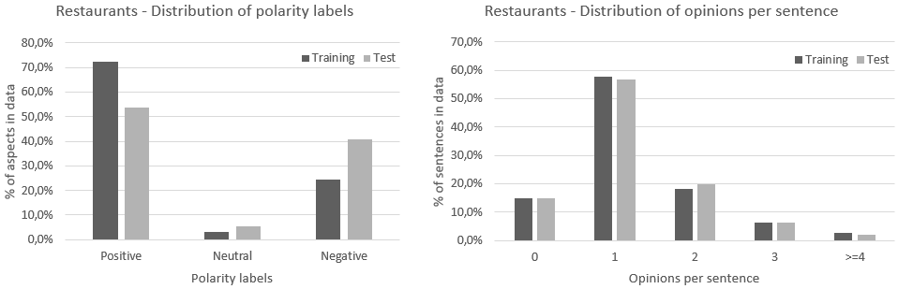
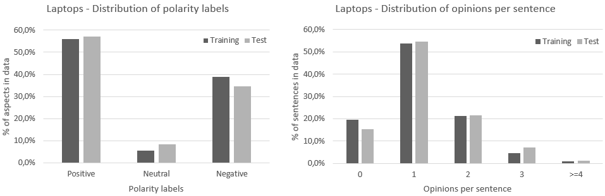
Data

Slide 15
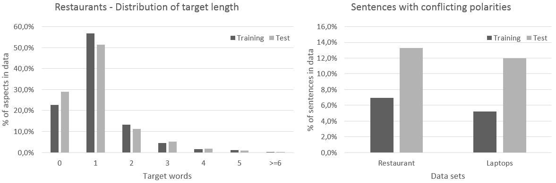
Data

Slide 16
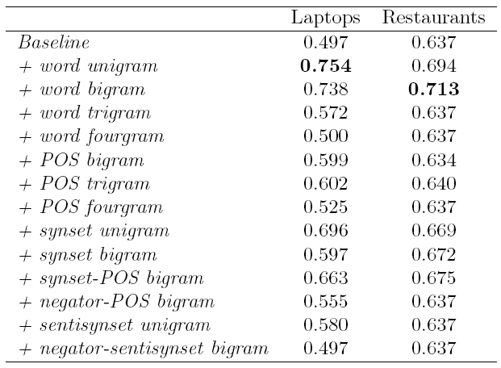
Evaluation
Marginal effect of adding one feature versus majority baseline (positive) using F1:

Slide 17
Feature Selection
Using forward feature selection
Laptop:
word unigram, synset bigram, sentisynset unigram, and synset unigram
Restaurant:
word unigram, synset bigram, sentisynset unigram, POS bigram, and negator-POS bigram
Observation: POS-based bigrams are selected for the restaurant dataset but not for the laptop dataset

Slide 18
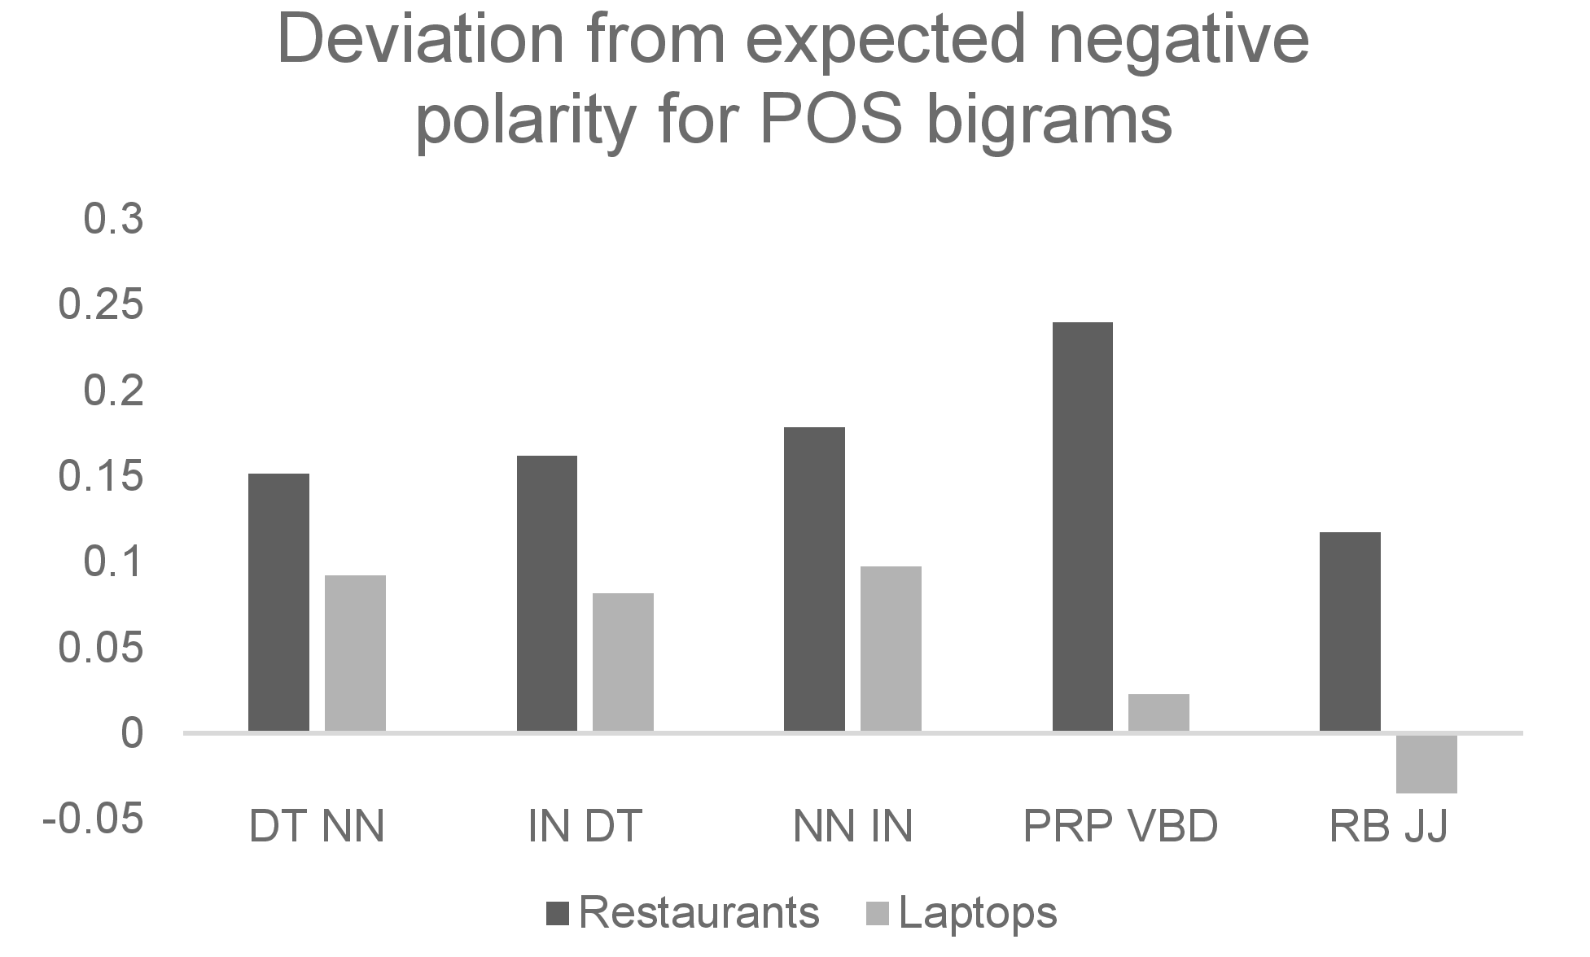
Feature Prevalence
Deviation from the expected negative polarity for POS bigram (if the feature does not discriminate the aspect sentiment, it will appear in the same proportion in a negative context as in the whole dataset)
Legend:
DT = determiner
NN = noun
IN = preposition
PRP = personal pronoun
VBD = verb past tense
RB = adverb
JJ = adjective
Bigram PRP VBD
(e.g., “I thought”) is good indicator for negative sentiment for restaurants

Slide 19
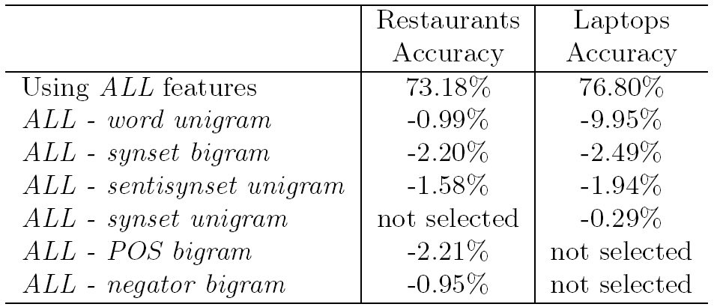
Surface Context and Feature Ablation
Optimal surface context:
8 words to the left of the target and 8 words to the right target
Feature ablation:
Using all features except for the analyzed feature
word unigram important for laptops
synset bigram important for both restaurants and laptops

Slide 20
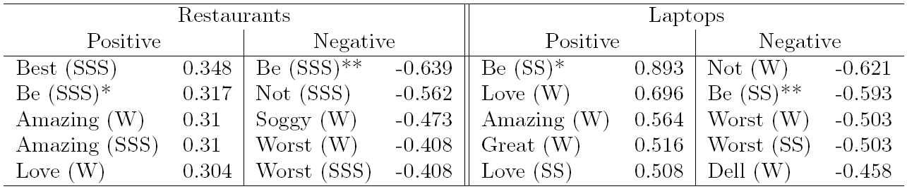
Feature Weight
SVM:
Optimal set of features and optimal hyper-parameters
Only positive/negative classification for interpretation (removed neutral)
Legend:
W = word unigram
SS = synset unigram
SSS = sentisynset unigram
* = present tense
** = past tense
word “soggy” strong
indicator for negative sentiment for restaurants
word “be” associated with positive sentiment in present tense and negative sentiment in past tense
word “Dell” strong
indicator for negative sentiment for laptops

Slide 21
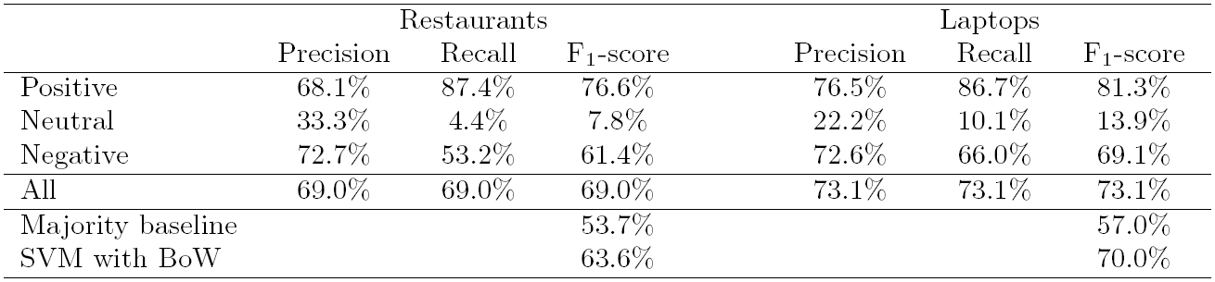
Classification Results
Using the optimal set of features and optimal hyper-parameters
Majority baseline: predict always positive
It is harder to predict the less occurring
sentiment classes (neutral and negative)
Restaurant dataset is harder: relatively more negative sentiment in test than in training, less instances, and more conflictual sentiment per sentence
5.4 percentage points increase compared to the SVM with BoW
3.1 percentage points increase compared to the SVM with BoW

Slide 22
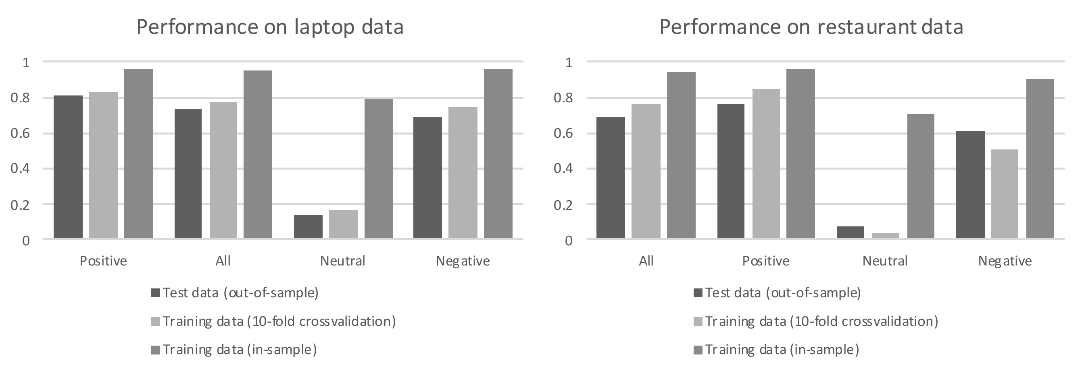
Classification Results
F1 scores:
The restaurant training dataset has relatively more positive sentiment instances than the restaurant test dataset ->
The cross-validation sentiment scores for the restaurant training dataset with positive sentiment are better than the sentiment scores for the restaurant test dataset with positive sentiment
(not true for the laptop dataset)

Slide 23
Failure Analysis – Example 1
“It is not a small, compact laptop, but I won’t
be traveling via air often, so its size and weight
is not a problem for me.”
‘laptop design’ is an implicit feature, annotated as positive but predicted as negative
Observation 1: The current features cannot deal with double negation (negations considered only in bigrams)
Observation 2: Some people might argue that the sentiment is neutral, underlining the subjectivity level involved in sentiment analysis

Slide 24
Failure Analysis – Example 2
“kinda to light and plastic feeling.”
‘laptop design’ is an implicit feature, annotated as negative but predicted as positive
Observation 1: There is one spelling error “to” instead of “too” (undetected by the algorithm)
Observation 2: The spelling error implies a positive sentiment as “light” has a positive sentiment in relation to laptops (while the “too light” is negative)

Slide 25
Failure Analysis – Examples 1 and 2
The sentiment is user-specific:
Example 1: laptop is heavy but the user does not mind (positive sentiment)
Example 2: laptop is light but the user prefers a heavier one (negative sentiment)
Observation: Difficult to predict sentiment even when taking domain knowledge into account

Slide 26
Failure Analysis – Example 3
“The biggie though is the fact that it disconnects from the
internet whenever if feels like it, even when the strength bar
is filled.”
‘laptop connectivity’ is annotated as negative but predicted as positive
Observation: The writing style is very specific here (“whenever it feels like it”), lexico-semantic patterns are unable to capture the negative sentiment

Slide 27
Conclusion
Lexico-semantic patterns help aspect-based sentiment analysis:
Laptop: word unigram, synset bigram, sentisynset unigram, and synset unigram (F1 increases 73.1% from 70.0% with BoW)
Restaurant: word unigram, synset bigram, sentisynset unigram, POS bigram, and negator-POS bigram (F1 increases to 69.0% from 63.6% with BoW)
Future work:
Applying a spell-checker before sentiment analysis
Using concept patterns based on a sentiment domain ontology
Developing hybrid approaches:
Knowledge reasoning (using a sentiment domain ontology)
Machine learning (focus on deep learning solutions)

