Slide 1
Exploiting Emoticons in
Sentiment Analysis
 | Daniella Bal Erasmus University Rotterdam daniella.bal@xs4all.nl | Flavius Frasincar Erasmus University Rotterdam frasincar@ese.eur.nl
Malissa Bal Erasmus University Rotterdam malissa.bal@xs4all.nl | Franciska de Jong Universiteit Twente f.m.g.dejong@utwente.nl | Uzay Kaymak Eindhoven University of Technology u.kaymak@ieee.org
Alexander Hogenboom
Erasmus University Rotterdam
hogenboom@ese.eur.nl

Slide 2
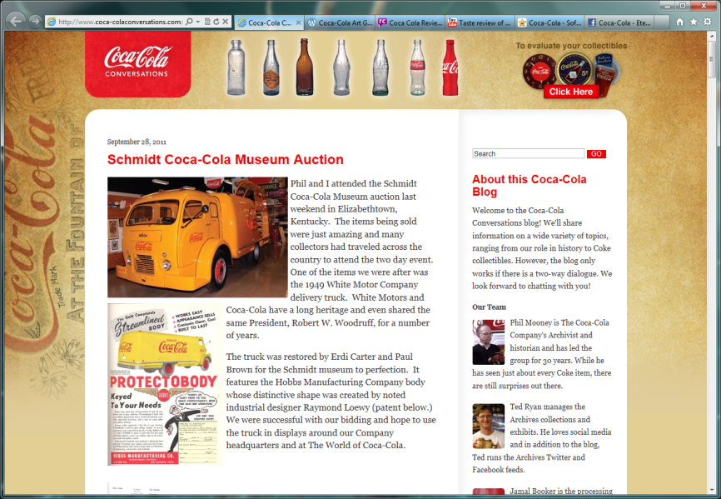

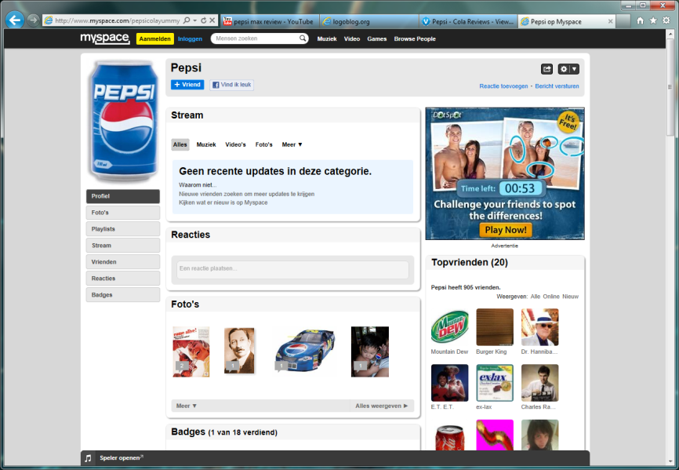

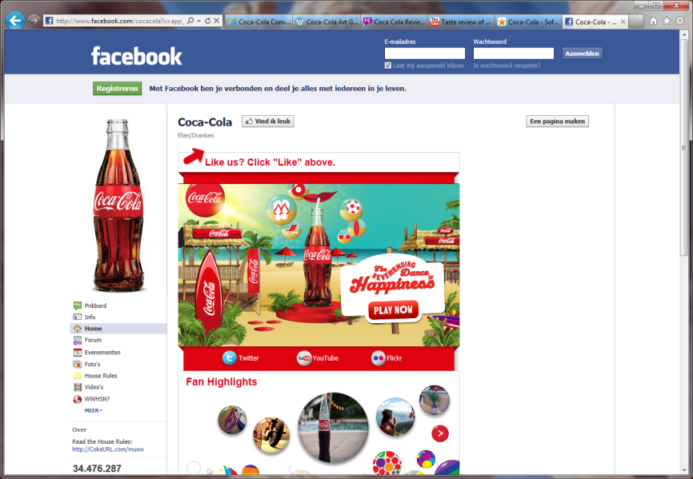
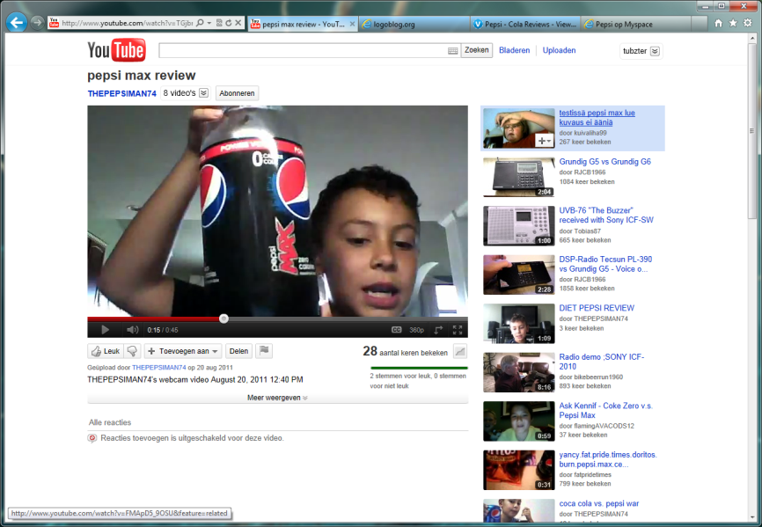
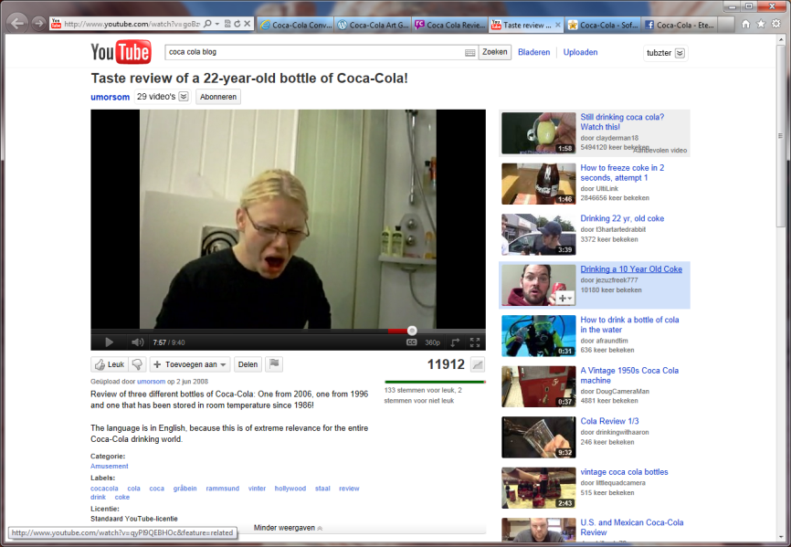
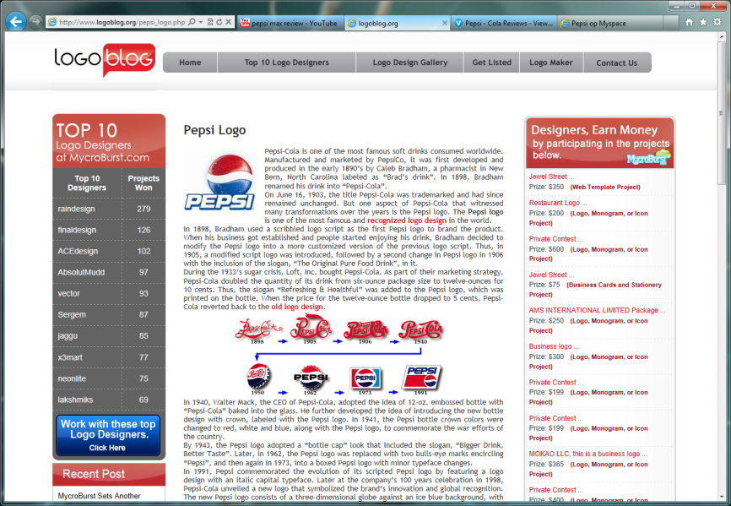
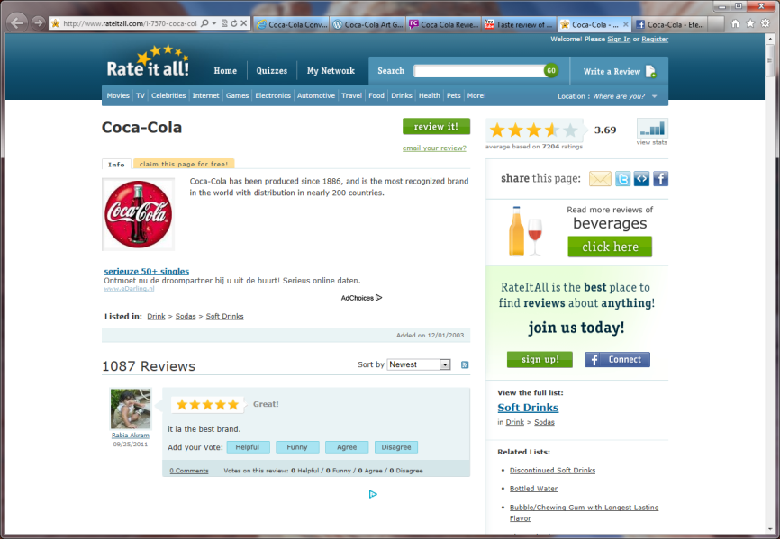

Introduction (1)
Today’s complex systems advocate a need for information monitoring tools for tracking sentiment
The Web offers an overwhelming amount of textual data, containing traces of sentiment

Slide 3
Introduction (2)
Intuitive sentiment analysis methods involve scanning a text for cues signaling its polarity (typically words)
Emoticons could be very useful as well, but most existing approaches throw away the typographical symbols constituting emoticons…
Methods that do use emoticons typically consider an emoticon as one of many cues for sentiment
But how do emoticons in fact convey sentiment and how can we best exploit this in sentiment analysis?
(-_- )
’

Slide 4
Sentiment Analysis
Sentiment analysis is typically focused on determining the polarity of natural language text
Applications exist in summarizing reviews, determining a general mood (consumer confidence, politics)
State-of-the-art approaches classify polarity of natural language text by analyzing vector representations using, e.g., machine learning techniques
Alternative approaches are lexicon-based, which renders them robust across domains and texts and enables linguistic analysis at a deeper level
Lexicons can be enriched with emoticons

Slide 5
Emoticons and Sentiment
Emoticons differ from sentiment-carrying words
The sentiment of emoticons dominates the sentiment carried by verbal cues (if any)
What is affected by emoticons?
  Preceding text (mostly)
  Paragraphs or sentences
How do emoticons affect text?
  Express sentiment: I got a promotion!
  Stress sentiment: That movie was bad
  Disambiguate sentiment: I just love my work
=D
=\
(-_- )
’

Slide 6
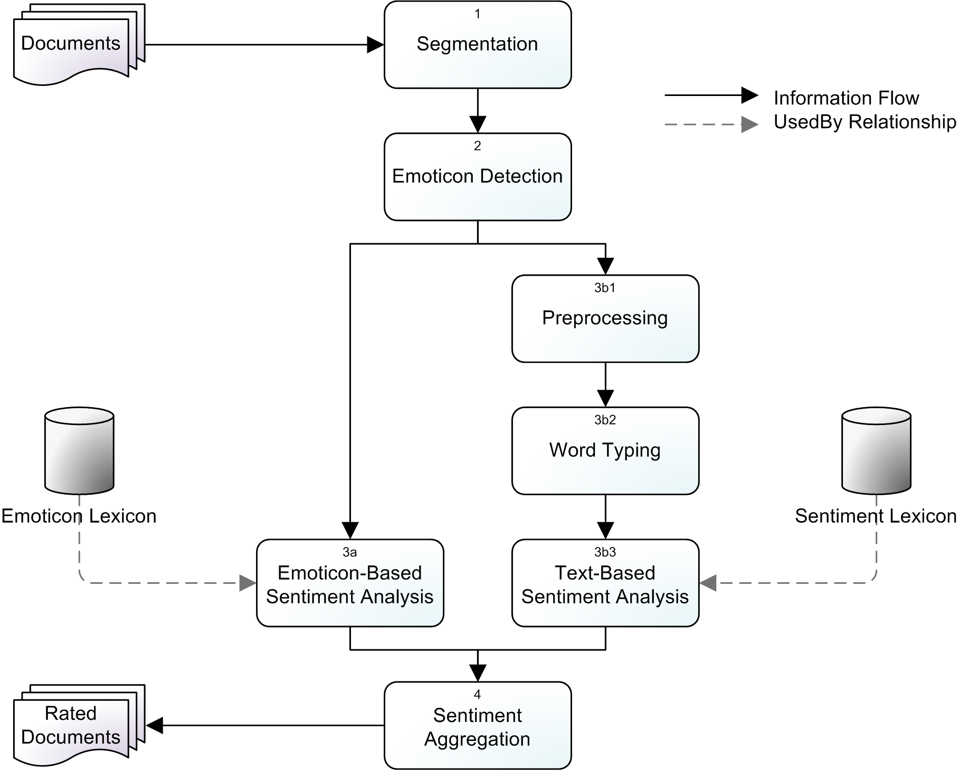
Exploiting Emoticons in Sentiment Analysis

Slide 7
Evaluation (1)
Test collection of 2,080 Dutch tweets and forum posts (1,067 positive and 1,013 negative, as annotated by our three human annotators)
Manually constructed emoticon lexicon consisting of 574 emoticons, rated by our three human annotators as -1.0 (negative), -0.5, 0.0, 0.5, or 1.0 (positive)
Proprietary sentiment lexicon and natural language processing components (Dutch company Teezir)

Slide 8
Evaluation (2)
Our baseline does not account for emoticons
Our considered alternative methods account for emoticons on sentence level and paragraph level
Performance differences have been assessed by means of a paired two-sample one-tailed t-test

Slide 9
Evaluation (3)
Typical causes of classification errors:
  Some text segments may be more important than others in terms of conveying the overall sentiment of a text
  Complex structures of text are not properly dealt with
 | Positive |  |  | Negative |  |  | Overall
Method | P | R | F1 | P | R | F1 | A | F1
Baseline | .21 | .22 | .22 | .23 | .22 | .22 | .22 | .22
Sentence-Level | .65 | .67 | .66 | .59 | .68 | .63 | .59 | .65
Paragraph-Level | .95 | .93 | .94 | .93 | .95 | .94 | .94 | .94

Slide 10
Conclusions
Our main contribution lies in our analysis of the role that emoticons play in conveying sentiment and how we can exploit this in automated sentiment analysis
Emoticons are used to express, stress, or disambiguate one’s intended sentiment and dominate the sentiment conveyed by other textual cues
Accounting for the sentiment implied by emoticons rather than textual cues on a paragraph level appears to be a promising strategy
Whenever emoticons are used, they play a crucial role in conveying an author’s sentiment

Slide 11
Future Work
Further explore the interplay of emoticons and text
Account for structural and semantic aspects of content
Validate our findings in other languages and domains

Slide 12
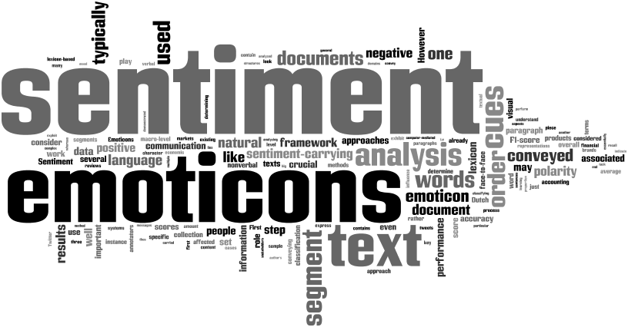
Questions?
  Alexander Hogenboom
  Erasmus School of Economics
  Erasmus University Rotterdam
  P.O. Box 1738, NL-3000 DR
  Rotterdam, the Netherlands
  hogenboom@ese.eur.nl

