Slide 1
Multiple Graphical Convolution Networks Approach for Aspect-Based Sentiment Classification
NLDB 2025
Diana Kazakova
Jasmijn Klinkhamer
4 July 2025
* Joint work with Flavius Frasincar

Slide 2
Content
Motivation
Data
Methodology
Evaluation
Conclusion
Future Work
Further Information
References

Slide 3
Motivation
Approximately 47% of consumers actively write reviews
Increasing user-generated content
Providing businesses to enhance customer satisfaction
To gain insights from textual data ⟶ sentiment analysis
  Sentiment score (positive, neutral, or negative)
  Three levels:
    Document
    Sentence
    Aspect ⟶ Aspect-Based Sentiment Analysis (ABSA) (Schouten & Frasincar, 2016)

Slide 4
Motivation
ABSA has two phases:
  Aspect Detection
  Aspect-Based Sentiment Classification
HAABSA++ enhanced sentiment prediction (Trusca et al., 2020)
Graph Neural Networks (Zhang, Li, & Song, 2019)
  Dual Graph Convolutional Network: syntactic and semantic graphs (Li et al., 2021)
  Bi-level interactive Graph Convolutional Network: lexical and semantic graphs (Zhang & Qian, 2020)
  Ontological graph (Liang, Giu, & Cambria, 2022)
No models that combine more than two graphs

Slide 5
Motivation
Enhance effectiveness of HAABSA++ ⟶ new back-up model
  Graph-based neural model
  Combines four graphs: syntactic, semantic, lexical, and ontological
  4GCN
New hybrid model: HAABSA4GCN

Slide 6
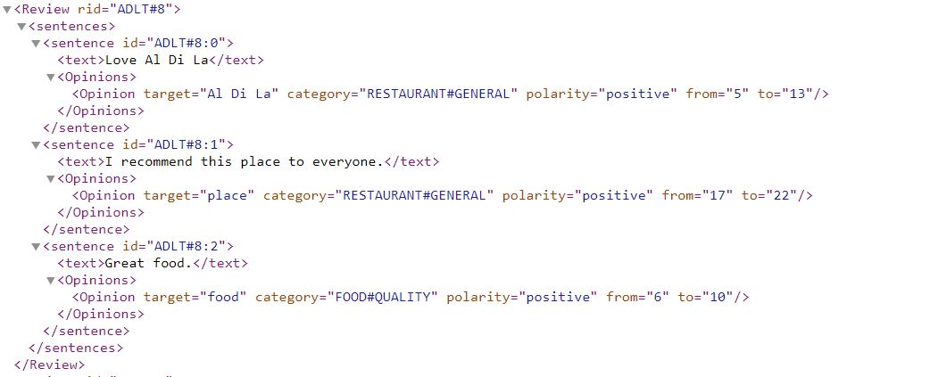
Data
SemEval 2015 and SemEval 2016
Restaurant datasets
Formatted in XML structure

Slide 7
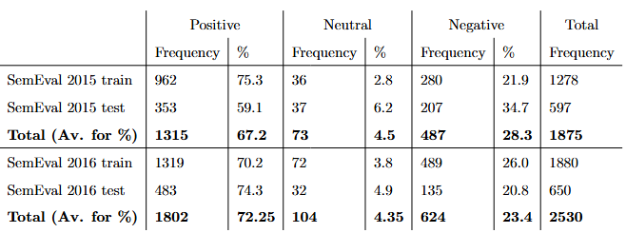
Data
Distribution of sentiment polarities
Class imbalance in training sets
2016 dataset larger than 2015 dataset

Slide 8
Methodology: HAABSA4GCN
HAABSA4GCN ⟶ rule-based method + back-up model
Domain sentiment ontology is taken from HAABSA++ model
LCR-Rot-hop++ neural network is replaced with 4GCN model and includes four parallel modules:
  Syntactic (SynGCN)
  Semantic (SemGCN)
  Lexical (LexGCN)
  Ontological (KnoGCN)
4GCN model is used in following cases:
  Prediction of conflicting sentiment
  No hits due to limited coverage of ontology
  Neutral sentiment

Slide 9
Methodology: 4GCN Architecture
Encoding:
  pre-trained BERT-large is used to generate encodings of the sentences.
4GCN consists of four GCN modules working in parallel:
  SynGCN - utilises the syntactic relations within a sentence (dependency parser)
  SemGCN - based on the semantic relations (self-attention mechanism)
  LexGCN - builds upon the lexical relations (word co-occurrence matrix)
  KnoGCN - constructed using the domain knowledge (ontology from the HAABSA++)
Decoding:
  outputs of each module are concatenated through dense layer using softmax function for the final result

Slide 10
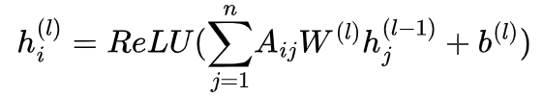
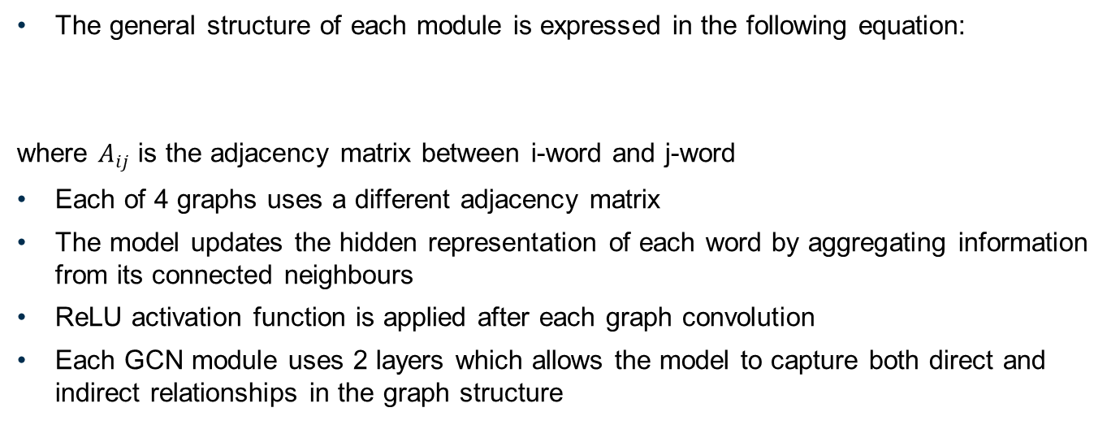
Methodology: Graph Construction
The general structure of each module is expressed in the following equation:
where $A_{ij}$ is the adjacency matrix between i-word and j-word
Each of 4 graphs uses a different adjacency matrix
The model updates the hidden representation of each word by aggregating information from its connected neighbours
ReLU activation function is applied after each graph convolution
Each GCN module uses 2 layers which allows the model to capture both direct and indirect relationships in the graph structure

Slide 11
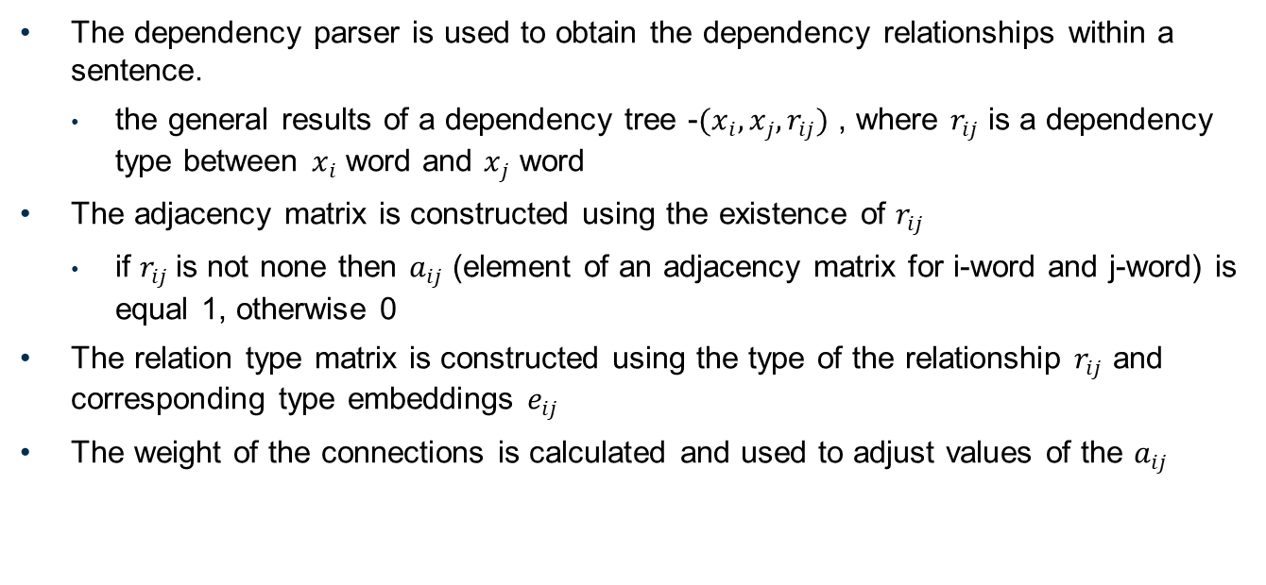
Methodology: SynGCN Graph Construction
The dependency parser is used to obtain the dependency relationships within a sentence.
  the general results of a dependency tree -$(x_{i},x_{j},r_{ij})$ , where $r_{ij}$ is a dependency type between $x_{i}$ word and $x_{j}$ word
The adjacency matrix is constructed using the existence of $r_{ij}$
  if $r_{ij}$is not none then $a_{ij}$ (element of an adjacency matrix for i-word and j-word) is equal 1, otherwise 0
The relation type matrix is constructed using the type of the relationship $r_{ij}$ and corresponding type embeddings $e_{ij}$
The weight of the connections is calculated and used to adjust values of the $a_{ij}$

Slide 12
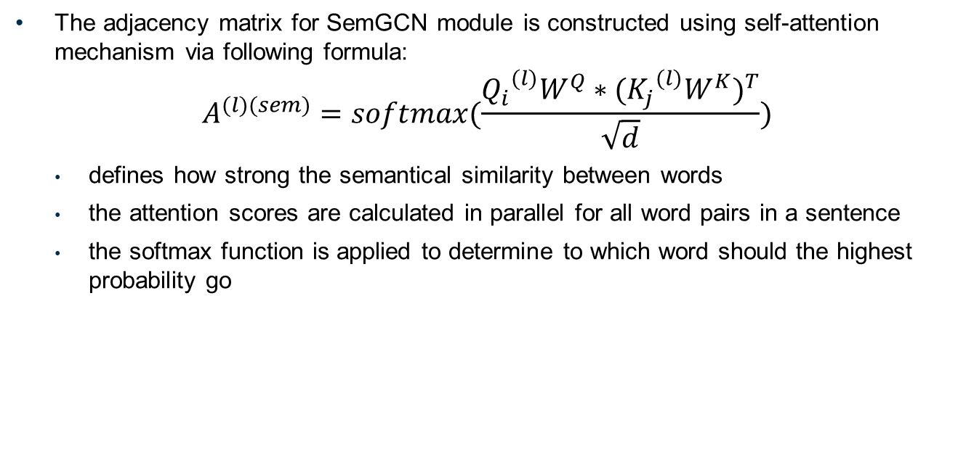
Methodology: SemGCN Graph Construction
The adjacency matrix for SemGCN module is constructed using self-attention mechanism via following formula:
$$A^{(l)(sem)}=softmax(\frac{{Q_{i}}^{(l)}W^{Q}∗{({K_{j}}^{(l)}W^{K})}^{T}}{\sqrt{d}})$$
  defines how strong the semantical similarity between words
  the attention scores are calculated in parallel for all word pairs in a sentence
  the softmax function is applied to determine to which word should the highest probability go

Slide 13
Methodology: LexGCN Graph Construction
LexGCN is constructed using 2 types of co-occurrence matrices:
  The global co-occurrence matrix
    across large corpus (SemEval + WebText)
  The local co-occurrence matrix
    constructed using a sentence-level co-occurrence
Weights from global co-occurrence matrix are reused in the local matrix if both words exist in the corpus
  Otherwise, the local co-occurrence is set to zero

Slide 14
Methodology: KnoGCN Graph Construction
KnoGCN uses a domain-specific ontology to construct a knowledge graph
  Based on structured relationships in the restaurant domain
  Captures expert-defined links between aspect and sentiment terms
A vocabulary of ontology-recognized words is built
  Only words present in this vocabulary are included in the KnoGCN graph
An adjacency matrix is formed using SynGCN approach
  dependency types within a sentence are used to enhance edge information
Each edge is assigned a learned weight
  Based on hidden states of the connected words and type embeddings

Slide 15
Evaluation: Compared models
HAABSA++: Hybrid model using ontology + LCR-Rot-hop++
HAABSA4GCN (ours): Replaces LCR-Rot-hop++ with 4GCN
4GCN (ours): Standalone model using four GCN types
Baselines:
  DualGCN: syntactic + semantic
  BiGCN: syntactic + lexical
  T-GCN: type-aware GCN
  R-GAT: syntactic only
Evaluation performed on SemEval 2015 & 2016 (restaurant domain)
Metric: Classification Accuracy

Slide 16
Evaluation: GCN Model Comparison
Model | SemEval 2015 | SemEval 2016
HAABSA++ (ontology only) | 65.8% | 78.3%
HAABSA++ | 81.7% | 87.0%
HAABSA4GCN (ours) | 83.1% | 87.7%
LCR-Rot-hop++ | 81.1% | 86.7%
4GCN (ours) | 83.4% | 89.1%
Key Points:
HAABSA4GCN improves on HAABSA++ by:
  +1.4 p.p (2015)
  +0.7 p.p (2016)
4GCN outperforms LCR-Rot-hop++ by:
  +2.3 p.p (2015)
  +2.4 p.p (2016)
4GCN shows strong generalization even as a standalone model

Slide 17
Evaluation: GCN Model Comparison
Model | SemEval 2015 | SemEval 2016
4GCN | 83.4% | 89.1%
T-GCN | 83.0% | 90.3%
BiGCN | 81.1% | 88.9%
DualGCN | 81.6% | 86.9%
R-GAT | 81.2% | 85.7%
4GCN performs best on SemEval 2015
Second-best on SemEval 2016 (slightly behind T-GCN)
Confirms benefit of integrating 4 diverse graph types
Key conclusions:
•Hybrid model (HAABSA4GCN) benefits from symbolic reasoning + neural learning
•4GCN is highly competitive even as a standalone model
•Graph diversity (syntax, semantics, lexicon, ontology) is effective
•Ontology improves interpretability, but 4GCN generalizes better

Slide 18
Conclusion
Problem: Improve ABSC by combining structured knowledge with deep learning
Existing solution: HAABSA++ — a hybrid model using a domain ontology and LCR-Rot-hop++
Proposed solution:
  HAABSA4GCN: hybrid model (ontology + 4GCN)
  4GCN: GCN-based model using four graph types (syntactic, semantic, lexical, ontological)
Main findings:
  HAABSA4GCN > HAABSA++ (83.1% > 81.7% (2015), 87.7% > 87.0% (2016))
  4GCN > LCR-Rot-hop++ (83.4% > 81.1% (2015), 89.1% > 86.7% (2016))
  4GCN outperforms DualGCN, R-GAT, BiGCN, and T-GCN on most benchmarks

Slide 19
Future work
Constructing a global co-occurrence matrix from a large corpus of restaurant reviews
Could improve reliability of the LexGCN adjacency matrix
Performing error analysis and failure case inspection
Could reveal patterns where 4GCN underperforms
Cross-domain evaluation (e.g., laptop domain)
A laptop ontology exists, enabling easier transfer

Slide 20
Further information
Dataset and code publicly available at: https://github.com/DianaKazakova/HAABSA4GCN is written in Python
Feel free to try it out and improve our research
Questions about the code should be sent to diana.kazakova432@gmail.com

Slide 21
References
Schouten, K., Frasincar, F.: Survey on aspect-level sentiment analysis. IEEE Transactions on Knowledge and Data Engineering 28(3), 813–830 (2016)
Trusca, M.M., Wassenberg, D., Frasincar, F., Dekker, R.: A hybrid approach for aspect-based sentiment analysis using deep contextual word embeddings and hierarchical attention. In: 20th International Conference Web Engineering (ICWE 2020). LNCS, vol. 12128, pp. 365–380. Springer (2020)
Zhang, C., Li, Q., Song, D.: Aspect-based sentiment classification with aspect-specific graph convolutional networks. In: 2019 Conference on Empirical Methods in Natural Language Processing and the 9th International Joint Conference on Natural Language Processing (EMNLP-IJCNLP 2019). pp. 4567–4577. ACL (2019)

Slide 22
References
Li, R., Chen, H., Feng, F., Ma, Z., Wang, X., Hovy, E.H.: Dual graph convolutional networks for aspect-based sentiment analysis. In: 59th Annual Meeting of the Association for Computational Linguistics and the 11th International Joint Conference on Natural Language Processing (ACL-IJCNLP 2021). pp. 6319–6329. ACL (2021).
Zhang, M., Qian, T.: Convolution over hierarchical syntactic and lexical graphs for aspect level sentiment analysis. In: 2020 Conference on Empirical Methods in Natural Language Processing (EMNLP 2020). pp. 3540–3549. ACL (2020)
Liang, B., Su, H., Gui, L., Cambria, E., Xu, R.: Aspect-based sentiment analysis via affective knowledge enhanced graph convolutional networks. Knowledge-Based Systems 235, 107643 (2022)

Slide 23
Questions?

