Slide 1
Document Knowledge Transfer for Aspect-Based Sentiment Classification Using a Left-Center-Right Separated Neural Network with Rotatory Attention*
Flavius Frasincar
frasincar@ese.eur.nl
*Joint work with Emily Fields, Gonem Lau, Robbert Rog, and Alexander Sternfeld

Slide 2
Contents
Motivation
Related Work
Data
Methodology
Evaluation
Conclusion
Future Work
Further Information
References

Slide 3
Motivation
Growing number of reviews:
In 2020: the number of reviews on Amazon around 250 million
Growing importance of reviews:
80% of the consumers read online reviews
75% of the consumers consider reviews important
Reading all reviews is time consuming, therefore the need for automation

Slide 4
Motivation
Sentiment mining is defined as the automatic assessment of the sentiment expressed in text (in our case by consumers in product reviews)
Several granularities of sentiment mining:
Document-level
Paragraph-level
Sentence-level
Aspect-level (product aspects are sometimes referred to as product features): Aspect-Based Sentiment Analysis (ABSA) firstly surveyed by Schouten and Frasincar (2016):
Document-level
Paragraph-level
Sentence-level [our focus here]

Slide 5
Motivation
ABSA has two stages:
Aspect Detection (AD): finding aspects in product reviews recently surveyed by Trusca and Frasincar (2023)
Explicit aspect detection: aspects appear literally in product reviews [our focus here]
Implicit aspect detection: aspects do not appear literally in the product reviews
Aspect-Based Sentiment Classification (ABSC): assigning the sentiment associated to explicit or implicit aspects recently surveyed by Brauwers and Frasincar (2023) [our focus here]
Three approaches for ABSA:
Knowledge Representation (KR)
Machine Learning (ML)
Hybrid: current state-of-the-art, e.g., A Hybrid Approach for Aspect-Based Sentiment Analysis++ (HAABSA++) proposed by Trusca, Wassenberg, Frasincar, and Dekker (2020)

Slide 6
Motivation
HAABSA++ is a two-step approach for ABSA at sentence-level:
Ontology-based reasoning
Deep learning (backup solution): LCR-Rot-hop++
There is a lot of annotated data for document sentiment but little for aspect sentiment
Research question: How to make use of document-level sentiment data for improving ABSC at sentence-level?
Solution: Transfer Learning (TL):
Inject document sentiment knowledge into the neural model that performs ABSC at sentence-level

Slide 7
Motivation
Document knowledge transfer can be motivated from three perspectives:
Human learning: we use knowledge from related tasks when learning new tasks
Pedagogy: we learn the foundations first before using this knowledge to learn more complex skills
Machine learning: improves generalization by introducing inductive bias (preference for hypotheses that explain more than one task)
Two tasks:
Main (target) task: ABSC
Auxiliary (related) task: Document Sentiment Classification (DSC)

Slide 8
Related Work
TL for ABSC proposed by He et al. (2018):
Simple attention-based model for ABSC
Considers three types of TL:
PRETraining (PRET)
MULTi-task Learning (MULT)
PRET+MULT
Our approach:
Complex model for ABSC: LCR-Rot-hop++
Considers three types of TL and their combinations:
PRET
MULT
Fine-Tuning (FT)
Additionally extends the LCR-Rot-hop++ with L1+L2 regularization

Slide 9
Data
ABSC:
SemEval 2015, Task 12, Subtask 1, Slot 3 for restaurants reviews
SemEval 2016, Task 5, Subtask 1, Slot 3 for restaurant reviews
3-point sentiment scale: positive, neutral, and negative
DSC:
Yelp 2014 for restaurant reviews
Converted the 5-point sentiment scale to a 3-point scale:
> 3 becomes positive
= 3 becomes neutral
< 3 becomes negative
Well-balanced sample of 30,000 documents, same as in (He et al., 2018) used for PRET (large dataset)

Slide 10
Data
ABSC Example:
As there are many more documents than aspects we upsample ABSC data with a factor of three
MULT-based approaches: each aspect-level data point is paired with a random document from our sample (small dataset)

Slide 11
Data
SemEval Descriptive Statistics:
Neutral is the minority class
Positive is the majority class (except SemEval 2015 test data)
Dataset | Positive |  | Neutral |  | Negative |  | Total
 | Freq. | % | Freq. | % | Freq. | % | Freq.
SemEval 2015 training data | 963 | 75.3 | 36 | 2.8 | 280 | 21.9 | 1279
SemEval 2015 test data | 354 | 34.7 | 38 | 6.3 | 208 | 59.0 | 600
SemEval 2016 training data | 1321 | 70.1 | 73 | 3.9 | 490 | 26.0 | 1884
SemEval 2016 test data | 487 | 74.4 | 32 | 4.9 | 136 | 20.8 | 655

Slide 12
Methodology
ABSC: LCR-Rot-hop++
LCR-Rot-hop++:
BERT word embeddings
Three Bi-LSTMs (left context, aspect target, right context)
Two iterative steps using bilinear attention:
Target2Context: uses the target representation (initially pooled) to obtain target-dependent left/right context representations (two vectors)
Context2Target: uses the left/right context representations to obtain left/right context-dependent target representations (two vectors)
Hierarchical attention (part of the previous two iterative steps):
After Target2Context: apply attention to the obtained two vectors
After Context2Target: apply attention to the obtained two vectors
Repeat the two iterative steps a number of hops (e.g., 3)

Slide 13
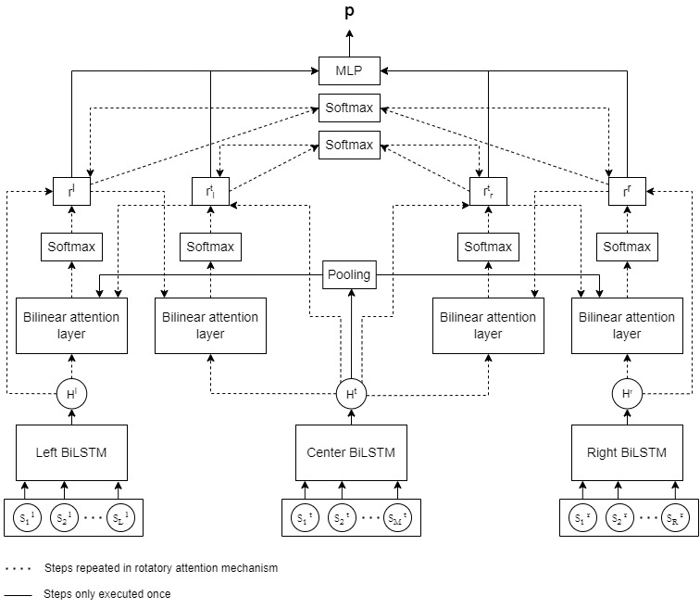
Methodology

Slide 14
Methodology
TL:
PRET: pre-train the three Bi-LSTMs (take the average of the final hidden layers to feed a classification layer) for DSC
MULT: simultaneously train the three Bi-LSTMs for DSC and ABSC (based on LCR-Rot-hop++) using the loss function:
$$L=J+λU+ω{\left\|Θ\right\|}_{1}+Ω{\left\|Θ\right\|}_{2}^{2}$$
where:
$J$ is the loss function for ABSC
$U$ is the loss function for DSC
$λ∈[0,1]$ is the importance of DSC
$Θ$ are the parameters of the model
$ω$ and $Ω$ are the weights of the L1 and L2 regularization, respectively
FT: train ABSC (based on LCR-Rot-hop++)

Slide 15
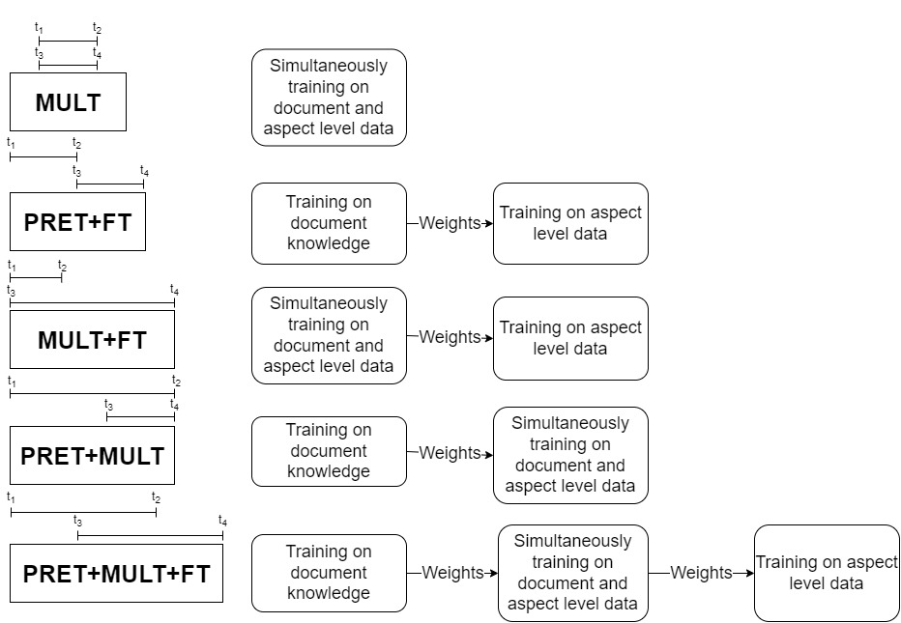
Methodology

Slide 16
Evaluation
Training data split:
80% pure training
20% validation (for hyperparameter tunning)
Hyperparameter tunning:
Using Hyperband
Two configurations:
FT-based models: use hyperparameters of FT
MULT-based models: use hyperparameters of MULT
Some combinations are eliminated as they are considered suboptimal:
FT-based: MULT and PRET+MULT
MULT-based: PRET+FT

Slide 17
Evaluation
Settings | Accuracy
 | SemEval 2015 | SemEval 2016
Benchmark model
LCR-Rot-hop++ | 74.00% | 86.87%
FT-based models
MULT+FT | 77.00% | 85.95%
PRET+FT | 78.00% | 88.70%
PRET+MULT+FT | 79.67% | 86.56%
MULT-based models
MULT | 80.50% | 88.63%
MULT+FT | 74.50% | 87.18%
PRET+MULT | 76.67% | 85.04%
PRET+MULT+FT | 77.67% | 86.87%

Slide 18
Evaluation
Settings | Accuracy
 | SemEval 2015 | SemEval 2016
Benchmark model
LCR-Rot-hop++ | 74.00% | 86.87%
FT-based models
MULT+FT | 77.00% | 85.95%
PRET+FT | 78.00% | 88.70%
PRET+MULT+FT | 79.67% | 86.56%
MULT-based models
MULT | 80.50% | 88.63%
MULT+FT | 74.50% | 87.18%
PRET+MULT | 76.67% | 85.04%
PRET+MULT+FT | 77.67% | 86.87%
SemEval 2016 best model: PRET+FT
SemEval 2015 best model: MULT

Slide 19
Evaluation
Settings | Accuracy
 | SemEval 2015 | SemEval 2016
Benchmark model
LCR-Rot-hop++ | 74.00% | 86.87%
FT-based models
MULT+FT | 77.00% | 85.95%
PRET+FT | 78.00% | 88.70%
PRET+MULT+FT | 79.67% | 86.56%
MULT-based models
MULT | 80.50% | 88.63%
MULT+FT | 74.50% | 87.18%
PRET+MULT | 76.67% | 85.04%
PRET+MULT+FT | 77.67% | 86.87%
For SemEval 2015 all TL models outperform the benchmark

Slide 20
Evaluation
Settings | Accuracy
 | SemEval 2015 | SemEval 2016
Benchmark model
LCR-Rot-hop++ | 74.00% | 86.87%
FT-based models
MULT+FT | 77.00% | 85.95%
PRET+FT | 78.00% | 88.70%
PRET+MULT+FT | 79.67% | 86.56%
MULT-based models
MULT | 80.50% | 88.63%
MULT+FT | 74.50% | 87.18%
PRET+MULT | 76.67% | 85.04%
PRET+MULT+FT | 77.67% | 86.87%
For SemEval 2016 only some TL models outperform the benchmark

Slide 21
Evaluation
Settings | Accuracy
 | SemEval 2015 | SemEval 2016
Benchmark model
LCR-Rot-hop++ | 74.00% | 86.87%
FT-based models
MULT+FT | 77.00% | 85.95%
PRET+FT | 78.00% | 88.70%
PRET+MULT+FT | 79.67% | 86.56%
MULT-based models
MULT | 80.50% | 88.63%
MULT+FT | 74.50% | 87.18%
PRET+MULT | 76.67% | 85.04%
PRET+MULT+FT | 77.67% | 86.87%
Best overall model is MULT, which improves the benchmark model by: 6.5 percentage points on SemEval 2015 and by 1.76 percentage points on SemEval 2016

Slide 22
Evaluation
MULT outperforms PRET probably due to catastrophic forgetting:
Knowledge learned in the PRET stage (DSC) might be forgotten when the model is trained on the main task (ABSC)
For MULT the auxiliary and main tasks are learned simultaneously helping the model remember document knowledge
In comparison with HAABSA++:
MULT outperforms HAABSA++ by 1.63 percentage on the SemEval 2016 dataset
MULT performs slightly worse than HAABSA++ by 1.2 percentage points on the SemEval 2015 dataset (for small and probably easier datasets the ontology reasoner performs very good)

Slide 23
Conclusion
Problem: limited availability of data for ABSC
Solution: as there is a lot of data for DSC use TL to inject document knowledge in a neural model for ABSC
Methods:
ABSC: HAABSA++ (LCR-Rot-hop++)
TL: PRET, MULT, and FT (and their combinations)
Best TL method: MULT (does not suffer from catastrophic forgetting)
Better than LCR-Rot-hop++ for both SemEval 2015 and SemEval 2016 (better results for SemEval 2015, small dataset)
Better than HAABSA++ only for SemEval 2016 (computationally cheaper alternative to a hybrid model on a large dataset)

Slide 24
Future Work
Experiment with other types of reviews:
Laptops
Hotels
Books
Consumer Electronics
Different architecture to incorporate domain knowledge transfer:
Share one Bi-LSTM module between the two tasks (instead of the current three Bi-LSTM modules)
Investigate not just document knowledge injection but also paragraph or sentence knowledge injection

Slide 25
Further Information
Dataset and code publicly available at: https://github.com/Gogonemnem/LCR-Rot-hop-plus-plus-TL
Code is written in Python
Feel free to try it out and improve our research
Questions about the code should be sent to Gonem Lau (gonemlau@gmail.com)

Slide 26
References
ABSA:
Kim Schouten and Flavius Frasincar: Survey on Aspect-Level Sentiment Analysis. IEEE Transactions on Knowledge and Data Engineering 28(3):813-830 (2016)
AD:
Maria Mihaela Trusca and Flavius Frasincar: Survey on Aspect Detection for Aspect-Based Sentiment Analysis. Artificial Intelligence Review 56(5):3797-3846 (2023)
ABSC:
Gianni Brauwers and Flavius Frasincar: A Survey on Aspect-Based Sentiment Classification. ACM Computing Surveys 55(4):65:1-65:37 (2023)

Slide 27
References
HAABSA++:
Maria Mihaela Trusca, Daan Wassenberg, Flavius Frasincar, and Rommert Dekker: A Hybrid Approach for Aspect-Based Sentiment Analysis Using Deep Contextual Word Embeddings and Hierarchical Attention. 20th International Conference on Web Engineering (ICWE 2020). LNCS, Volume 12128, Springer, 365-380 (2020)
TL for ABSC:
Ruidan He, Wee Sun Lee, Hwee Tou Ng, and Daniel Dahlmeier: Exploiting Document Knowledge for Aspect-level Sentiment Classification. 56th Annual Meeting of the Association for Computational Linguistics (ACL 2018), ACL, 579-585 (2018)

Slide 28
Examples

