Slide 1
Explaining a Deep Learning Model for Aspect-Based Sentiment Classification Using Post-hoc Local Classifiers
Vlad Miron
vlad.ioan.miron@gmail.com
Flavius Frasincar
frasincar@ese.eur.nl
Maria Mihaela Trușcă
maria.trusca@csie.ase.ro

Slide 2
Contents
Motivation
Aspect-Based Sentiment Analysis (ABSA)
HAABSA++ and LCR-Rot-hop++
Local Interpretable Model-agnostic Explanations (LIME)
Similarity-based Sampling method with balanced sentiments (SSb)
Issues and solutions
Related work
Data
Methodology
Evaluation
Conclusion
Future Work

Slide 3
Motivation
Ever increasing number of reviews and opinionated comments posted online – Yelp receives 26830 new reviews per minute
Reviews can be useful to brands wanting to improve an existing product or service and to consumers trying to make a purchase decision
Online reviews are becoming increasingly important: in 2021 81% of consumers said they read online reviews compared to 63% of consumers saying the same in 2020

Slide 4
Motivation
Useful to systematically gauge the sentiment of a large corpus of reviews
Explain the sentiment prediction given by the model by a set of influential words which lead to the classification

Slide 5
Aspect-Based Sentiment Analysis (ABSA)
ABSA comprises two steps:
Aspect Detection (AD): determines aspects
Aspect-Based Sentiment Classification (ABSC): determines the sentiment related to the aspects
The main downfall of deep learning models for ABSC: black box nature
Explore state-of-the-art deep learning model used for ABSC using 1 interpretability technique and 2 sampling methods for a restaurant reviews dataset

Slide 6
HAABSA++ and LCR-Rot-hop++
HAABSA++ uses (i) an ontology model which is (ii) backed up by a deep learning algorithm (LCR-Rot-hop++) for cases where the ontology is not able to gauge the sentiment of the sentence
Left-Centre-Right Separated Neural Network with Rotary attention repeated for a given number of iterations with a hierarchical attention layer and BERT embeddings, LCR-Rot-hop++ represents the basis for our research

Slide 7
Local Interpretable Model-agnostic Explanations (LIME)
Local interpretability algorithm
Creates neighbourhood of instances around the sentence it aims to explain and uses said neighbours to train
Calculates importance coefficients for the words in the review to highlight the features which were most important for the sentiment predicted
Improve class balance in the training set of the interpretability algorithm (LIME) to improve its performance

Slide 8
Similarity-based Sampling method with balanced sentiments (SSb)
LIME uses a local neighbourhood around the instance it aims to explain
Similarity-based Sampling (SS) is a sampling method which creates sentences similar to the original sentences, where possibly 1 or more words out of the original sentence are swapped with similar words
SSb is an extension of SS, where the neighbours created by SS are fed to LCR-Rot-hop++ and then selected such that the final set of local instances is more balanced in terms of sentiment predictions (closer to roughly 33.3% of negative, neutral, and positive sentiment sentences)

Slide 9
Issues and solutions
Downside of LCR-Rot-hop++ -> Black box in nature
Solution -> use an interpretability algorithm, LIME
Downside of LIME -> Prone to bias for the majority class
Solution -> use similarity based sampling method with a balanced set of neighbours (SSb) to create the neighbours used by LIME

Slide 10
Related work
ABSC:
[1] took an ontology approach to ABSC
[2] introduced LCR-Rot, a deep learning model for ABSC
[3] introduced HAABSA, using LCR-Rot-hop to account for the shortcomings of the ontology approach
[4] introduced HAABSA++, using an improved deep learning model, LCR-Rot-hop++ (which also implements context-dependent BERT embeddings)
Interpretability algorithms:
[5] introduces LACE (ad-hoc method to generate classifiers)
[6] introduces Anchor (slow convergence)
[7] proposes SHAP (does not use neighbourhood sampling method)

Slide 11
Data
SemEval 2016 Task 5 Subtask 1 Slot 3 dataset
Target words ambiance, service, and meal correspond to the aspects AMBIENCE#GENERAL, SERVICE#GENERAL, and FOOD#QUALITY, all of which have a positive polarity

Slide 12
Data
Neutral is the minority class, positive is the majority class
The remaining test data could not be classified by the ontology approach
Neutral and negative classes increase in representation in the remaining test data
Dataset | Negative |  | Neutral |  | Positive |  | Total
 | Freq. | % | Freq. | % | Freq. | % | Freq.
Train data | 489 | 26 | 72 | 3.8 | 1319 | 70.2 | 1880
Test data | 135 | 20.8 | 32 | 4.9 | 483 | 74.3 | 650
Remaining test data | 82 | 33 | 22 | 8.9 | 144 | 58.1 | 248
Used test data | 8 | 32 | 2 | 8 | 15 | 60 | 25

Slide 13
Methodology
Deep learning model for ABSC: LCR-Rot-hop++
3 Bidirectional Long Short-Term Memory (Bi-LSTM) models
Context-dependent BERT embeddings
The system consists of four parts: the left and right contexts, which are used to create the left and right target representation
The following steps are repeated for a given number of iterations (or hops, usually 3):
The rotary attention mechanism changes the representation of the different sentence parts
The hierarchical attention mechanism takes sentence parts as input and weights them
After the final rotation, the final representations of the four parts are used as input for the Multi-Layer Perceptron, which uses a softmax function to output aspect-level sentiment predictions

Slide 14
Methodology
Mechanism employed by LIME:

Slide 15
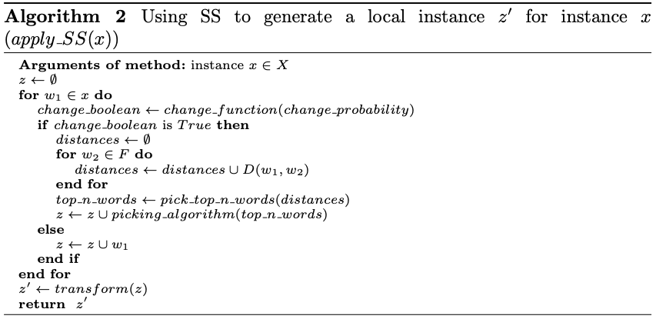
Methodology
Sampling method 1: SS

Slide 16
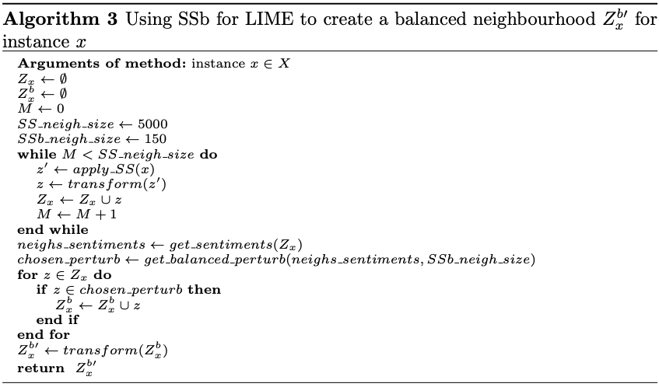
Methodology
Sampling method 2: SSb

Slide 17
Methodology
Interpretability algorithm: LIME
Multinominal logistic regression used for ternary classification
Train 3 binary classifications models:
Draw interpretability from $β_{j}^{(k)}$,which is the marginal effect of feature $j$ on the binary sentiment classification of instance $x$

Slide 18
Evaluation
Sampling methods:
The proportion of negative and positive labelled sentences gets marginally decreased while the neutral category is increased almost 20 times in frequency
Entropy increased from 0.95 to 1.2 showing improvement in label balance
SI Combination | Negative |  | Neutral |  | Positive |  | Entropy
 | Freq. | % | Freq. | % | Freq. | % | Value
SS for LIME | 42737 | 34.2 | 410 | 0.3 | 81853 | 65.5 | 0.95
SSb for LIME | 1219 | 32.5 | 221 | 5.9 | 2310 | 61.6 | 1.2

Slide 19
Evaluation
Interpretability algorithm:
SSb performs better than SS
We may encounter hit rate of 100% due to reduced sample size
SI Combination | Hit Rate | Fidelity | Harmonic Mean
 | % | % | %
LIME with SS | 100 | 90.1 | 94.8
LIME with SSb | 100 | 91.1 | 95.4

Slide 20
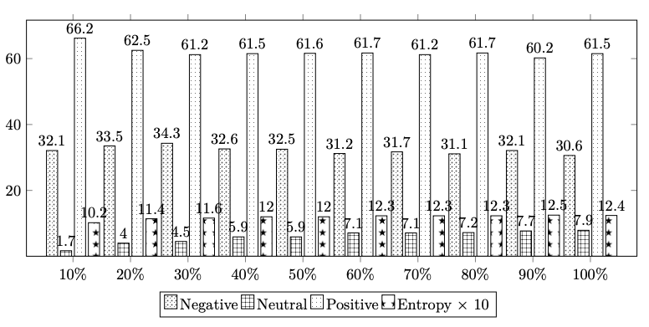
Evaluation
Sensitivity analysis:
SSb improves both class balance and performance of LIME
Tune hyperparameter $change_probability$ to further improve SSb
Peak entropy reached for change probability of 90% showing that altering the original sentence increasingly leads to a more diverse set of labels
Notice decrease of the entropy when hyperparameter is set at 100%, suggesting that high values make its impact unpredictable

Slide 21
Evaluation
Performance of LIME with SSb increases with higher values of the hyperparameter, up to values of 70%
Trade-off between hit rate and fidelity appears as a higher probability of changing a word implies a more diverse set of neighbours. Thus, sentences in the set of neighbours start to differ more from the original sentence and LIME gets less trained to correctly classify $x$ but more comfortable with a wide range of similar sentences to $x$

Slide 22
Evaluation
The benefit of increasing $change_probability$ disappears after a value of 80% as the perturbed sentences, although more diverse in terms of sentiments, start to make less grammatical or contextual sense
Example: for a $change_probability$ of 100%, the sentence “the owner is belligerent to guests that have a complaint” (“owner” is the target) turned in one of the perturbations into “an owner was belligerent about drink which use the disappointment”. For a $change_probability$ of 50%, one perturbation looks like “this owner is belligerent to people that make a request” -> high $change_probability$ values may lead to reviews unrepresentative of real comments left by customers, reducing performance of LIME
A $change_probability$ of 70% seems to be optimal as it reaches the best value for the harmonic mean, while dratically improving sentment balance compared to SS

Slide 23
Conclusion
Problem: bias in interpretability algorithm used for explaining ABSC model
Solution: feed interpretability algorithm with a more balanced set of neighbours in terms of sentiments
Methods:
ABSC: HAABSA++ (LCR-Rot-hop++)
Interpretability algorithm: LIME
Sampling methods: SS and SSb
Best configuration: LIME with SSb and a $change_probability$ of 70%
SSb better than SS both in terms of sentiment balance of neighbours and performance with LIME
$change_probability$ of 70% achives overall best performance with LIME and third best class balance

Slide 24
Future work
Further improve the method of balancing sentiment proportions of perturbations
Use both BERT embeddings and sentiment-aware BERT embeddings to replace words in the original sentence with good contextual fits that differ in terms of sentiment portrayed

Slide 25
References
[1] ABSA:
Kim Schouten and Flavius Frasincar: Survey on Aspect-Level Sentiment Analysis. IEEE Transactions on Knowledge and Data Engineering 28(3): 813-830 (2016)
[2] LCR-Rot:
Zheng, S., Xia, R.: Left-center-right separated neural network for aspect-based sentiment analysis with rotatory attention. arXiv preprint arXiv:1802.00892 (2018)
[3] HAABSA:
Wallaart, O., Frasincar, F.: A hybrid approach for aspect-based sentiment analysis using a lexicalized domain ontology and attentional neural models. In: 16th Ex- tended Semantic Web Conference (ESWC 2019). LNCS, vol. 11503, pp. 363–378. Springer (2019)
[4] HAABSA++:
Maria Mihaela Trusca, Daan Wassenberg, Flavius Frasincar, and Rommert Dekker: A Hybrid Approach for Aspect-Based Sentiment Analysis Using Deep Contextual Word Embeddings and Hierarchical Attention. 20th International Conference on Web Engineering (ICWE 2020). LNCS, Volume 12128, Springer, 365-380 (2020)

Slide 26
References
[5] LACE:
Pastor, E., Baralis, E.: Explaining black box models by means of local rules. In: 34th ACM/SIGAPP Symposium on Applied Computing (SAC 2019). pp. 510–517. ACM (2019)
[6] Anchor:
Ribeiro, M.T., Singh, S., Guestrin, C.: Anchors: High-precision model-agnostic explanations. In: Thirty-Second AAAI Conference on Artificial Intelligence (AAAI 2018). vol. 32, pp. 1527–1535. AAAI Press (2018)
[7] SHAP:
Lundberg, S.M., Lee, S.I.: A unified approach to interpreting model predictions. In 31st Annual Conference on Neural Information Processing Systems (NIPS 2017) 30, 4765–4774 (2017)

