Slide 1
An Information Gain-Driven Feature Study for Aspect-Based Sentiment Analysis
Kim Schouten, Flavius Frasincar, and Rommert Dekker
Erasmus University Rotterdam, the Netherlands

Slide 2
Many opinions…
Nowadays the Web is filled with opinion and sentiment
People freely share their thoughts on basically everything
Useful, but lot of noise
Need automatic methods to sift through this much data
Our scope is consumer reviews

Slide 3
Sentiment Analysis
Sentiment Analysis -> extract sentiment from text
Sentiment can be defined as polarity (positive/negative)
Or as something more complex (numeric scale or set of emotions)
Useful for consumers to know what other people think
Useful for producers to gauge public opinion w.r.t. their product

Slide 4
Aspect-Based Sentiment Analysis
Sentiment Analysis has a scope, for instance a document
More interesting however is the aspect level
An aspect is a characteristic or feature of a product or service being reviewed
This can range from general things like price and size of a product, to very specific aspects like wine selection for restaurants or battery life for laptops

Slide 5
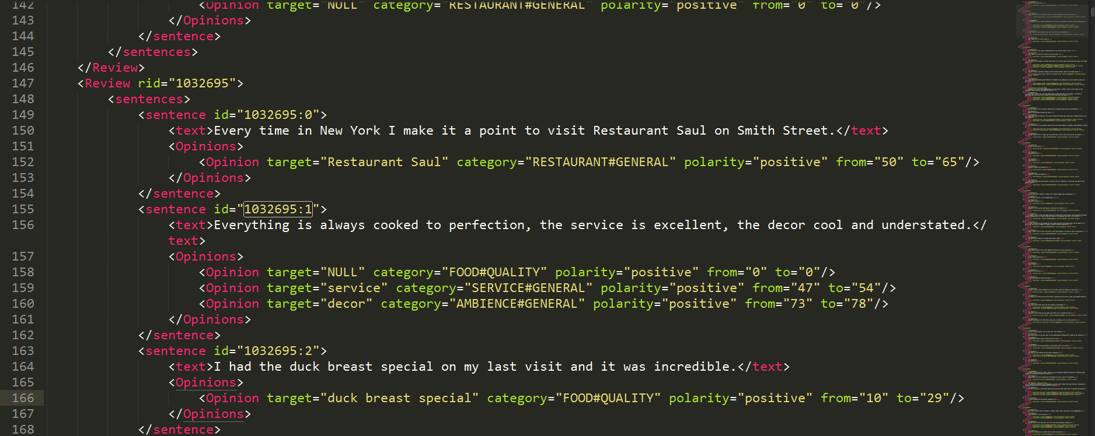
Data snippet

Slide 6
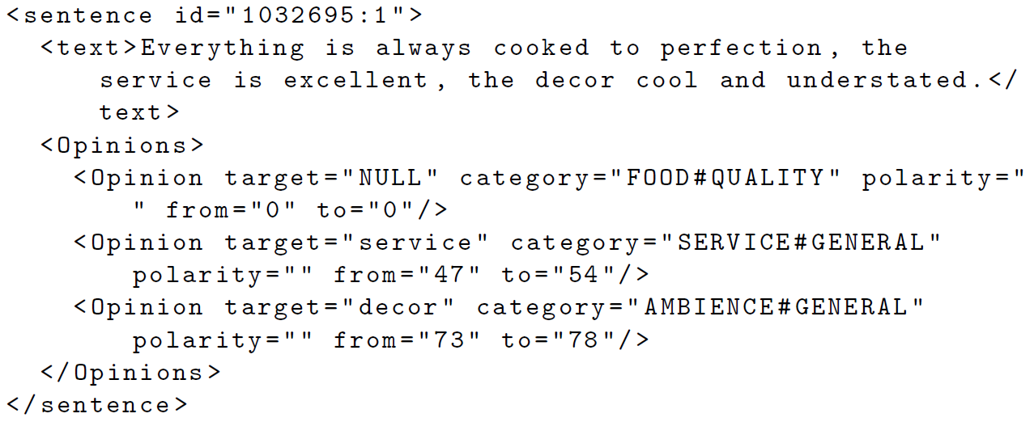
Data snippet

Slide 7
Currently…
Mostly supervised machine learning algorithms
Focus on performance
Feature overload
But which features are actually useful?

Slide 8
Setup
NLP Pipeline to extract linguistic features
Compute Information Gain (IG) for each feature
Order features by descending IG
Run a linear SVM to classify sentiment for each aspect
Incrementally add features from ordered list and record performance
All of this with ten-fold cross-validation
  7 folds for training the SVM
  2 folds for determining parameters (aspect context, and the SVM C param)
  1 fold for testing

Slide 9
NLP Pipeline
JLanguageTool
Stanford CoreNLP
Lesk implementation

Slide 10
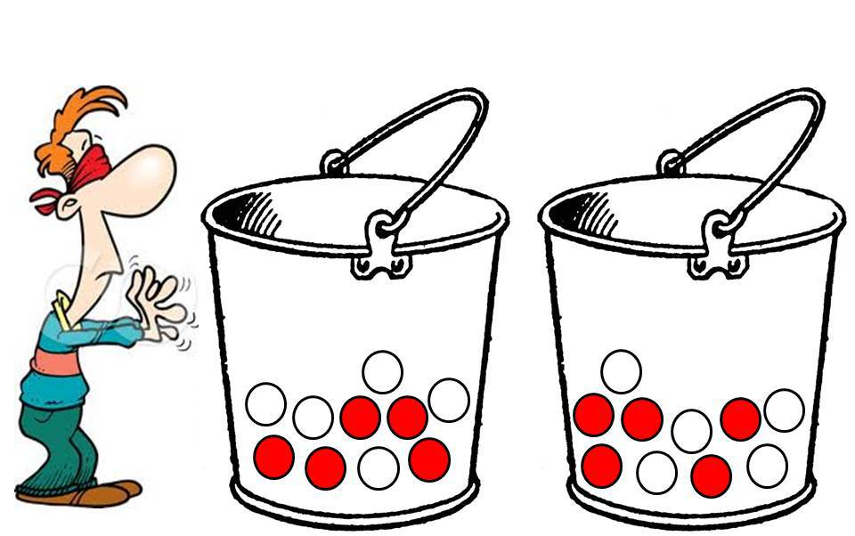
Information Gain
Each binary feature splits the data in two
How much easier is it to choose the correct class given this split?

Slide 11
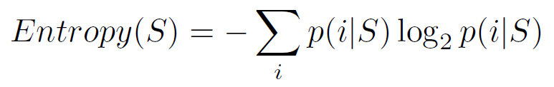
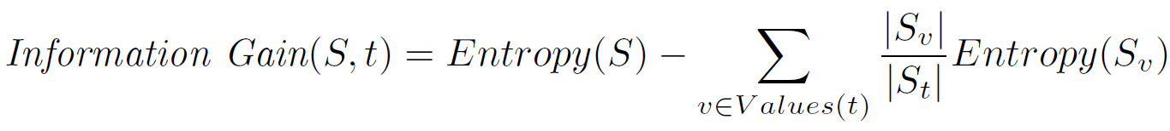
Information Gain
Compute entropy, or impurity, of data
Then Information Gain is the decrease in entropy after split

Slide 12
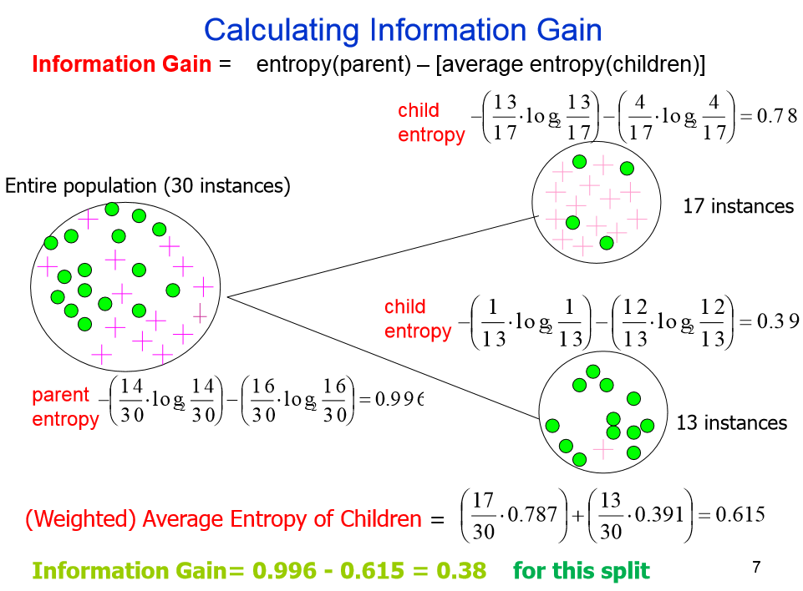
homes.cs.washington.edu/~shapiro/EE596/notes/InfoGain.pdf

Slide 13
Features
Word-based features
  Lemma
  Negation present
Synset-based features
  Synset “ok#JJ#1”
  Related-synsets “Similar To big#JJ#1”
Grammar-based features
  Lemma-grammar “keep-nsubj-we”
  POS-grammar “VB-nsubj-PRP”
  Synset-grammar “ok#JJ#1-cop-be#VB#1”
  Polarity-grammar “neutral-nsubj-neutral”
Aspect feature
  Category (of aspect) “FOOD#QUALITY”

Slide 14
Data
Sentiment | Number of aspects | % of aspects
Positive | 1652 | 66.1%
Neutral | 98 | 3.9%
Negative | 749 | 30%
Total | 2499 | 100%
Type | Number of aspects | % of aspects
Explicit | 1879 | 75.2%
Implicit | 620 | 24.8%
Total | 2499 | 100%

Slide 15
Results – features ordered by descending IG

Slide 16
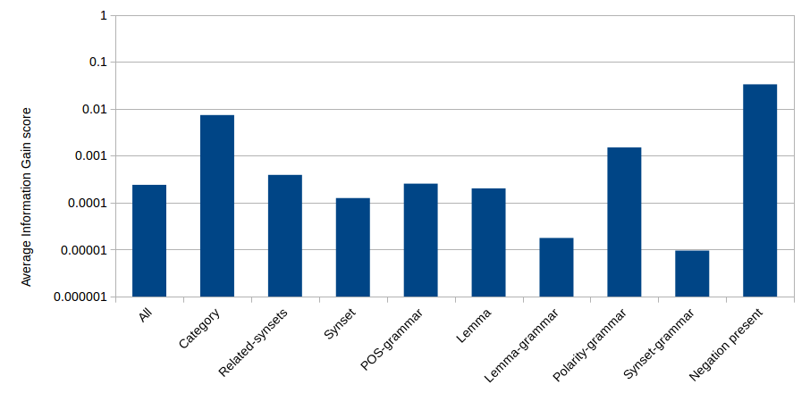
Results – average IG per feature type

Slide 17
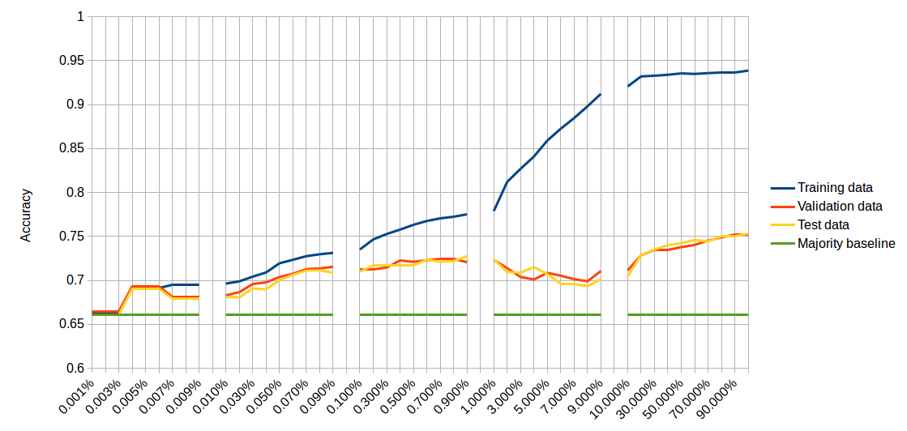
Results – sentiment classification results

Slide 18
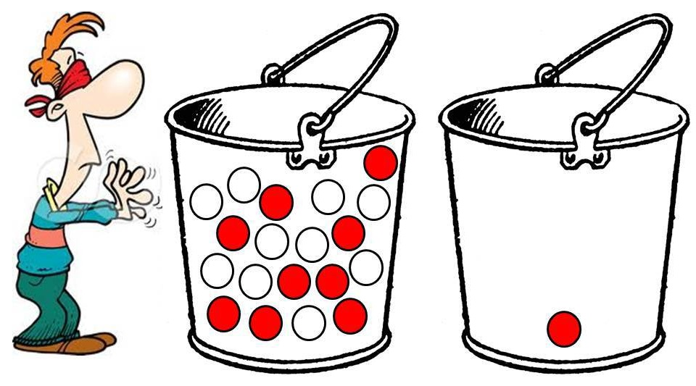
Overfitting with low IG scores

Slide 19
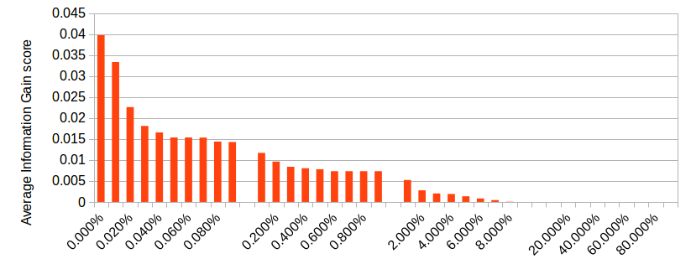
Results – average IG

Slide 20
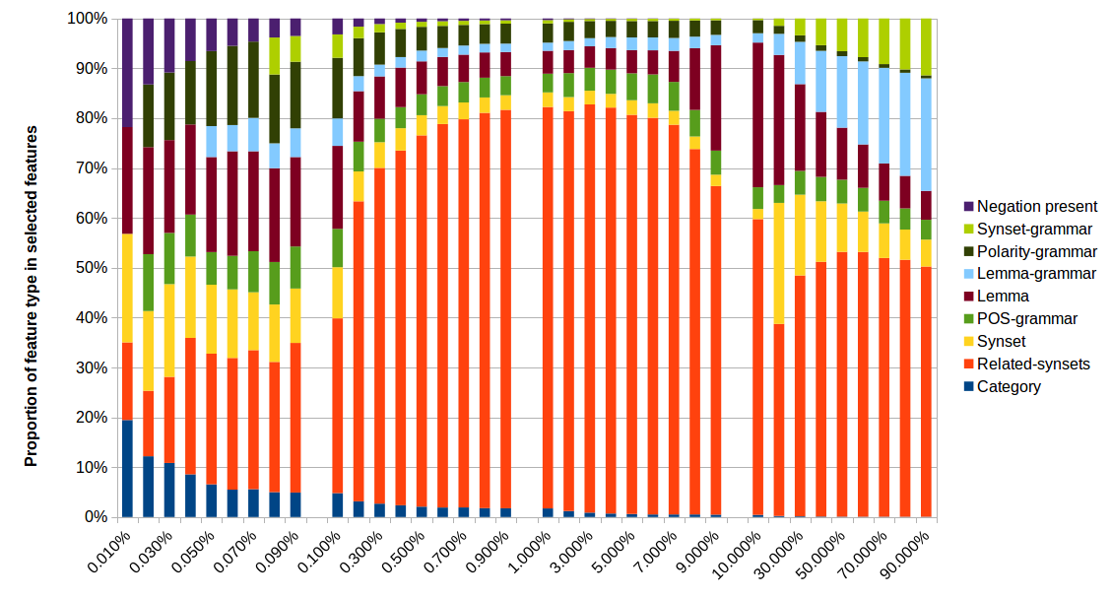
Results – proportion of feature type

Slide 21
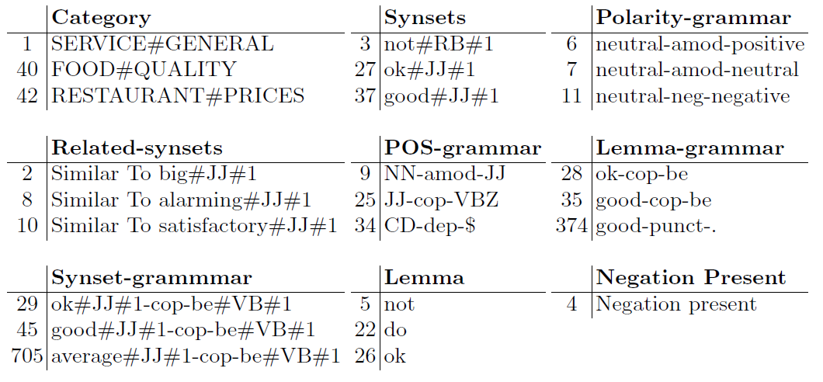
Results – top 3 features per type

Slide 22
Conclusions
Using Information Gain to select features:
  We can use just 1% of the features at only a 2.9% penalty in accuracy
  And with 1% of the features, training time of the SVM is reduced by 80%
Relatively unknown features such as related-synsets and polarity-grammar turned out to be effective for sentiment classification
In future work we hope to
  Compare the grammar-based features with the traditional n-grams
  Include more features, e.g., multiple sentiment lexicons
  Investigate feature interaction
  Incorporate a smarter aspect context instead of the simple word window

