Slide 1
Towards Cross-Language Sentiment Analysis through Universal Star Ratings
 | Malissa Bal Erasmus University Rotterdam malissa.bal@xs4all.nl
Flavius Frasincar Erasmus University Rotterdam frasincar@ese.eur.nl | Daniella Bal Erasmus University Rotterdam daniella.bal@xs4all.nl
Alexander Hogenboom
Erasmus University Rotterdam
hogenboom@ese.eur.nl

Slide 2


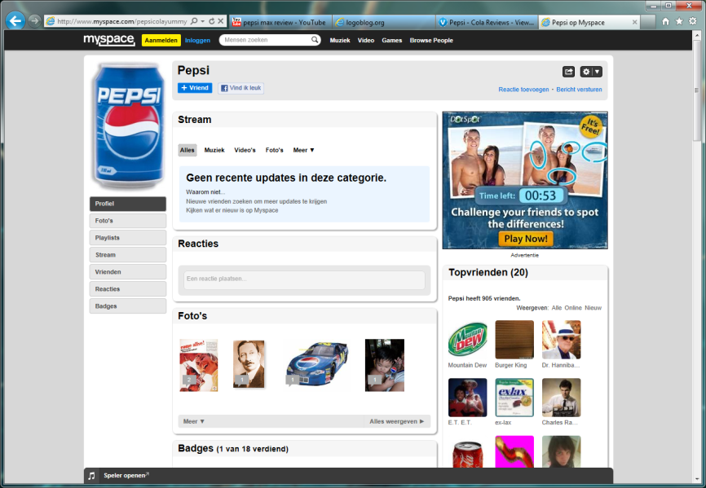

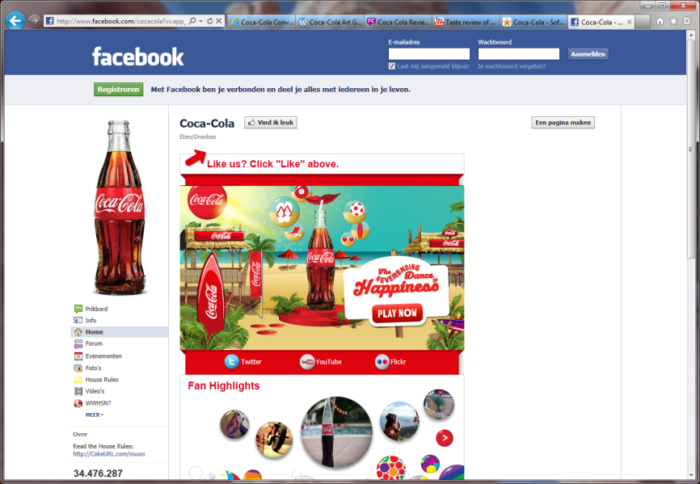
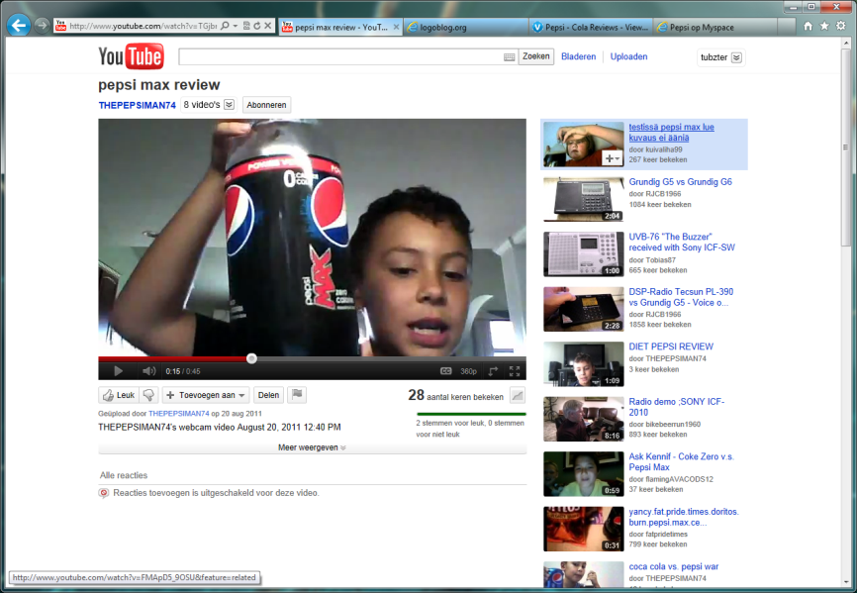
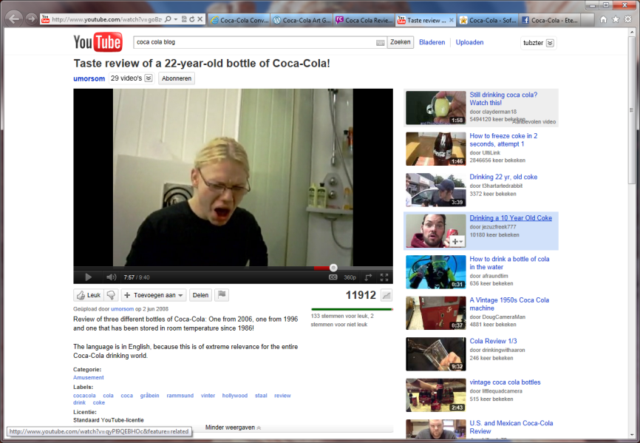
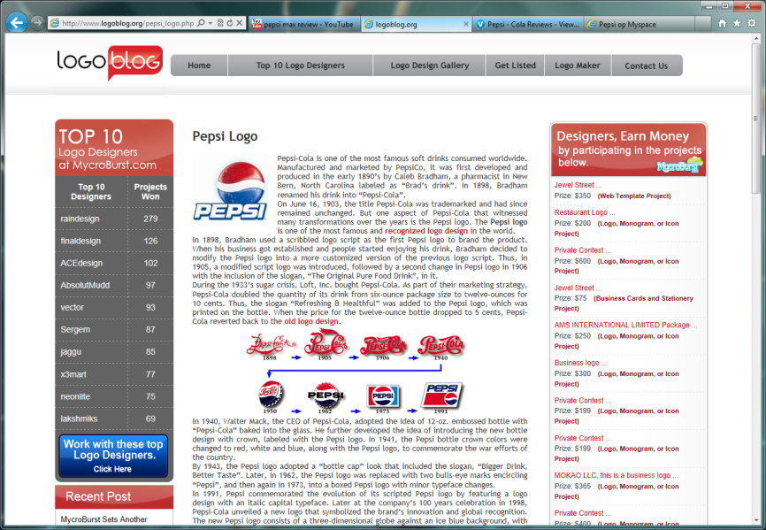
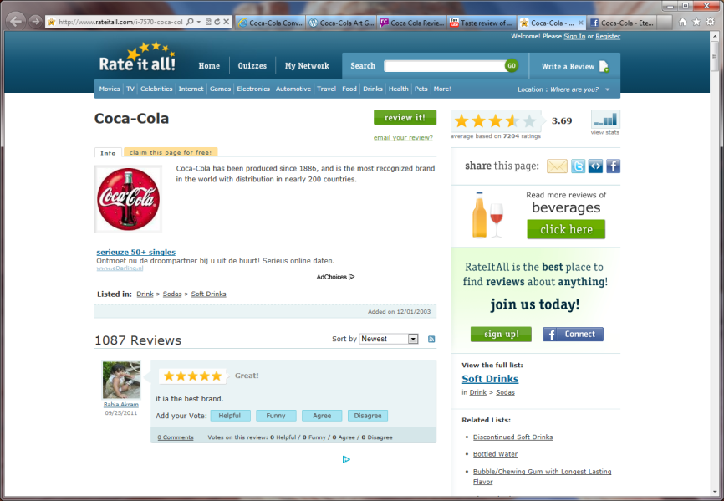

Introduction (1)
The Web offers an overwhelming amount of multi-lingual textual data, containing traces of sentiment
Information monitoring tools for tracking sentiment are crucial for today’s businesses

Slide 3
Introduction (2)
Language-specific sentiment analysis typically produces sentiment scores
Sentiment scores are incomparable across languages as they originate from language-specific phenomena
Star ratings are universal classifications of people’s intended sentiment and thus enable comparison
As star ratings are not always available, we need a mapping from language-specific scores of sentiment conveyed by words to universal star ratings

Slide 4
Cross-Language Sentiment Analysis (1)
Sentiment analysis is typically focused on determining the polarity of natural language text
Applications exist in summarizing reviews, determining a general mood (consumer confidence, politics)
State-of-the-art approaches classify polarity of natural language text by analyzing vector representations using, e.g., machine learning techniques
Alternative approaches are lexicon-based, which renders them robust across domains and texts and enables linguistic analysis at a deeper level
Challenge: other languages require other approaches

Slide 5
Cross-Language Sentiment Analysis (2)
Typical solutions:
Machine translation into reference language
Lexicon creation for new languages
Construction of new sentiment analysis frameworks
Most approaches yield incomparable sentiment scores
Sentiment-carrying text is an artifact of the use of language rather than a culture-free analytical tool
Capturing the relation between the use of language and universal star ratings reflecting intended sentiment is crucial for cross-language sentiment analysis

Slide 6
From Sentiment Scores to Star Ratings (1)
Assumptions:
Star ratings are universal classifications of intended sentiment
Classes are defined on an ordinal scale
Higher language-specific sentiment scores are associated with higher star ratings
We model the relation between sentiment scores and star ratings as a monotonically increasing step function
We thus construct language-specific sentiment maps, where subsets of texts with (largely) similar star ratings are separated by boundaries

Slide 7
From Sentiment Scores to Star Ratings (2)
The challenge is to find optimal set of boundaries, minimizing the total number of misclassifications
Boundaries must be non-overlapping and ordered
Non-trivial optimization can be performed by means of:
Greedy algorithms
Machine learning
Brute force

Slide 8
Evaluation (1)
Exploration of how sentiment scores can be converted into universal star ratings and how such mappings differ across languages (10-fold cross-validated)
Data set of short movie reviews in Dutch (1,759) and English (46,315), rated by their authors, with normally distributed ratings over five star classes
Sentiment analysis by means of an existing lexicon-based multi-lingual framework, yielding language-specific sentiment scores in the interval [-1.5, 1.5]
Paired observations of sentiment scores and star ratings can be used to construct sentiment maps by means of a brute force approach (step size 0.1)

Slide 9
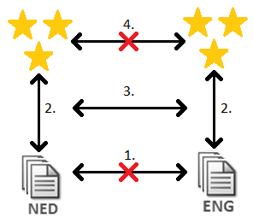
Evaluation (2)

Slide 10

Evaluation (3)
Sentiment map for Dutch:
Sentiment map for English:
Dutch sentiment map yields a star rating classification accuracy for Dutch documents of about 20%
Star rating classification accuracy for English documents equals about 40% when using the English sentiment map

Slide 11
Conclusions
We propose to compare the sentiment conveyed by words in unstructured text across languages through universal star ratings for intended sentiment
The way in which words in natural language text reveal people's intended sentiment differs across languages
Language-specific sentiment scores can separate universal classes of intended sentiment from one another only to a limited extent

Slide 12
Future Work
Allow for a non-linear relation between sentiment scores and star ratings
Drop the monotonicity constraint
Assess other proxies for star ratings, e.g., emoticons or rhetorical structure

Slide 13
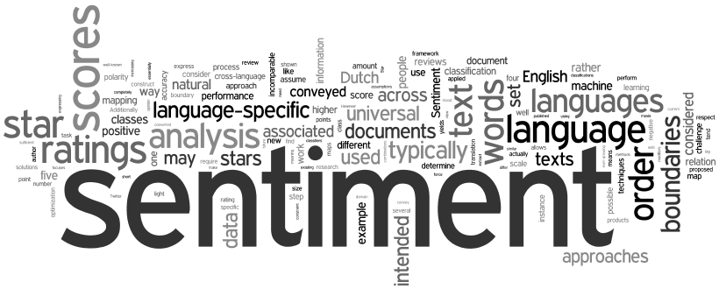
Questions?
Alexander Hogenboom Erasmus School of Economics Erasmus University Rotterdam P.O. Box 1738, NL-3000 DR Rotterdam, the Netherlands
hogenboom@ese.eur.nl

