Slide 1
A Statistical Approach to Star Rating Classification of Sentiment
 | Ferry Boon Erasmus University Rotterdam ferry.boon@gmail.com | Flavius Frasincar Erasmus University Rotterdam frasincar@ese.eur.nl
Alexander Hogenboom
Erasmus University Rotterdam
hogenboom@ese.eur.nl

Slide 2
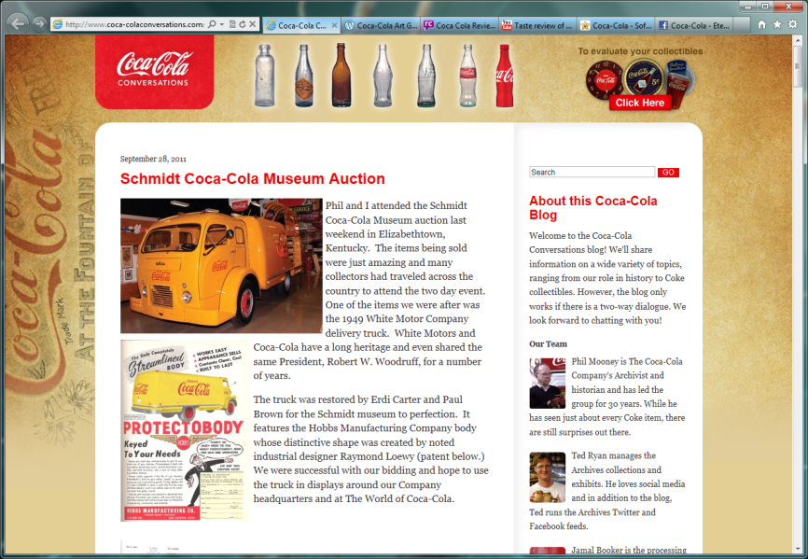

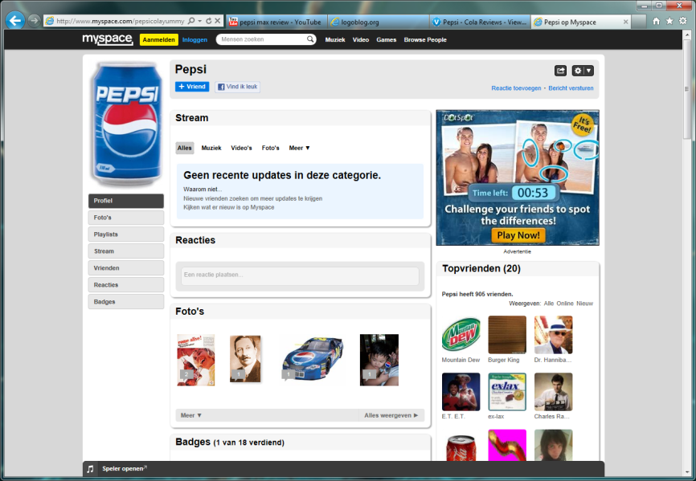

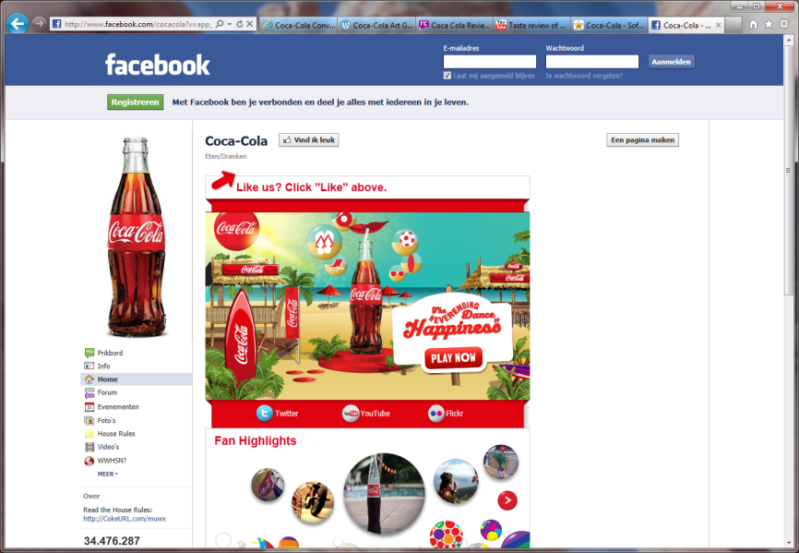
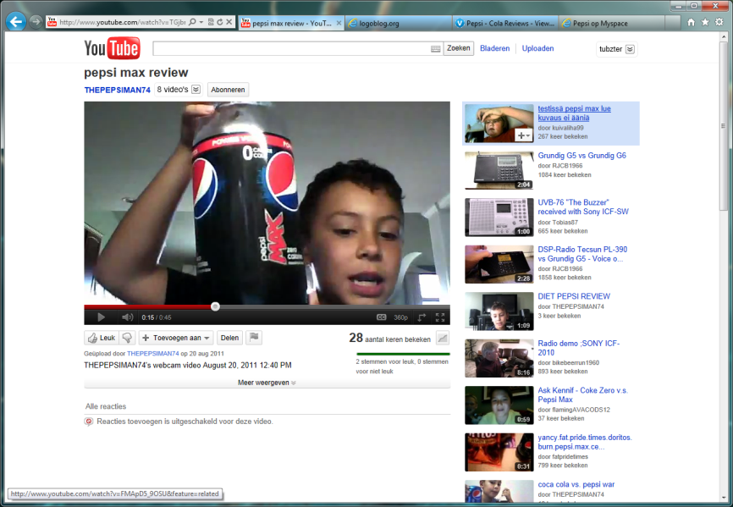
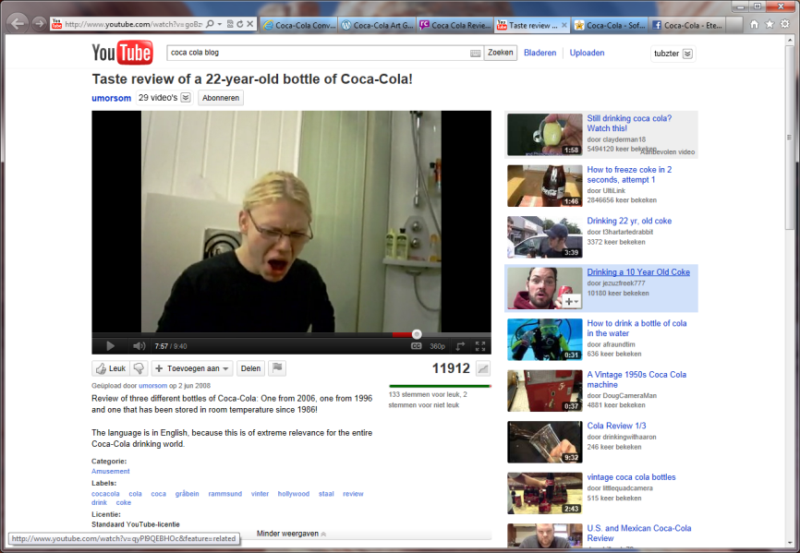
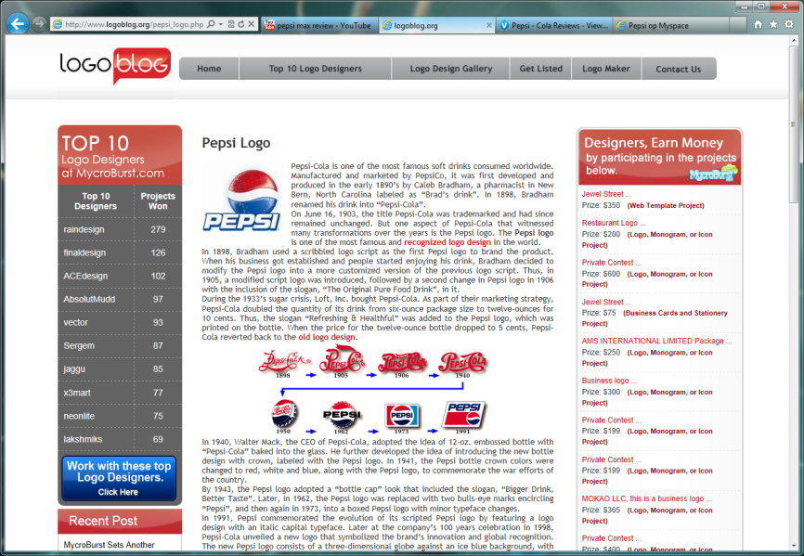
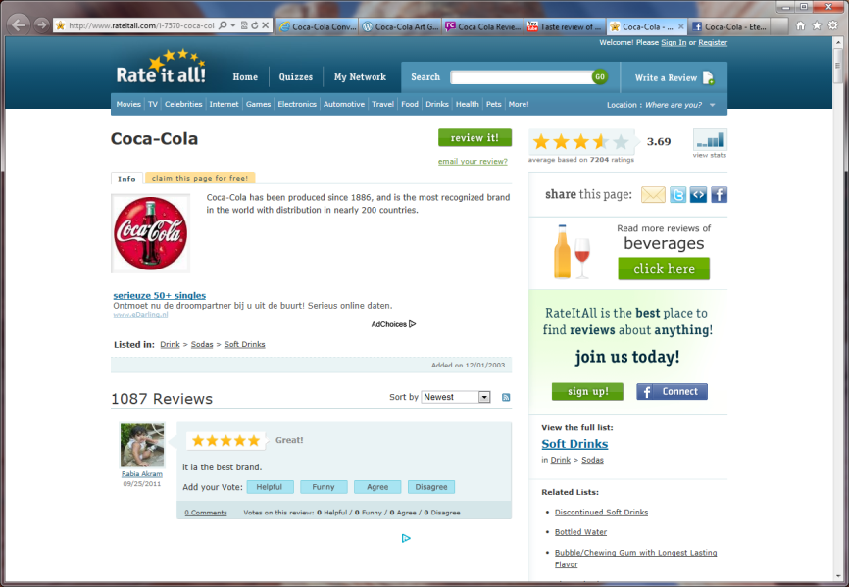

Introduction (1)
The Web offers an overwhelming amount of textual data, containing traces of sentiment
Information monitoring tools for tracking sentiment are of paramount importance for today’s businesses

Slide 3
Introduction (2)
A reliable indication of the sentiment intended by authors of user-generated content is crucial for, e.g., reputation management
Star ratings are universal classifications of people's intended sentiment
Opinionated content in, e.g., blogs or tweets, often has not been assigned ratings for intended sentiment
A major challenge lies in automatic classification of intended sentiment quantified in star ratings

Slide 4
Sentiment Analysis
Sentiment analysis is typically focused on determining the polarity of natural language text
Main approaches:
  Lexicon-based sentiment analysis
  Machine learning methods
Lexicon-based approaches are more robust across domains and texts
Machine learning methods excel in classification accuracy and computational efficiency
Exploiting sentiment lexicons in a machine learning method for sentiment classification appears to be a viable, hybrid approach

Slide 5
Star Rating Classification (1)
Task: automatic classification of intended sentiment on a five-star scale
Aim: combining classification accuracy and processing speed benefits of machine learning approaches with the robustness of lexicon-based approaches
Proposal: binary bag-of-sentiwords representation, linking vectorized text to a sentiment lexicon
Considered classifiers:
  Nearest Neighbor (NN)
  Naïve Bayes (NB)

Slide 6
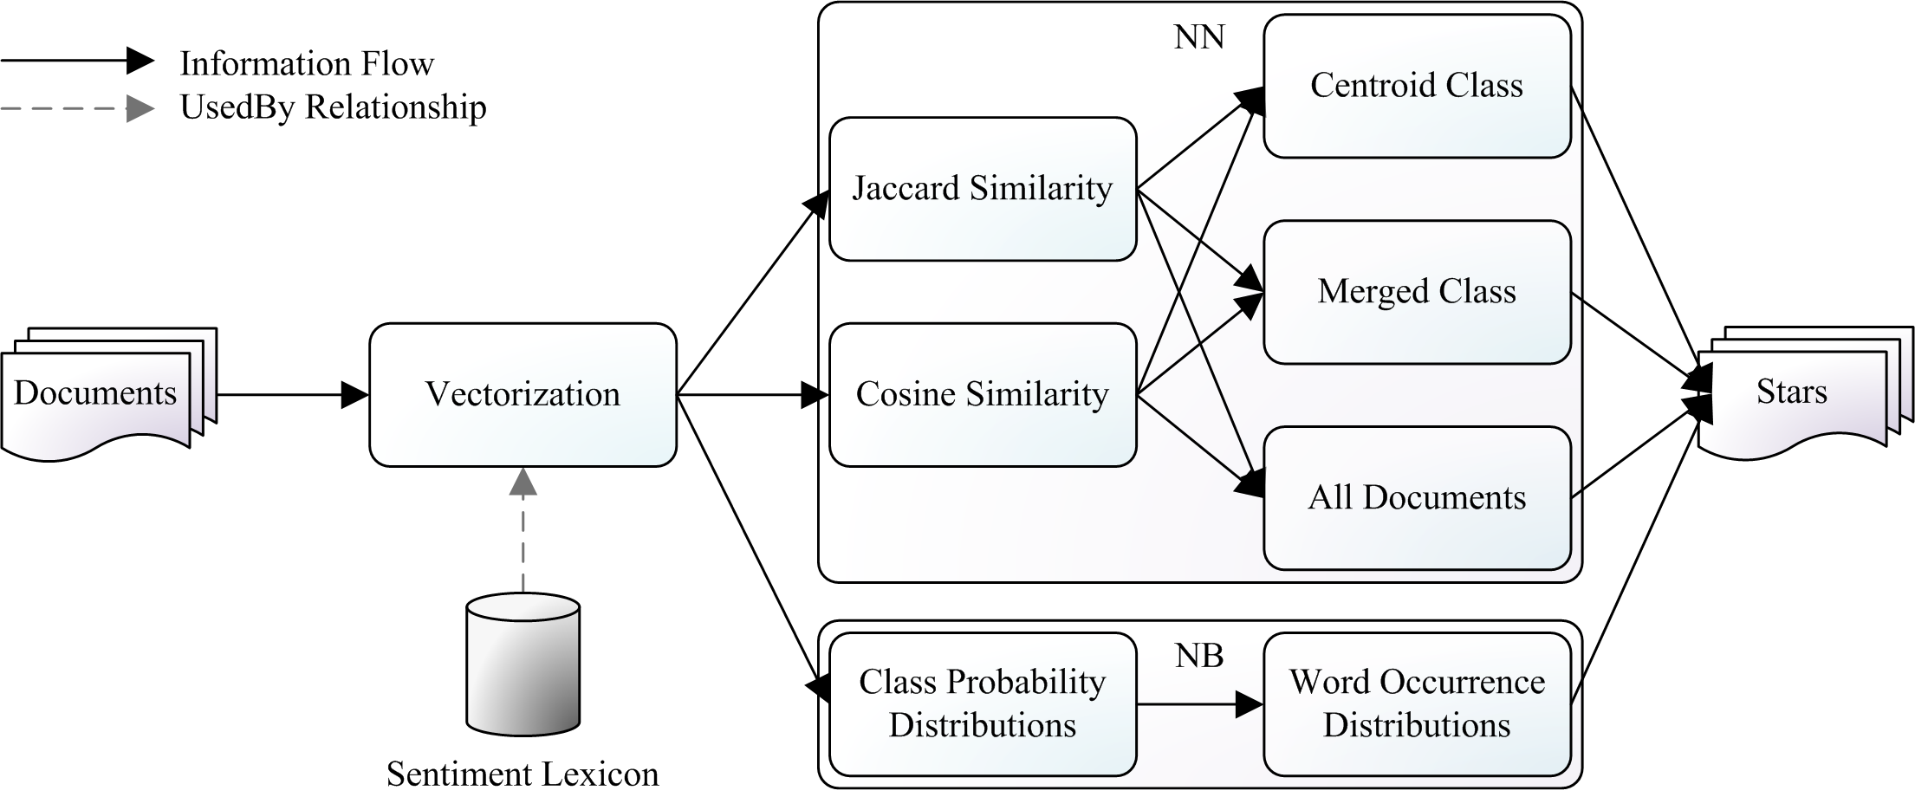
Star Rating Classification (2)

Slide 7
Evaluation (1)
Aim: assessing the performance of our considered statistical methods of classifying star ratings of reviews based on cues in the actual natural language content
Data: collection of 20,000 Amazon product reviews (50% training set, 50% test set)
Vector features: 4,300 unique lexical representations of sentiment-carrying words from the Multi-Perspective Question Answering (MPQA) corpus

Slide 8
Evaluation (2)
Typical causes of classification errors:
  More complex sentences containing, e.g., negation
  Few sentiment-carrying words
  Noise due to, e.g., irrelevant sentiment-carrying information
Method | Precision | Recall | F1 | Accuracy | RMSE
NN (Jaccard, centroid) | 0.241 | 0.235 | 0.219 | 0.300 | 1.879
NN (Jaccard, all) | 0.294 | 0.325 | 0.261 | 0.323 | 1.673
NN (Jaccard, merged) | 0.228 | 0.211 | 0.184 | 0.477 | 1.432
NN (cosine, centroid) | 0.232 | 0.230 | 0.230 | 0.365 | 1.508
NN (cosine, all) | 0.293 | 0.318 | 0.244 | 0.291 | 1.727
NN (cosine, merged) | 0.227 | 0.229 | 0.223 | 0.392 | 1.567
NB | 0.328 | 0.269 | 0.269 | 0.508 | 1.296

Slide 9
Conclusions
We propose to model the content of reviews by means of a binary vector representation, with features signaling the presence of sentiment-carrying words
Using this bag-of-sentiwords representation, a NN classifier maximizes recall
A NB classifier excels in terms of precision, accuracy, and RMSE of the assigned number of stars
Our findings can be useful for marketing or reputation management efforts relying on intended sentiment

Slide 10
Future Work
Add new features in our vector representation, e.g., frequencies or word senses
Devise a weighting scheme in order to account for the position or role of sentiment-carrying words in a text
Assess other methods for star rating classification

Slide 11
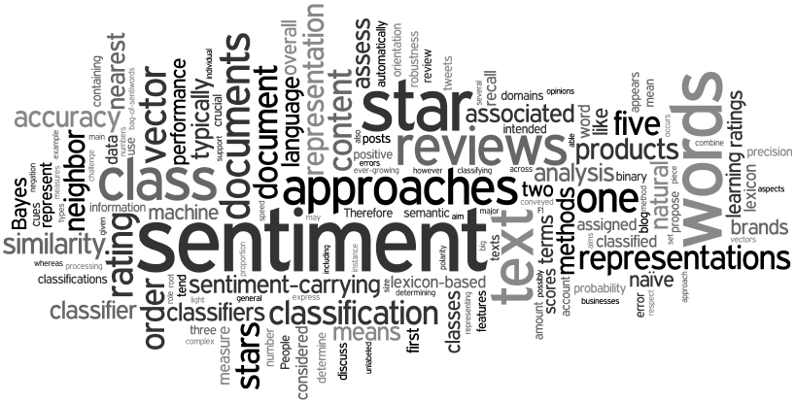
Questions?
  Alexander Hogenboom
  Erasmus School of Economics
  Erasmus University Rotterdam
  P.O. Box 1738, NL-3000 DR
  Rotterdam, the Netherlands
  hogenboom@ese.eur.nl

