Slide 1





Contrasting sentiments across Languagesanguages
Applying Contrastive Learning to an Attention Neural Model in a Multilingual Context
Philipp Gottschalk, Flavius Frasincar and Eyo Herstad

Slide 2







Contents Page
Introduction
Data
Methodology
Results
Discussion

Slide 3






Introduction
Scenario: ever-expanding presence of opinionated texts on the web → online reviews, social media, opinion pieces
Aspect-Based Sentiment Classification (ABSC): are certain aspects in a sentence positive, neutral or negative
ML-ABSC and XL-ABSC: multilingual and cross-lingual approaches for low-resource languages
Models: various modelling approaches to address these issues in the literature
New contrastive model: CLS-${\text{X}\text{L}\text{MR}}_{base}$-LCR-Rot-hop++
Notes:
Sentiment Analysis -> Aspect Based Sentiment Analysis -> ABSC
ML-ABSC and XL-ABSC: explain them and what the key difference is
CLS- Contrastive Learning Sentiment – XLM-Roberta base- LCR-Rot-hop++

Slide 4

Our Models
Main Idea: Introduces new contrastive learning models inspired by mLCR-Rot-hop++ (Horst et al., 2024)
Main Innovations:
New multilingual embedders integrated into the neural attention model
Two types of contrastive learning (CL) used in modelling
Overview CLS-${\text{X}\text{L}\text{MR}}_{base}$-LCR-Rot-hop++ :
A neural network with a rotary attention mechanism
Sentiment-level contrastive learning and an XLM-Roberta (Conneau et al., 2020) embedder

Slide 5
Background and Previous Research
Lin et al. (2023)
Contrastive learning in a multilingual context
Sentiment-level CL to decrease semantic spaces
Zhang et. al (2021)
Introduction of Aspect-Code Switching (ACS)
Increase of data by translating to target language and then switching aspects
Introduces mLCR-Rot-hop++ and adjacent models
→ various unilingual, ML- and XL-ABSC models
Utilises a standard mBERT embedder (Devlin et al., 2019)
Utilises data augmentation strategies such as ACS
Horst and Frasincar (2024)

Slide 6
SemEval-2016: Restaurant
First introduced in Pontiki et al. (2016)
<sentence id="1349391:0">
<text>sometimes i get good food and ok service.</text>
<Opinions>
<Opinion target="food" category="FOOD#QUALITY" polarity="positive" from= "21" to="25"/>
<Opinion target="service" category="SERVICE#GENERAL" polarity="neutral"
from="33" to="40"/>
</Opinions>
</sentence>
English
Spanish
French
Dutch
4 languages
Aspect Target
Aspect Category
Sentiment Polarity
Components
Notes:
Explain the entire context
REMOVE Turkish and Russian:
Russian is in Cyrillic so we do not believe that cross-lingual ABSC would be particularly effective here
Turkish is extremely small dataset: only 39 sentences with 144 sentiments in test
Mention that we remove the implicit aspects
SB1 dataset, summary statistics are in the appendix

Slide 7






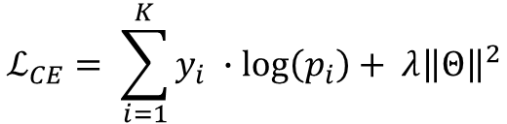
LCR-Rot-hop++ Framework
Instance $i$ split into target phrase + left context + right context
Calculate context representations using target representations (pooling)
Hierarchical attention: tune context representations
Compute target representations using context representations
Concatenate vectors → sentiment predictions using softmax layer
Cross-Entropy
$$ℒ_{CE}= \sum_{i=1}^{K}{y_{i} ∙log\left(p_{i}\right)}+ λ{\left\|Θ\right\|}^{2}$$
XLM-R and ${\text{X}\text{L}\text{M}\text{-}\text{R}}_{base}$
mBERT
250k tokens
100 languages
110k tokens
104 languages
Notes:
Embedded using the specific embedders mentioned here
Layers, Hidden Size, Attention Heads, #param:
mBERT = {12, 768, 12, 172M}
XLMR_base = {12, 768, 12, 270M}
XLMR = {24, 1024, 16, 550M}
Y_i is the sentiment vector of instance i
P_i prediction vector of for instance i
L2 regularization term for parameter set

Slide 8



${\text{X}\text{L}\text{MR}}_{base}$-LCR-Rot-hop++
Train
Embedder
Model
Loss Function
Test
EN
XLM-R
LCR-Rot-hop++
$$ℒ_{CE}$$
XX $∈$ {EN, FR, ES, NL}

Slide 9
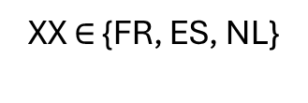



${\text{X}\text{L}\text{MR}}_{base}$-LCR-Rot-hop-XX++
Train
Embedder
Model
Loss Function
Test
XX $∈$ {FR, ES, NL}
XLM-R_{base}
LCR-Rot-hop++
$$ℒ_{CE}$$
XX $∈$ {FR, ES, NL}

Slide 10



${\text{X}\text{L}\text{MR}}_{base}$-MLCR-Rot-hop++
Train
Embedder
Model
Loss Function
Test
EN
FR
XLM-R_{base}
LCR-Rot-hop++
$$ℒ_{CE}$$
XX $∈$ {EN, FR, ES, NL}
ES
NL

Slide 11



${\text{X}\text{L}\text{MR}}_{base}$-LCR-Rot-hop- ${\text{ACS}}_{XX}$++
Train
Embedder
Model
Loss
Function
Test
Google API
ACS
EN_{CS-XX}
XLM-R_{base}
LCR-Rot-hop++
$$ℒ_{CE}$$
XX $∈$ {FR, ES, NL}
EN
XX_{EN}
XX_{CS-EN}
Notes:
Google API ->supports over 130 languages
Alignment-free label projection
-> Allows us to obtain pseudo labelled data in the target language
Translate using markings and filter instances with an empty target

Slide 12
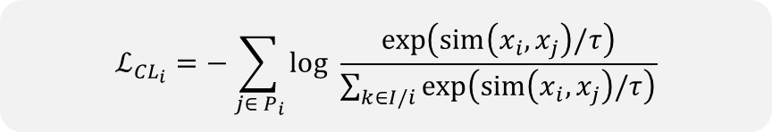


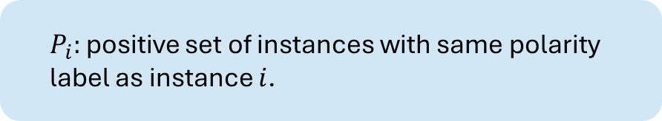
Contrastive Learning
Two methods of CL adopted, inspired by Lin et al. (2023): sentiment and representation level
$$ℒ_{{CL}_{i}}=−\sum_{j∈ P_{i}}{log \frac{exp\left(sim\left(x_{i},x_{j}\right)/τ\right)}{\sum_{k∈I/i}{exp\left(sim\left(x_{i},x_{j}\right)/τ\right)}}}$$
$$ℒ=\left(1−β\right) ∙ ℒ_{CE}+ β {∙ ℒ}_{CL}$$
Difference between sentiment and representation level (CLS vs CLR):
Sentiment level: $x_{i}$ is the sentiment prediction vector of instance $i$.
Representation level: $x_{i}$ is the concatenated representation vector of instance $i$.
$P_{i}:$ positive set of instances with same polarity label as instance $i$.
$$P_{i}=\left\{j :j ∈I, y_{i }=y_{j} ∧i≠j\right\}$$
Notes:
Explain contrastive learning
-> Aim is to align the sentiment prediction vectors or the concatenated representation vectors in positive batches, i.e. in batches that have the same label
Additional notes:
Tau is the hyperparameter temperature -> set as standard at 0.07
Sim is the cosine similarity functions
Tested for all previous models with and without contrastive learning

Slide 13


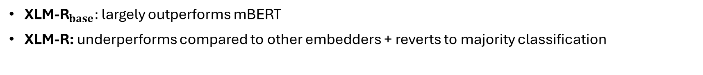
Results: Trends across Models
Evaluation Metrics: accuracy of predictions + macro-$F_{1}$
Contrastive Learning
Sentiment level: ↑ performances across the board
Representation level: volatile and often reverts to majority classification
Embedders
${\text{X}\text{L}\text{M}\text{−}\text{R}}_{base}:$ largely outperforms mBERT
XLM-R: underperforms compared to other embedders + reverts to majority classification
Notes:
Accuracy + macro-F1 score
Macro F1 score is important in punishing unbalanced datasets -> which this one is
Representation: sometimes better such as in CLR-XLMR_base-LCR-Rot-hop++ for English, but often significantly worse
Likely the inclusion of too much noise
XLM-R: nearly always underperforms with respect to the other two.

Slide 14
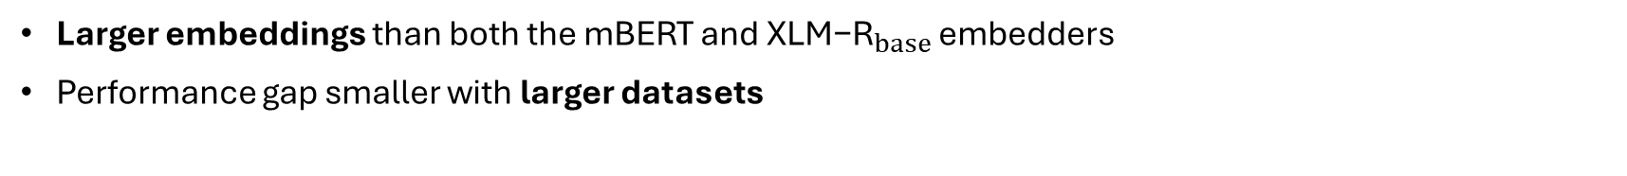
Discussion of Results
Underperformance of Representation Level CL
Based on high-level representation vectors with more information
→ Harder to decrease the semantic space
Practical issue: far larger computational requirements
Underperformance of XLM-R embedder
Larger embeddings than both the mBERT and ${\text{X}\text{L}\text{M}\text{−}\text{R}}_{base}$ embedders
Performance gap smaller with larger datasets
Notes:
High level representations -> more noise due to the increased information length of these vectors
Computational requirements -> calculation in large batches either very time consuming or computationally expensive
L, H, A, #param:
mBERT = {12, 768, 12, 172M}
XLMR_base = {12, 768, 12, 270M}
XLMR = {24, 1024, 16, 550M}
See that performance gap significantly decreases when working with larger datasets -> such as the ACS dataset, where we are looking at 8000 instances for each languages

Slide 15




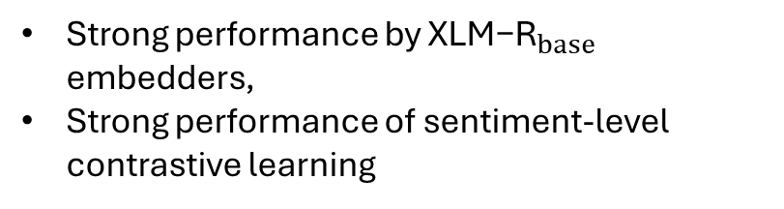
Conclusion
Contributions of Paper
New models for ABSC across languages
Contrastive learning introduced to state-of-the-art models
Testing of different embedders
Findings
Strong performance by ${\text{X}\text{L}\text{M}\text{−}\text{R}}_{base}$ embedders,
Strong performance of sentiment-level contrastive learning

Slide 16
References
Conneau, A., Khandelwal, K., Goyal, N., Chaudhary, V., Wenzek, G., Guzm´ an, F., Grave, E., Ott, M., Zettlemoyer, L., Stoyanov, V.: Unsupervised cross-lingual representation learning at scale. In: 58th Annual Meeting of the Association for Computational Linguistics (ACL 2020). pp. 8440–8451. ACL (2020)
Devlin, J., Chang, M., Lee, K., Toutanova, K.: BERT: Pre-training of deep bidirec tional transformers for language understanding. In: 2019 Conference of the North American Chapter of the Association for Computational Linguistics: Human Lan guage Technologies (NAACL-HLT 2019). pp. 4171–4186. ACL (2019)
Horst, S., Frasincar, F.: Multilingual, cross-lingual, and unilingual models for ABSC. In: 25th International Conference on Web Information Systems Engineering (WISE 2024). LNCS, vol. 15436, pp. 89–101. Springer (2024)
Lin, N., Fu, Y., Lin, X., Zhou, D., Yang, A., Jiang, S.: CL-XABSA: Contrastive learning for cross-lingual aspect-based sentiment analysis. IEEE/ACM Transac tions on Audio, Speech, and Language Processing 31, 2935–2946 (2023)
Pontiki, M., Galanis, D., Papageorgiou, H., Androutsopoulos, I., Manandhar, S., Al-Smadi, M., Al-Ayyoub, M., Zhao, Y., Qin, B., Clercq, O.D., Hoste, V., Apidianaki, M., Tannier, X., Loukachevitch, N.V., Kotelnikov, E.V., Bel, N., Zafra, S.M.J., Eryigit, G.: SemEval-2016 task 5: Aspect based sentiment analysis. In: 10th International Workshop on Semantic Evaluation (SemEval 2016). pp. 19–30. ACL (2016)
Trusca, M.M., Wassenberg, D., Frasincar, F., Dekker, R.: A hybrid approach for aspect-based sentiment analysis using deep contextual word embeddings and hier archical attention. In: 20th International Conference on Web Engineering (ICWE 2020). LNCS, vol. 12128 of LNCS, pp. 365–380. Springer (2020)
Zhang, W., He, R., Peng, H., Bing, L., Lam, W.: Cross-lingual aspect-based senti ment analysis with aspect term code-switching. In: 2021 Conference on Empirical Methods in Natural Language Processing (EMNLP 2021). pp. 9220–9230. ACL (2021)

Slide 17
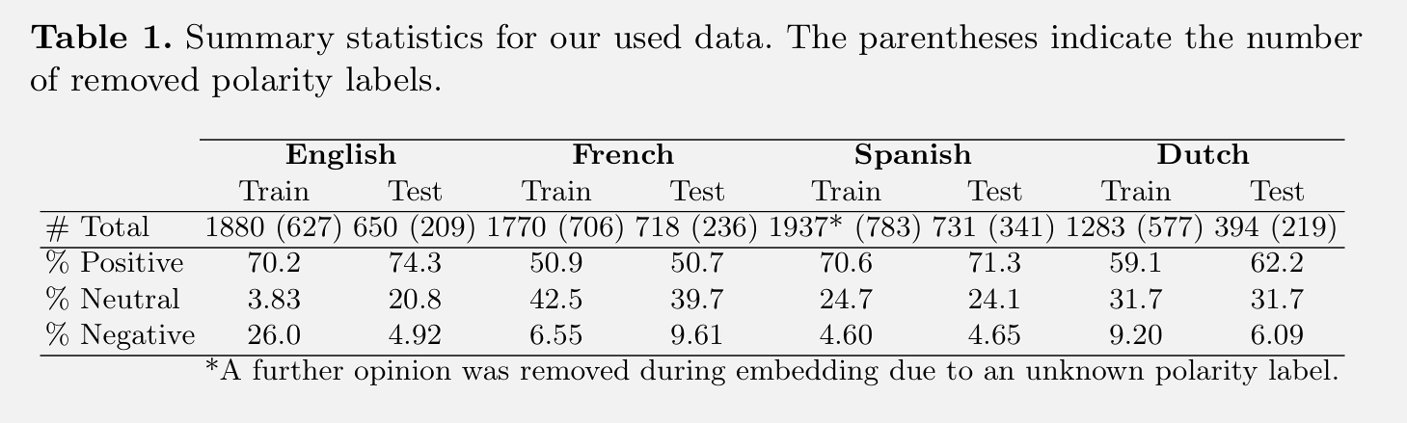
SemEval-2016: Summary Statistics
Note: unbalanced data → far more positive sentiments
Notes:
Give some context to the summary statistics if need be

Slide 18
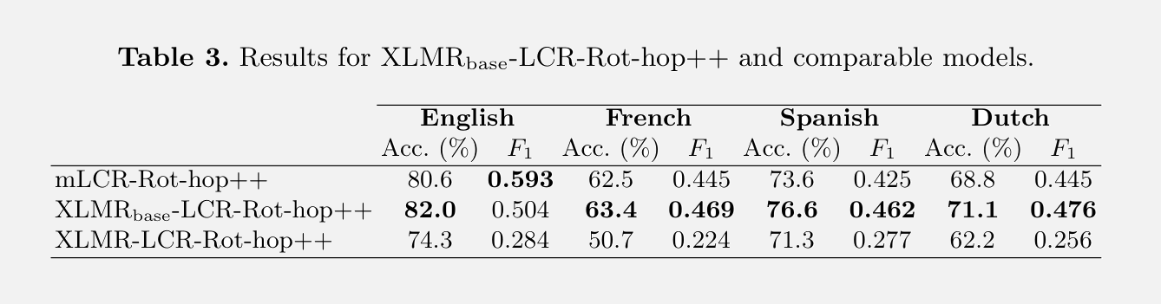

Results: ${\text{X}\text{L}\text{MR}}_{base}$-LCR-Rot-hop++
Notes:
Give some context to the summary statistics if need be

Slide 19
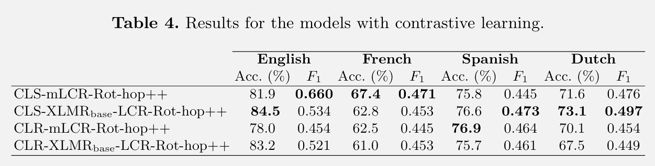

Results: CL-${\text{XLMR}}_{base}$-LCR-Rot-hop++
Notes:
Give some context to the summary statistics if need be

Slide 20
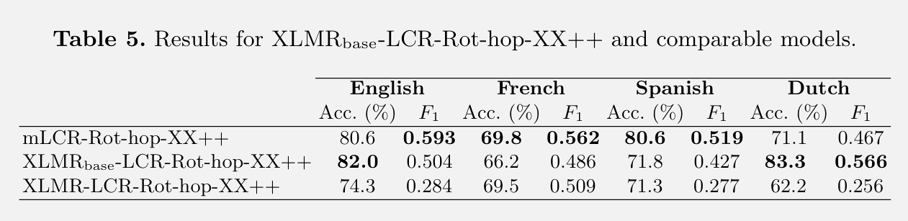

Results: ${\text{XLMR}}_{base}$-LCR-Rot-hop-XX++
Notes:
Give some context to the summary statistics if need be

Slide 21
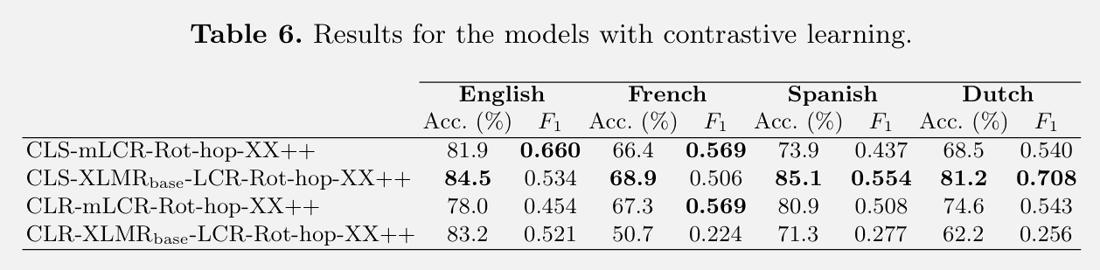

Results: CL-${\text{XLMR}}_{base}$-LCR-Rot-hop-XX++
Notes:
Give some context to the summary statistics if need be

Slide 22
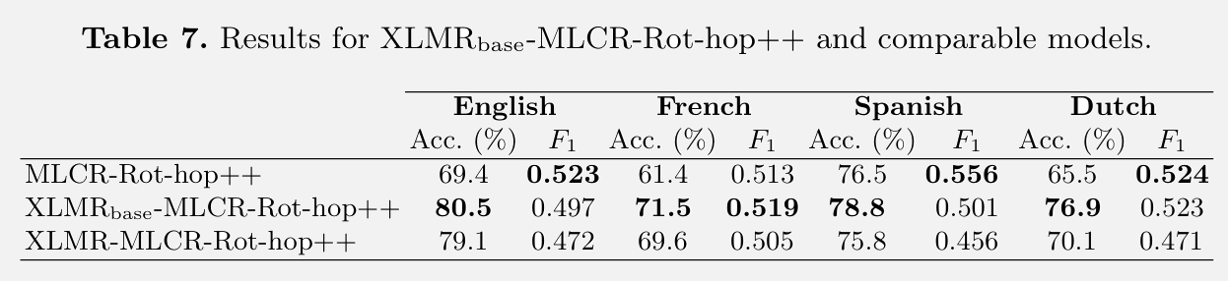

Results: ${\text{XLMR}}_{base}$-MLCR-Rot-hop++
Notes:
Give some context to the summary statistics if need be

Slide 23
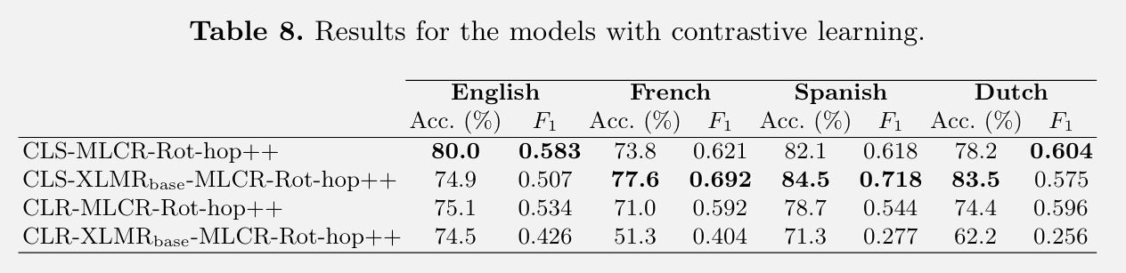

Results: CL-${\text{XLMR}}_{base}$-MLCR-Rot-hop++
Notes:
Give some context to the summary statistics if need be

Slide 24
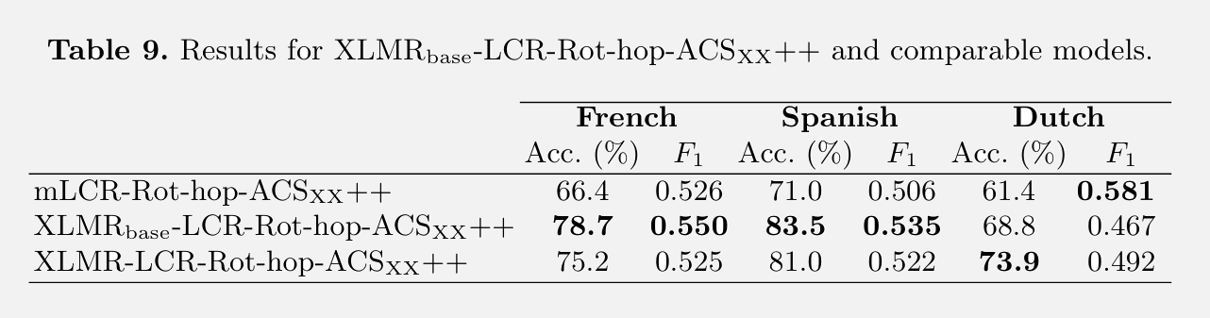

Results: ${\text{XLMR}}_{base}$-LCR-Rot-hop- ${\text{ACS}}_{XX}$++
Notes:
Give some context to the summary statistics if need be

Slide 25
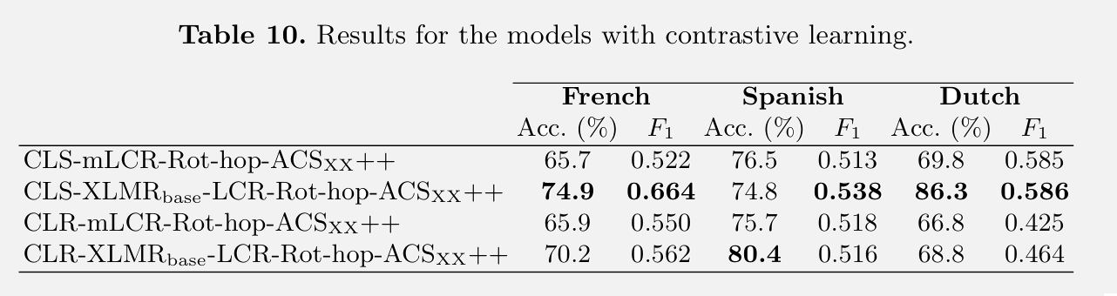

Results: CL-${\text{XLMR}}_{base}$-LCR-Rot-hop- ${\text{ACS}}_{XX}$++
Notes:
Give some context to the summary statistics if need be

