Slide 1
Data Augmentation Using BERT-Based Models for Aspect-Based Sentiment Analysis*
Flavius Frasincar
frasincar@ese.eur.nl
*Joint work with Bron Hollander and Finn van der Knaap

Slide 2
Contents
Motivation
Related Work
Data
Methodology
Evaluation
Conclusion
Future Work
Further Information
References

Slide 3
Motivation
Growing number of reviews:
In 2020: the number of reviews on Amazon around 250 million
Growing importance of reviews:
Consumers:
80% of the consumers read online reviews
75% of the consumers consider reviews important
Companies:
Improve products
Marketing products
Reading all reviews is time consuming, therefore the need for automation

Slide 4
Motivation
Sentiment mining is defined as the automatic assessment of the sentiment expressed in text (in our case by consumers in product reviews)
Several granularities of sentiment mining:
Document-level
Paragraph-level
Sentence-level
Aspect-level (product aspects are sometimes referred to as product features): Aspect-Based Sentiment Analysis (ABSA) firstly surveyed by Schouten and Frasincar (2016):
Document-level
Paragraph-level
Sentence-level [our focus here]

Slide 5
Motivation
ABSA has two stages:
Aspect Detection (AD): finding aspects in product reviews recently surveyed by Trusca and Frasincar (2023)
Explicit aspect detection: aspects appear literally in product reviews [our focus here]
Implicit aspect detection: aspects do not appear literally in the product reviews
Aspect-Based Sentiment Classification (ABSC): assigning the sentiment associated to explicit or implicit aspects recently surveyed by Brauwers and Frasincar (2023) [our focus here]
Three approaches for ABSA:
Knowledge Representation (KR)
Machine Learning (ML)
Hybrid: current state-of-the-art, e.g., A Hybrid Approach for Aspect-Based Sentiment Analysis++ (HAABSA++) proposed by Trusca et al. (2020)

Slide 6
Motivation
HAABSA++ is a two-step approach for ABSA at sentence-level:
Ontology-based reasoning
Deep learning (backup solution): LCR-Rot-hop++
Problem: There is a little annotated data to train the deep learning solution
Solution: Use data augmentation to enlarge the annotated data set

Slide 7
Related Work
HAABSADA proposed by Liesting et al. (2021):
Applied to HAABSA (precursor of HAABSA++)
Used the data augmentations techniques:
Easy Data Augmentation (EDA)
Back-translation
Mixup
Proposed a new data augmentation technique: EDA-adjusted
Best performance obtained with EDA-adjusted
Data augmentation using Pre-trained Transformer Models (PTMs) by Kumar et al. (2020):
Used for sentiment analysis
Used PTMs: BERT, C-BERT, GPT-2, BART
Our focus: data augmentation using BERT-based (encoder) models for HAABSA++

Slide 8
Data
SemEval:
SemEval 2015, Task 12, Subtask 1, Slot 3 for restaurants reviews
SemEval 2016, Task 5, Subtask 1, Slot 3 for restaurant reviews
3-point sentiment scale: positive, neutral, and negative
Example:

Slide 9
Data
SemEval Descriptive Statistics:
Neutral is the minority class
Positive is the majority class
20% of training data set aside for validation (hyperparameter tuning)
Dataset | Positive |  | Neutral |  | Negative |  | Total
 | Freq. | % | Freq. | % | Freq. | % | Freq.
SemEval 2015 training data | 962 | 75.3 | 36 | 2.8 | 280 | 21.9 | 1278
SemEval 2015 test data | 353 | 59.1 | 37 | 6.2 | 207 | 34.7 | 597
SemEval 2016 training data | 1319 | 70.2 | 72 | 3.8 | 489 | 26.0 | 1880
SemEval 2016 test data | 483 | 74.3 | 32 | 4.9 | 135 | 20.8 | 650

Slide 10
Methodology
ABSC: LCR-Rot-hop++
LCR-Rot-hop++:
BERT word embeddings
Three Bi-LSTMs (left context, aspect target, right context)
Two iterative steps using bilinear attention:
Target2Context: uses the target representation (initially pooled) to obtain target-dependent left/right context representations (two vectors)
Context2Target: uses the left/right context representations to obtain left/right context-dependent target representations (two vectors)
Hierarchical attention (part of the previous two iterative steps):
After Target2Context: apply attention to the obtained two vectors
After Context2Target: apply attention to the obtained two vectors
Repeat the two iterative steps a number of hops (e.g., 3)

Slide 11
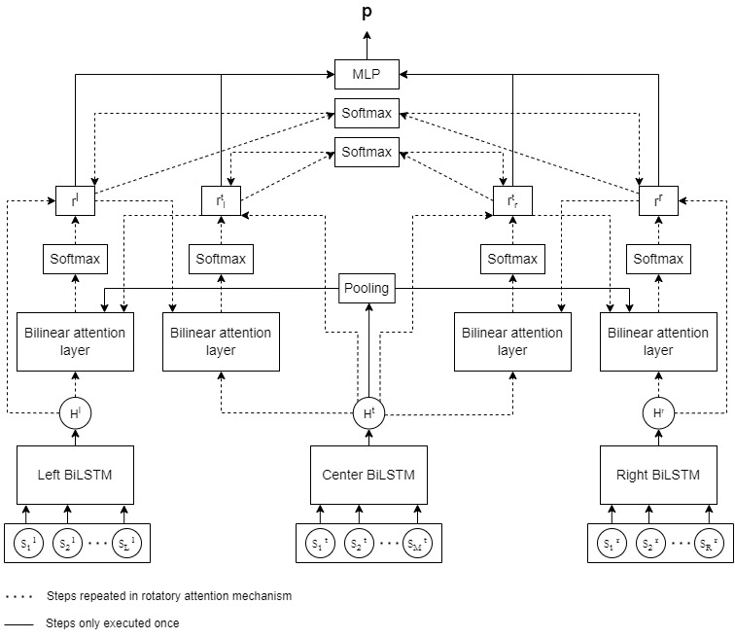
Methodology

Slide 12
Methodology
Data Augmentation:
EDA-adjusted (benchmark)
BERT
C-BERT
BERT_{prepend}
BERT_{expand}
Three main steps:
Fine-tuning BERT models for Masked Language Modeling (MLM) on the training data
Apply the fine-tuned BERT models on the training data using MLM to generate new sentences (15% chance to replace a word by the word with the highest probability excluding the original word)
Train LCR-Rot-hop++ on the augmented data

Slide 13
EDA-Adjusted
WSD:
Lesk Simplified algorithm: uses the WordNet synset that has the largest overlap between its gloss and the sentence from which the word to be disambiguated originates
Data augmentation operations:
Synonym Replacement: replace a word with a synonym
Random Insertion: insert the synonym of a sentence word in a random place in a sentence
Target Swap: swap two aspect targets that belong to the same aspect category

Slide 14
BERT
Sentiment
label is not
used

Slide 15
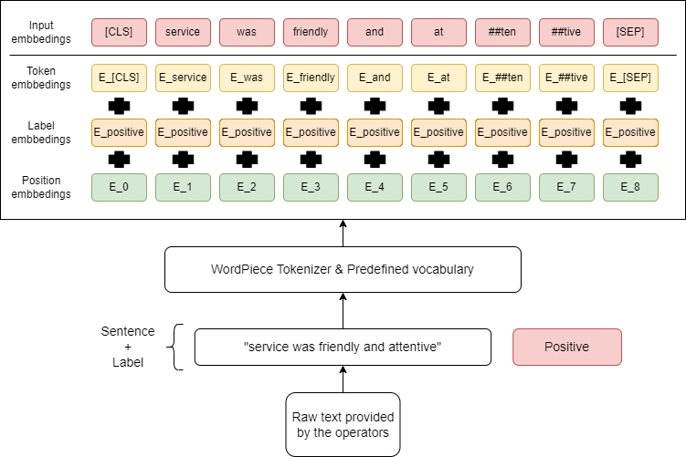
C-BERT
Sentiment
label is used
as segment

Slide 16
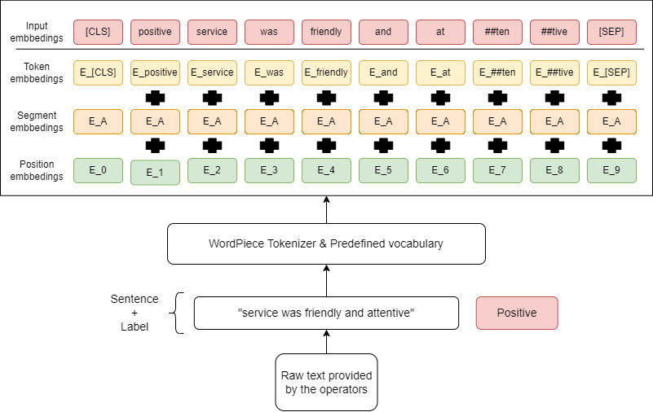
BERT_{prepend}/BERT_{expand}
Sentiment
label is used at
the beginning
of the sentence
For BERT_{expand}
the sentiment
label is added
to the model
vocabulary

Slide 17
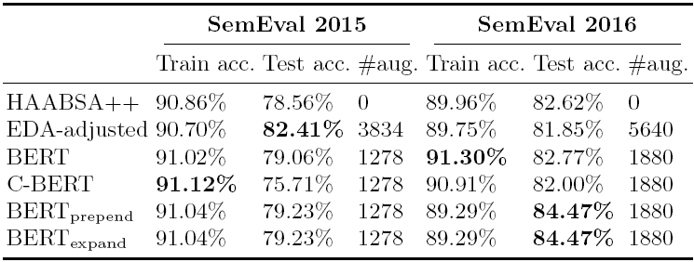
Evaluation
SemEval 2015 (small dataset):
EDA-adjusted has highest test accuracy (3.85 percentage points over HAABSA++)
EDA-adjusted has three times more augmentations (three operations)
C-BERT overfits and does not beat HAABSA++

Slide 18
Evaluation
SemEval 2016 (large dataset):
EDA-adjusted is the worst model despite the three times more augmentation
C-BERT overfits and does not beat HAABSA++ (again)
BERT_{prepend} and BERT_{expand} obtain the best results (1.85 percentage points over HAABSA++)

Slide 19
Evaluation
EDA-adjusted:
Lexicon-based method
Works best for the small dataset
C-BERT:
Neglects the order between sentences
Overfits
BERT_{prepend} and BERT_{expand}:
Work best on the large dataset
WordPiece tokenizer does not split the words “positive” and “negative”, so the two models give the same results

Slide 20
Conclusion
Problem: There is a little annotated data to train the deep learning solution
Solution: Use data augmentation to enlarge the annotated data set
EDA-adjusted
BERT-based (encoder):
BERT
C-BERT
BERT_{prepend}
BERT_{expand}
Small dataset: EDA-adjusted works best
Large dataset: BERT_{prepend} and BERT_{expand} work best

Slide 21
Future Work
Experiment with other types of reviews:
Laptops
Hotels
Books
Consumer Electronics
Selective Word Substitution (better sentence diversity by masking sentiment caring words) by Pantelidou et al. (2022)
Adjectives, adverbs, and verbs
SentiWordNet sentiment words
Experiment with other PTMs:
RoBERTa (encoder)
GPT (decoder)
BART (encoder-decoder)

Slide 22
Further Information
Dataset and code publicly available at: https://github.com/BronHol/HAABSA_PLUS_PLUS_DA is written in Python
Feel free to try it out and improve our research
Questions about the code should be sent to Bron Hollander (511709bh@student.eur.nl)

Slide 23
References
ABSA:
Kim Schouten and Flavius Frasincar: Survey on Aspect-Level Sentiment Analysis. IEEE Transactions on Knowledge and Data Engineering 28(3):813-830 (2016)
AD:
Maria Mihaela Trusca and Flavius Frasincar: Survey on Aspect Detection for Aspect-Based Sentiment Analysis. Artificial Intelligence Review 56(5):3797-3846 (2023)
ABSC:
Gianni Brauwers and Flavius Frasincar: A Survey on Aspect-Based Sentiment Classification. ACM Computing Surveys 55(4):65:1-65:37 (2023)

Slide 24
References
EDA-adjusted:
Tomas Liesting, Flavius Frasincar, and Maria Mihaela Trusca: Data Augmentation in a Hybrid Approach for Aspect-Based Sentiment Analysis. 36th Symposium on Applied Computing (SAC 2021), pages 828-835, ACM (2021)
DA with PTMs:
Varun Kumar, Ashutosh Choudhary, Eunah Cho: Data Augmentation using Pre-trained Transformer Models, arXiv preprint arXiv:2003.02245 (2020)

Slide 25
References
HAABSA++:
Maria Mihaela Trusca, Daan Wassenberg, Flavius Frasincar, and Rommert Dekker: A Hybrid Approach for Aspect-Based Sentiment Analysis Using Deep Contextual Word Embeddings and Hierarchical Attention. 20th International Conference on Web Engineering (ICWE 2020). LNCS, Volume 12128, Springer, 365-380 (2020)
DA with Selective Word Substitution:
Kyriaki Pantelidou, Despoina Chatzakou, Theodora Tsikrika, Stefanos Vrochidis, and Ioannis Kompatsiaris: Selective Word Substitution for Contextualized Data Augmentation. 27th International Conference on Natural Language & Information Systems (NLDB 2022), LNCS, Volume 13286, Springer, 508-516 (2022)

Slide 26
Examples
Original:
My husband said he could’ve eaten several more, the portion was fine for me he even exclaimed that the french fries were the best he has had.
EDA-adjusted:
My married man enunciate he could’ve feed several more, the portion was fine for me he even proclaim that the french christopher fry were the better he has had.
BERT:
My reliable said he could’ve eaten several times, the portion was fine for me he even exclaimed that the french fries are his best he had had.

Slide 27
Examples
C-BERT:
My husband said he could’ve eaten several more, the portion was fine for me he even exclaimed that the losing fries were the finest he has had.
BERT_{prepend} and BERT_{expand}:
My husband said he could’ve eaten several much, the portion was fine for me he even exclaimed that the losing fries were the finest he has had.

