Slide 1
Weakly-Supervised Left-Center-Right Context-Aware Aspect Category and Sentiment Classification*
Flavius Frasincar
frasincar@ese.eur.nl
*Joint work with Gonem Lau

Slide 2
Contents
Motivation
Data
Methodology
Evaluation
Conclusion
Future Work
Further Information
References

Slide 3
Motivation
Growing number of reviews:
In 2020: the number of reviews on Amazon around 250 million
Growing importance of reviews:
Consumers:
80% of the consumers read online reviews
75% of the consumers consider reviews important
Companies:
Improve products
Marketing products
Reading all reviews is time consuming, therefore the need for automation

Slide 4
Motivation
Sentiment mining is defined as the automatic assessment of the sentiment expressed in text (in our case by consumers in product reviews)
Several granularities of sentiment mining:
Document-level
Paragraph-level
Sentence-level
Aspect-level (product aspects are sometimes referred to as product features): Aspect-Based Sentiment Analysis (ABSA) firstly surveyed by Schouten and Frasincar (2016):
Document-level
Paragraph-level
Sentence-level [our focus here]

Slide 5
Motivation
ABSA has four tasks according to Zhang et al. (2023):
Aspect Term Extraction (ATE): finding aspect terms/targets
Aspect Category Detection (ACD): finding aspect categories
Opinion Term Extraction (OTE): finding opinion terms
Aspect Sentiment Classification (ASC): finding aspect sentiment
Problem: lack of annotated data for ABSA
Our focus: weakly supervised ACD and ASC
Existing solution: Context-aware Aspect category and Sentiment Classification (CASC) proposed Kumar et al. (2021)
Training on noisy labels computed using seed words (average labeler)
Multi-task learning using one dense layer per task

Slide 6
Motivation
Solution for ASC: LCR-Rot-hop++ proposed by Trusca, Wassenberg, Frasincar, and Dekker (2020)
Our approach: replace the linear layer with LCR-Rot-hop++:
More complex neural network
Exploits aspect term position
Predicts multiple aspect categories per sentence
Our focus also:
ATE as LCR-Rot-hop++ needs aspect terms (max target labeler)
Another approach for noisy labels (maximum labeler)
LCR-Rot-hop++ extended to:
Weak supervision
ACD

Slide 7
Data
Restaurants reviews
Unlabeled (for training):
Yelp
Labeled (for testing):
SemEval 2015
SemEval 2016
Labeled example:

Slide 8
Data
Data preprocessing:
Keep sentences that have at least one aspect category
Ignore neutral sentiment (difficult to get neutral seed words)
Three aspect categories: food (food + drinks), place (ambiance + location), and service (reduce granularity like in CASC)
Remove sentences with multiple aspects (predict one aspect per sentence like in CASC) but for gold target experiments
Remove aspect targets that belong to multiple aspect categories and no targets (due to limitations of LCR-Rot-hop++)

Slide 9
Methodology
Word embeddings: Domain Knowledge-BERT (DK-BERT) same as in CASC
BERT post-trained one the Yelp restaurant review data
Modified CASC:
Class Vocabulary Construction: using aspect and sentiment seed words determine an extended set of aspect and sentiment words (as in CASC)
Labeled Data Preparation: use the set of aspect and sentiment words to determine the noisy aspect and sentiment labels
Two sets of labels: average (as in CASC) and maximum
New: determine also the aspect terms (ATE) using the maximum target labeler
Joint Neural Network for ACD and ASC: use LCR-Rot-hop++ with two classification heads

Slide 10
Class Vocabulary Construction
Given set of seed words (around 5-10 words as in CASC) for each aspect category and sentiment
Determine using DK-BERT MLM the top $K=20$ words replacement (pseudo-synonyms) of the seeds words in the training data to enlarge the original set of seed words
Select the top $M=100$ most frequent words per aspect category $a$ ($V_{a}$)
Select the top $M=100$ most frequent words per sentiment $s$ ($V_{s}$)

Slide 11
Labeled Data Preparation
Determine potential-aspects: nouns in training data
Determine potential-opinions: adjectives and adverbs in training data
Determine using DK-BERT MLM the top $K=20$ words replacement (pseudo-synonyms) of the potential words in the training data
Compute per sentence per potential-aspect the set of all pseudo-synonyms ($G_{aspect}$)
Compute per sentence per potential-sentiment the set of all pseudo-synonyms ($G_{sentiment}$)

Slide 12
Labeled Data Preparation
Per sentence compute the overlap score ($S_{a}$) between each aspect vocabulary ($V_{s}$) and each (present) potential-aspect vocabulary ($G_{aspect}$)
In case of multiple potential-aspects per sentence we have two labelers:
Take the average of the overlap scores across the different potential-aspects in a sentence (average score labeler)
Take the maximum overlap scores across the different potential-aspects in a sentence (maximum score labeler)
To mitigate the differences in sizes between vocabularies we standardize (across sentences) the overlap scores per aspect categories/sentiments

Slide 13
Labeled Data Preparation
Assign to every sentence one aspect category noisy label:
Largest overlap score
Overlap score larger than a threshold $λ=0.5$
In a similar manner we assign to every sentence one sentiment noisy label
We also perform ATE (needed by LCR-Rot-hop++):
Assign to every sentence one aspect target given by the potential-aspect that has the largest overlap score

Slide 14
Joint Neural Network for ACD and ASC
LCR-Rot-hop++:
DK-BERT word embeddings
Three Bi-LSTMs (left context, aspect target, right context)
Two iterative steps using bilinear attention:
Target2Context: uses the target representation (initially pooled) to obtain target-dependent left/right context representations (two vectors)
Context2Target: uses the left/right context representations to obtain left/right context-dependent target representations (two vectors)
Hierarchical attention (part of the previous two iterative steps):
After Target2Context: apply attention to the obtained two vectors
After Context2Target: apply attention to the obtained two vectors
Repeat the two iterative steps a number of hops

Slide 15
Joint Neural Network for ACD and ASC
LCR-Rot-hop++ extended with two classification heads:
ACD (new)
ASC (old)
Trained using the previously determined noisy labels
Loss function: Generalized Cross Entropy (GCE)
More robust to noisy labels than Categorical Cross Entropy (CCE) and converges faster than Mean Absolute Error (MAE)
Uses a hyperparameter $q$ ($q=0$ it is CCE and $q=1$ it is MAE)
Hyperparameter optimization using:
Validation data (20% of training data)
Adam optimization
Hyperband speed-up

Slide 16
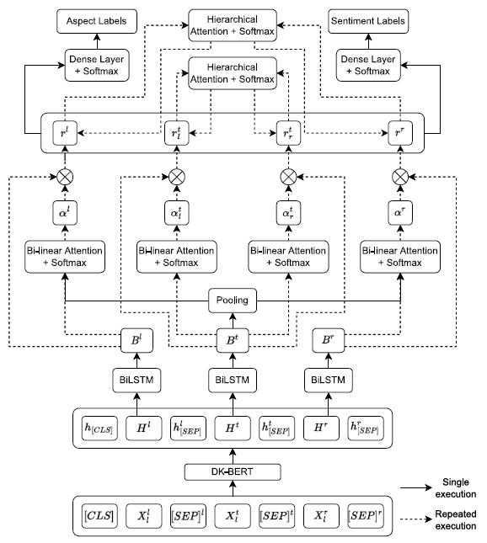
Joint Neural Network for ACD and ASC

Slide 17
Evaluation
Models:
CASC: original model
CASC+MAX: CASC model with maximum score labeler instead of average score labeler
CASC+MAX+ATE: CASC+MAX that performs also Aspect Term Extraction (ATE) and separates the sentence from the aspect term using [SEP]
LCR+CASC: our proposed model (CASC+MAX+ATE that replaces the two head linear layers with LCR-Rot-hop++ with two head linear layers)
LCR+CASC-DL: our proposed model without DL (LCR-Rot-hop++) [same as CASC+MAX+ATE]
LCR+CASC-CON: our proposed model without context representations (uses only the target representations)
LCR+CASC+ASYNC: our model with two separate DLs (LCR-Rot-hop++ modules)
[Model]+ATE (GOLD): models that use the gold aspect target annotations from test data (SemEval) [noisy labels for training are still generated using a labeler]

Slide 18
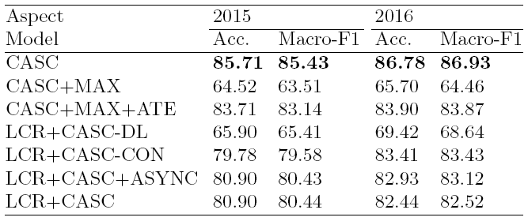
Aspect Category Detection
CASC is best
Our model
MAX labeler is worse than AVG labeler (need all aspect terms)
CASC+MAX+ATE is the second best
DL is useful
Context is useful on the small dataset
Asynchronous training did not make a big difference

Slide 19
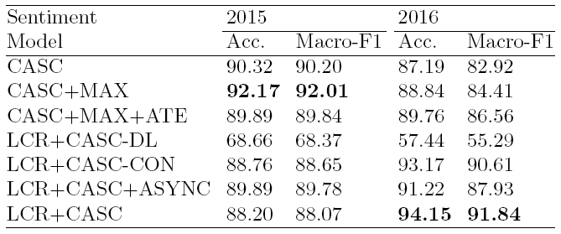
Aspect Sentiment Classification
CASC+MAX is best for 2015
Our model is best for 2016
MAX labeler is better than AVG labeler (strong sentiment terms)
CASC+MAX+ATE beats CASC for the large dataset
DL is useful
Context is useful on the large dataset
Asynchronous training is useful on the small dataset

Slide 20
Aspect Category Detection w/ Gold Labels
LCR+CASC+ASYNC+ATE (Gold) is in general the best
CASC performance drops from single to multiple aspects, while LCR+CASC does not (made for multiple aspects)
More stable results with MAX labeler
Context is useful
Asynchronous training is in general useful

Slide 21
Aspect Sentiment Classification w/ Gold Labels
LCR+CASC+ATE (Gold) is in general the best
Smaller decrease in performance from single to multiple aspects
MAX labeler is better for the large dataset
Context is useful
Asynchronous training is not useful

Slide 22
Evaluation
With ATE:
Our model suffers from the current ATE solution
DL is useful
Our model is better for ASC on the large dataset
With ATE (gold):
Our model is in general better for ACD and ASC
Our model excels when multiple aspects are present

Slide 23
Conclusion
Problem: lack of annotated data for ABSA
Existing solution: CASC weak supervision for ACD/ASC
Our solution: extend CASC with LCR-Rot-hop++ (DL)
Our model is better for ASC on the large dataset
Our ATE side solution performs subpar
Our solution works best if aspect targets are given
Our solution excels for multiple aspects
Accounting for the aspect target position matters
Context information is useful

Slide 24
Future Work
Experiment with other types of reviews:
Laptops
Hotels
Books
Consumer Electronics
Improve the noisy labels:
Use BERT attention mechanism to select potential-opinions that are related to potential-aspects
Improve ATE:
Use noun phrases as aspect targets instead of single words

Slide 25
Further Information
Dataset and code publicly available at: https://github.com/Gogonemnem/LCR-PLUS-CASC is written in Python
Feel free to try it out and improve our research
Questions about the code should be sent to Gonem Lau (gonemlau@gmail.com)

Slide 26
References
ABSA:
Kim Schouten and Flavius Frasincar: Survey on Aspect-Level Sentiment Analysis. IEEE Transactions on Knowledge and Data Engineering 28(3):813-830 (2016)
Wenxuan Zhang, Xin Li, Yang Deng, Lidong Bing, and Wai Lam: A Survey on Aspect-Based Sentiment Analysis: Tasks, Methods, and Challenges. IEEE Transactions Knowledge Data Engineering 35(11):11019-11038 (2023)

Slide 27
References
CASC:
Avinash Kumar, Pranjal Gupta, Raghunathan Balan, Lalita Bhanu Murthy Neti, and Aruna Malapati: BERT Based Semi-Supervised Hybrid Approach for Aspect and Sentiment Classification. Neural Processing Letters 53(6):4207-4224 (2021)
LCR-Rot-hop++:
Maria Mihaela Trusca, Daan Wassenberg, Flavius Frasincar, and Rommert Dekker: A Hybrid Approach for Aspect-Based Sentiment Analysis Using Deep Contextual Word Embeddings and Hierarchical Attention. 20th International Conference on Web Engineering (ICWE 2020). LNCS, Volume 12128, Springer, 365-380 (2020)

