Slide 1

A Hybrid Approach for Aspect-Based Sentiment Analysis Using
Deep Contextual Word Embeddings and Hierarchical Attention
Maria Trusca
Bucharest University of Economic Studies
maria.trusca@csie.ase.ro
Daan Wassenberg
Erasmus University Rotterdam
daan.wassenberg@hotmail.com
Flavius Frasincar
Erasmus University Rotterdam
fransincar@ese.eur.nl
Rommert Dekker
Erasmus University Rotterdam
rdekker@ese.eur.nl
Notes:
My name is Maria Trusca, I am Bucharest University of Economic Studies. The name of our work is “A Hybrid Approach for Aspect-Based Sentiment Analysis Using Deep Contextual Word Embeddings and Hierarchical Attention”. My colleagues are Daan Wassenberg, Flavius Frasincar and Rommert Dekker. They all are from Erasmus University Rotterdam

Slide 2
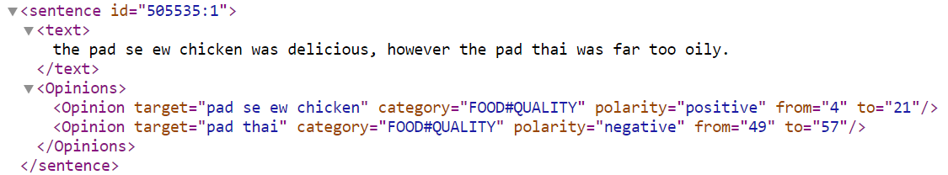
Aspect-based Sentiment Analysis (ABSA)
Aspect Category Detection: identifies the pair Entity#Aspect, e.g. Food#Quality;
Opinion Target Extraction: identifies the expression used in the text to describe the aspect, e.g. pad se ew chicken;
Sentiment Classification: finds the sentiment label of the pair Entity#Aspect.

Slide 3
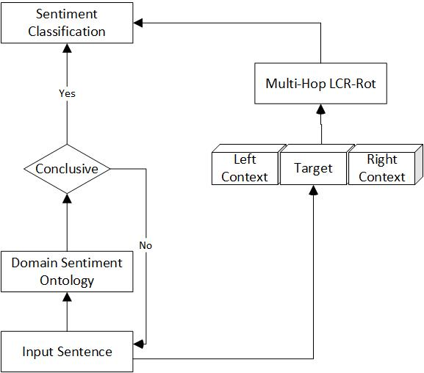
Two-step Approach
Domain Sentiment Ontology
Deep Neural Network

Slide 4
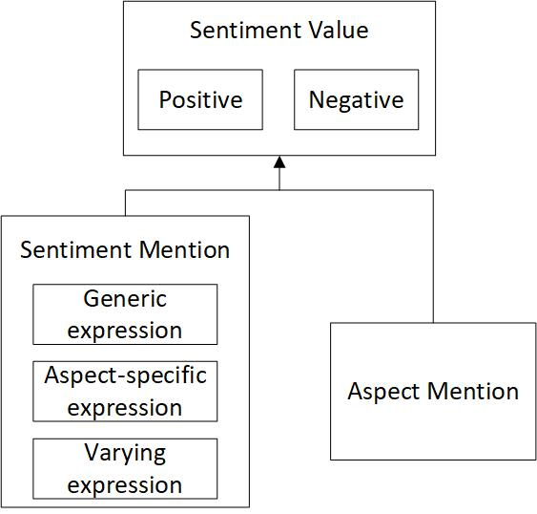
Domain Sentiment Ontology
The domain sentiment ontology has three main classes:
SentimentMention class represents sentiment expressions;
AspectMention class identifies aspects related to sentiment expressions;
SentimentValue class groups aspects in the Positive and Negative subclasses based on the type of sentiment expression.
  Generic sentiment expression
  Aspect-specific sentiment expression
  Varying sentiment expression

Slide 5
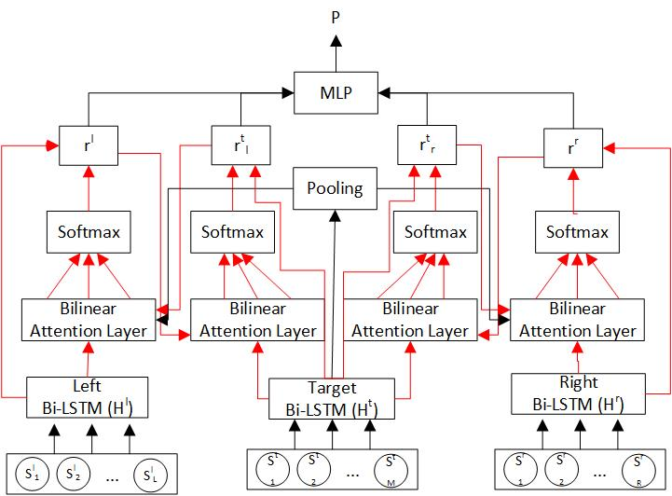
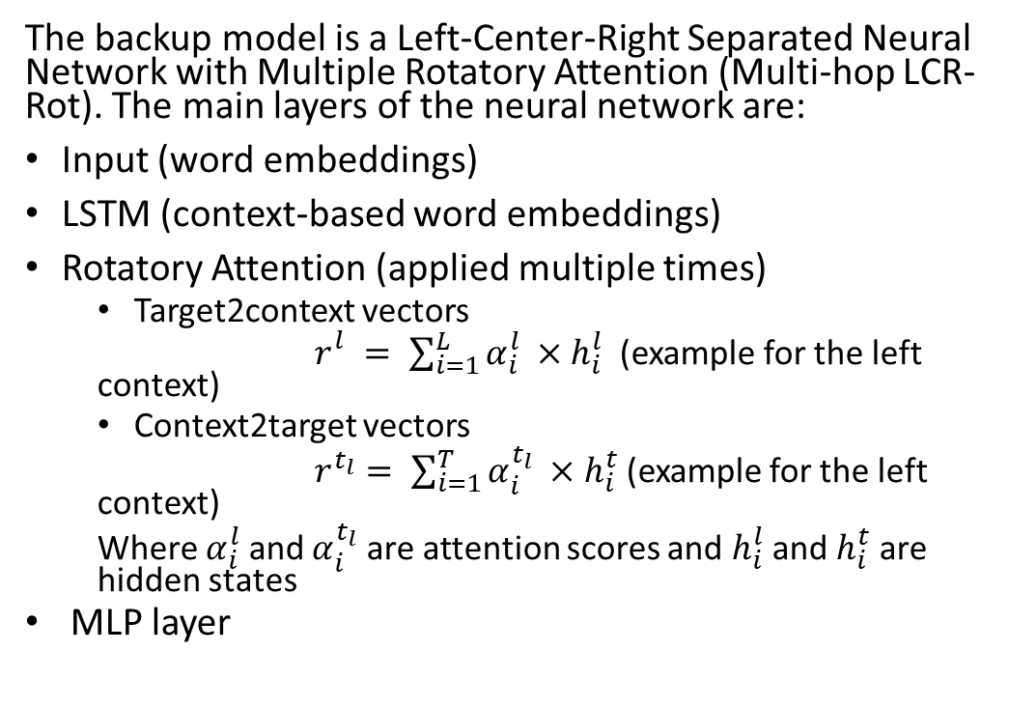
Deep Neural Network
The backup model is a Left-Center-Right Separated Neural Network with Multiple Rotatory Attention (Multi-hop LCR-Rot). The main layers of the neural network are:
Input (word embeddings)
LSTM (context-based word embeddings)
Rotatory Attention (applied multiple times)
  Target2context vectors
  $r_{}^{l}= \sum_{i=1}^{L}{α_{i}^{l}} ×h_{i}^{l}$ (example for the left context)
  Context2target vectors
  $r^{t_{l}}= \sum_{i=1}^{T}{α_{i}^{t_{l}}} ×h_{i}^{t}$ (example for the left context)
  Where $α_{i}^{l}$ and $α_{i}^{t_{l}}$ are attention scores and $h_{i}^{l}$ and $h_{i}^{t}$ are hidden states
  MLP layer

Slide 6
1st Extension: Word Embeddings
Context-independent word embeddings
GloVe (HAABSA): word embeddings based on word occurrences instead of language models.
CBOW (word2vec): word embeddings represent the weights of a neural network that maximize the likelihood that a word is predicted from a given context of words.
SG (word2vec): word embeddings represent the weights of a neural network that maximize the likelihood that a context of words is predicted from a given word.
FastText: a SG model where the word context is represented by its n-grams.
Context-dependent word embeddings
ELMo: word embeddings based on a linear combination of hidden states (LSTM)
BERT: word embeddings based on the hidden states associated with the Transformer blocks.

Slide 7
1st Extension: Word Embeddings
 | SemEval 2015 |  | SemEval 2016
 | In-sample | Out-of-sample | In-sample | Out-of-sample
Context-independent word embeddings GloVe (HAABSA) CBOW SG FastText
 | 88.0% | 80.3% | 89.6% | 86.4%
 | 84.8% | 74.6% | 82.7% | 83.5%
 | 84.7% | 76.0% | 85.4% | 84.1%
 | 87.4% | 79.0% | 87.3% | 86.5%
Context-dependent word embeddings ELMo BERT
 | 85.1% | 80.1% | 91.1% | 86.7%
 | 87.9% | 81.1% | 89.2% | 86.7%

Slide 8
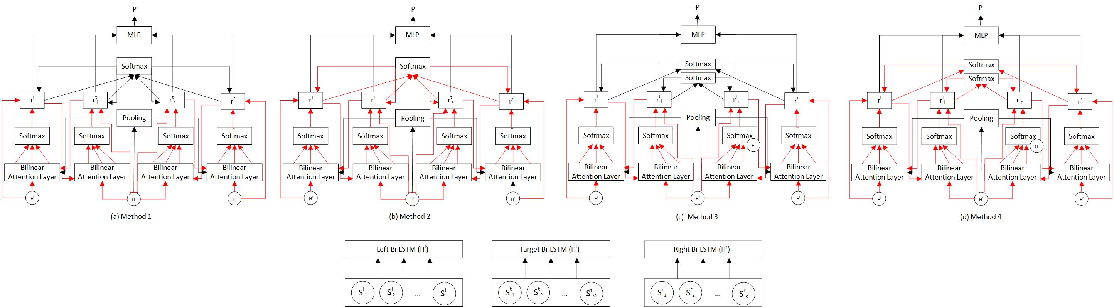
2nd Extension: Hierarchical Attention
Method 1: attention weighting is applied on the final four vectors of the rotatory attention;
Method 2: attention weighting is applied in each iteration of the rotatory attention, on the intermediate four vectors;
Method 3: attention weighting is separately applied on the final two context and target vectors pairs of the rotatory attention;
Method 4: attention weighting is separately applied in each iteration of the rotatory attention, on the intermediate context and target vectors pairs.

Slide 9
2nd Extension: Hierarchical Attention
 | SemEval 2015 |  | SemEval 2016
 | In-sample | Out-of-sample | In-sample | Out-of-sample
Multi-Hop LCR-Rot (HAABSA with BERT) | 87.9% | 81.1% | 89.2% | 86.7%
Method 1 | 87.9% | 81.5% | 88.0% | 87.1%
Method 2 | 87.9% | 81.7% | 88.7% | 86.7%
Method 3 | 87.8% | 81.3% | 88.7% | 86.7%
Method 4 | 88.0% | 81.7% | 88.9% | 87.0%

Slide 10
Comparison between our model and state-of-the-art models for the SC task
SemEval 2015 |  | SemEval 2016
HAABSA++ (Method 4) | 81.7% | XRCE (SW) | 88.1%
LSTM+SynATT+TarRep | 81.7% | HAABSA++ (Method 4) | 87.0%
PRET+MULT | 81.3% | BBLSTM-SL | 85.8%
BBLSTM-SL | 81.2% | PRET+MULT | 85.6%
Sentiue (SW) | 78.7% | LSTM+SynATT+TarRep | 84.6%

Slide 11
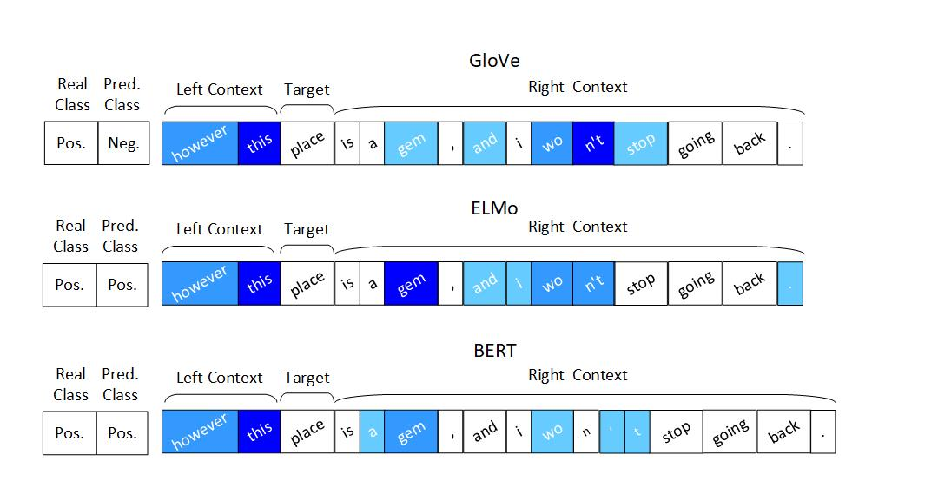
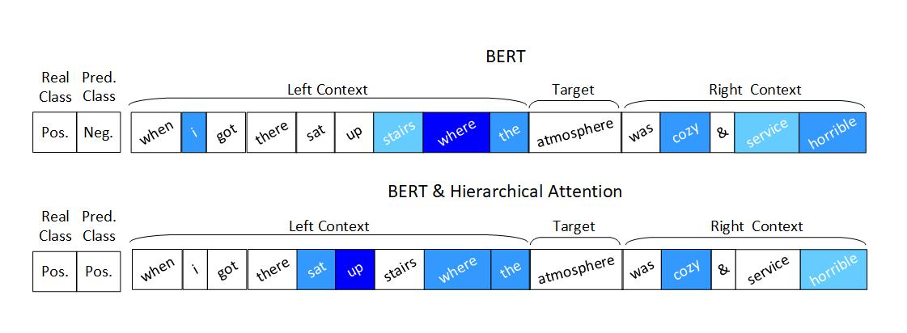
Case studies

Slide 12
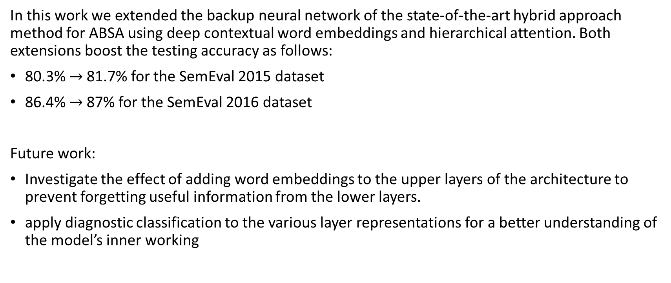
Conclusion and Future Work
In this work we extended the backup neural network of the state-of-the-art hybrid approach method for ABSA using deep contextual word embeddings and hierarchical attention. Both extensions boost the testing accuracy as follows:
80.3% $→$81.7% for the SemEval 2015 dataset
86.4% $→$87% for the SemEval 2016 dataset
Future work:
Investigate the effect of adding word embeddings to the upper layers of the architecture to prevent forgetting useful information from the lower layers.
apply diagnostic classification to the various layer representations for a better understanding of the model’s inner working

Slide 13


Thank you!
For questions, please send an email to maria.trusca@csie.ase.ro

