Slide 1
Knowledge Injection for Aspect-Based Sentiment Classification*
Flavius Frasincar
frasincar@ese.eur.nl
*Joint work with Romany Dekker, Danae Gielisse, Chaya Jaggan, and Sander Meijers

Slide 2
Contents
Motivation
Related Work
Data
Methodology
Evaluation
Conclusion
Future Work
Further Information
References

Slide 3
Motivation
Growing number of reviews:
In 2020: the number of reviews on Amazon around 250 million
Growing importance of reviews:
80% of the consumers read online reviews
75% of the consumers consider reviews important
Reading all reviews is time consuming, therefore the need for automation

Slide 4
Motivation
Sentiment mining is defined as the automatic assessment of the sentiment expressed in text (in our case by consumers in product reviews)
Several granularities of sentiment mining:
Document-level
Paragraph-level
Sentence-level
Aspect-level (product aspects are sometimes referred to as product features): Aspect-Based Sentiment Analysis (ABSA) firstly surveyed by Schouten and Frasincar (2016):
Document-level
Paragraph-level
Sentence-level [our focus here]

Slide 5
Motivation
ABSA has two stages:
Aspect Detection (AD): finding aspects in product reviews recently surveyed by Trusca and Frasincar (2023)
Explicit aspect detection: aspects appear literally in product reviews [our focus here]
Implicit aspect detection: aspects do not appear literally in the product reviews
Aspect-Based Sentiment Classification (ABSC): assigning the sentiment associated to explicit or implicit aspects recently surveyed by Brauwers and Frasincar (2023) [our focus here]
Three approaches for ABSA:
Knowledge Representation (KR)
Machine Learning (ML)
Hybrid: current state-of-the-art, e.g., A Hybrid Approach for Aspect-Based Sentiment Analysis++ (HAABSA++) proposed by Trusca, Wassenberg, Frasincar, and Dekker (2020)

Slide 6
Motivation
HAABSA++ is a two-step approach for ABSA at sentence-level:
Ontology-based reasoning
Deep learning (backup solution): LCR-Rot-hop++
We already have a domain sentiment ontology
There is work on injecting knowledge from a Knowledge Graph (KG) in sentences for better language representation
Research question: How to inject knowledge from a domain sentiment ontology in a neural network for improving ABSC at sentence-level?

Slide 7
Related Work
K-BERT proposed by Liu et al. (2020):
Extension of BERT by injecting knowledge from KG in sentences before computing BERT word embeddings
Injects triples from KG in the input sentences
In order to mitigate semantic loss knowledge inserted only in test sentences
K-BERT has been used by other approaches:
Semantic Knowledge Graph (SKG): for ABSC
Semantic Analysis Knowledge Graph (SAKG): for sentiment analysis and sentence completion

Slide 8
Related Work
Our approach:
Complex model for ABSC: LCR-Rot-hop++ (instead of simple neural models)
Use of a domain sentiment ontology (instead of generic knowledge graphs)
Use lexical representations of concepts and their subconcepts when injecting knowledge (instead of triples) [avoid semantic loss due to the semantic gap provided by domain relationships]
Use multiple-hops for traversing the domain sentiment ontology when injecting knowledge (instead of triples)
As K-BERT we inject knowledge at test time only [avoid semantic loss]

Slide 9
Data
ABSC:
SemEval 2015, Task 12, Subtask 1, Slot 3 for restaurant reviews
SemEval 2016, Task 5, Subtask 1, Slot 3 for restaurant reviews
3-point sentiment scale: positive, neutral, and negative
Each sentence contains one or more opinions (instances)
SemEval:
SemEval 2015:
Training instances:1278
Test instances: 597
SemEval 2016:
Training instances: 1880
Test instances: 650

Slide 10
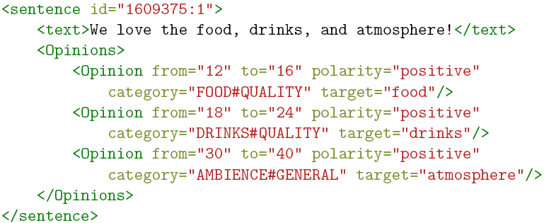
Data
ABSC Example:

Slide 11
Data
SemEval Descriptive Statistics:
SemEval 2015 dataset is smaller than SemEval 2016 dataset
Neutral is the minority class
Positive is the majority class
Sentiment distribution in training and test sets are similar
 | Training Data |  |  | Test Data
 | Positive | Neutral | Negative | Positive | Neutral | Negative
SemEval 2015 | 75.3% | 2.8% | 21.9% | 59.1% | 6.1% | 34.8%
SemEval 2016 | 70.2% | 3.8% | 26.0% | 74.3% | 4.9% | 20.8%

Slide 12
Methodology
ABSC: LCR-Rot-hop++
LCR-Rot-hop++:
BERT contextual word embeddings
Three Bi-LSTMs (left context, aspect target, right context)
Two iterative steps using bilinear attention:
Target2Context: uses the target representation (initially pooled) to obtain target-dependent left/right context representations (two vectors)
Context2Target: uses the left/right context representations to obtain left/right context-dependent target representations (two vectors)
Hierarchical attention (part of the previous two iterative steps):
After Target2Context: apply attention to the obtained two vectors
After Context2Target: apply attention to the obtained two vectors
Repeat the two iterative steps a number of hops (e.g., 3)

Slide 13
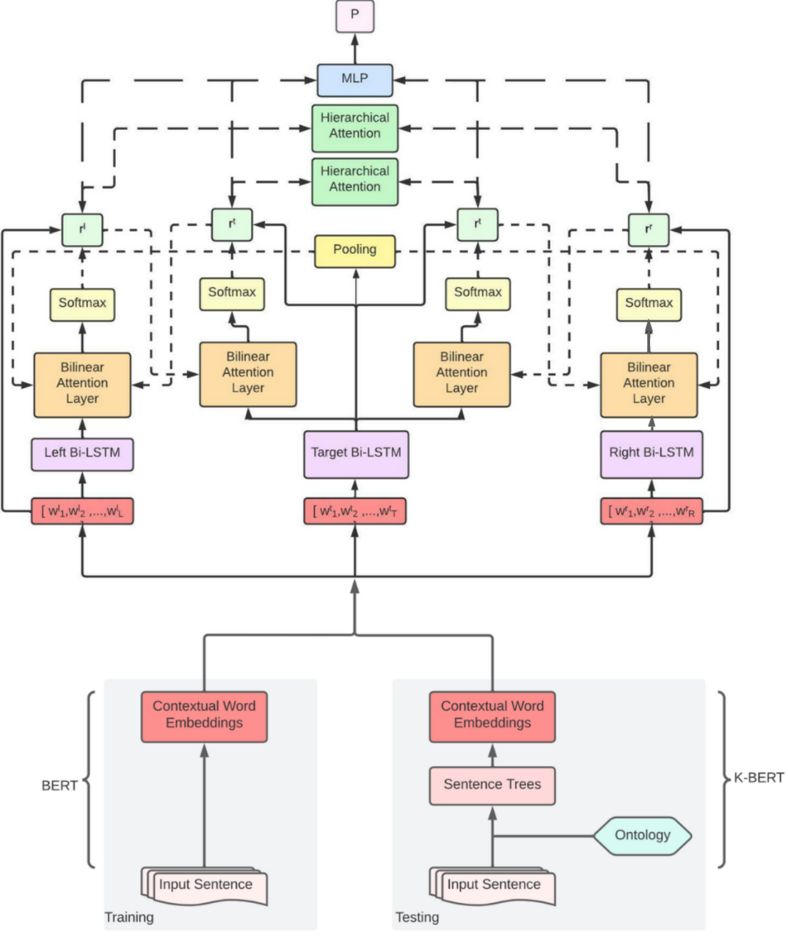
Methodology
LCR-Rot-hop-ont++:

Slide 14
Methodology
Knowledge Injection:
K-Query:
We look for sentence words that appear as lexical representations of concepts in the ontology
Starting with these concepts we navigate $k$-hops ($k$ subClassOf relationships, $k≥0$) in the domain sentiment ontology and retain all concepts on these paths
0-hop: we collect only the synonyms of the sentence words as given by the domain sentiment ontology
K-Inject:
We insert the lexical representations of the encountered concepts from K-Query in the sentence after each sentence word that was matched to a concept from the domain sentiment ontology
We keep the ontology structure in the sentence resulting in a sentence tree

Slide 15
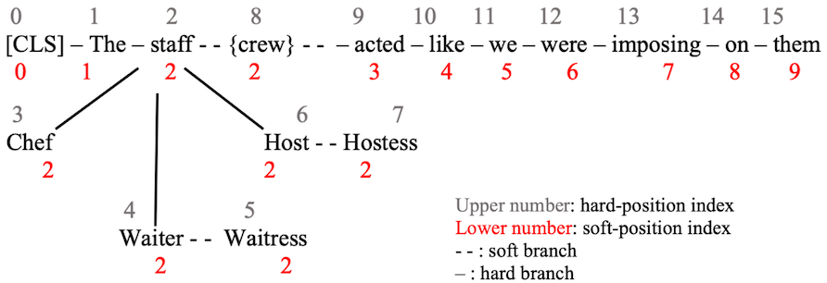
Methodology
Sentence Tree Example:
0-hops: “staff”-”crew”, “Waiter”-”Waitress”, “Host”-”Hostess”
1-hops: “staff”-”Chef”, “staff”-”Waiter”, “staff”-”Host”
Branches:
Hard: use the ontology structure (subClassOf)
Soft: use the ontology synonyms (alternative lexical representations)

Slide 16
Methodology
Hard position: physical position of a word in a sentence
Knowledge Noise (KN): knowledge inserted from the domain sentiment ontology that changes the semantics of the original sentence
Two techniques to mitigate KN:
Soft Positioning (SP): gives the same position to all inserted words as the original word (the original words keep their original positions)
Visibility Matrix (VM): makes sure that in the BERT Multi-Head Attention each word is able to see only the words from the same branch (limits the effect of “noise” words inserted from the domain sentiment ontology)

Slide 17
Methodology
Visibility Matrix:
$$M_{ij}=\left\{\begin{aligned}0 if w_{i}⊕w_{j} \\ −∞ if{ w}_{i}⊗w_{j}\end{aligned}\right.$$
where:
$⊕$: words are in the same branch (visible to each other)
⊗: words are not in the same branch (not visible to each other)
$i$ and $j$ are hard position indexes
Visibility Rules:
Synonyms are only visible to words that they originate from (in sentence or domain sentiment ontology)
Words on a hard branch are able to see each other but are not able to see words from other hard branches

Slide 18
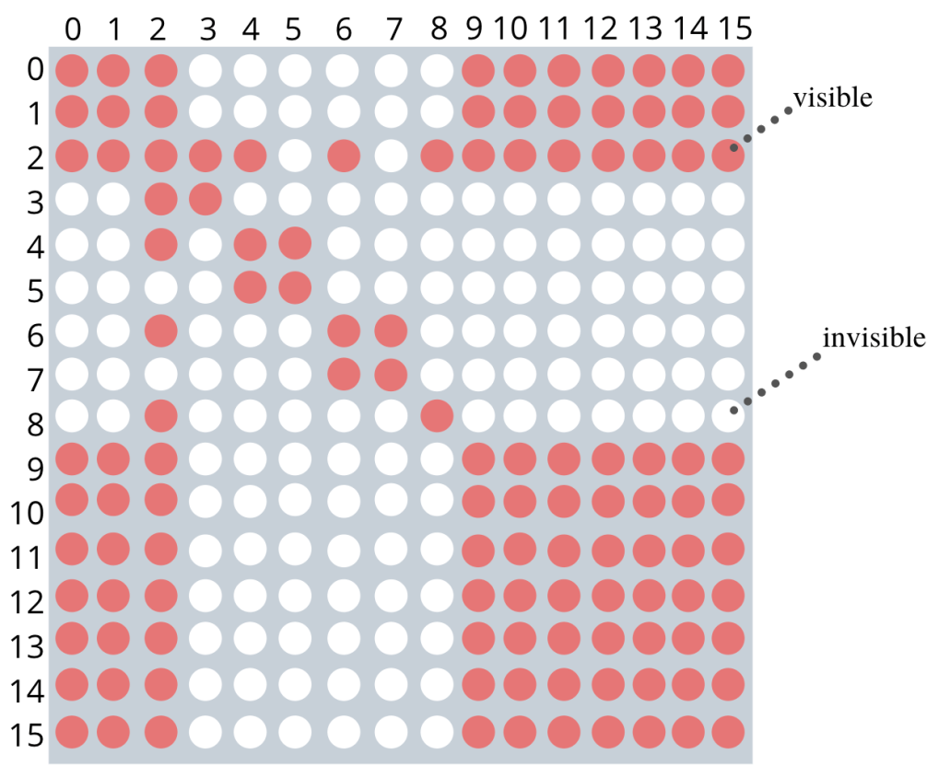
Methodology
Word “stuff” that has hard position 2 can see all words besides words with hard positions 5 (“Waitress”) and 7 (“Hostess”):
Sees all original sentence words
Sees all related words from the domain sentiment ontology: “Chef”, “Waiter”, and “Host”
Sees the synonym words from the domain sentiment ontology “crew”
Does not see related words from the domain sentiment ontology synonyms: “Waitress” and “Hostess”

Slide 19
Methodology
We use the BERT Base encoder:
12 transformer blocks
768 hidden layer size
12 self-attention heads
Each transformer block has two layers:
Multi-Head Attention (MHA) layer
FeedForward Network (FFN) layer
Multi-Head Attention uses Self-Attention
Input is $h^{0}=sum(E_{t}, E_{s}, E_{seg})$ where
$E_{t}$ is the embedding of the token
$E_{s}$ is the embedding of the soft-position
$E_{seg}$ is the embedding of the segment (sentence)
Output is the sum of the outputs of the last four transformer blocks

Slide 20
Methodology
To simplify the notation, we abstract the Multi-Head Attention and Feedforward Network
Masked Self-Attention:
$$Q^{i+1},K^{i+1},V^{i+1}=h^{i}W_{q},h^{i}W_{k},h^{i}W_{v}$$
$$S^{i+1}=softmax\left(\frac{Q^{i+1}K^{i+1}+M}{\sqrt{d_{k}}}\right)$$
$$h^{i+1}=S^{i+1}V^{i+1}$$
where
$Q$, $K$, and $V$ are matrices of queries, keys, and values
$h^{i}$ and$h^{i+1}$ are the input and output
$d_{k}$ is the dimensions of keys ($768{dimensions}/{12 heads}=64 dimensions$)
If words $k$ and $j$ are not on the same branch $M_{kj}=−∞⇒S_{kj}^{i+1}=0$ (word $w_{j}$ does not make a contribution to word $w_{k}$, i.e., word $w_{j}$ is not visible to word $w_{k}$)

Slide 21
Evaluation
Both Soft Positioning and Visibility Matrix have been shown by K-BERT to be useful by means of an ablation experiment
Conservative approach towards semantic loss:
Use only $0$-hops (synonyms)
Use knowledge injection only at test time
Use accuracy as evaluation measure as the most commonly used performance measure for this task
We use:
SemEval 2015: small dataset
SemEval 2016: large dataset

Slide 22
Evaluation
 | SemEval 2015 | SemEval 2016
LCR-Rot-hop-ont++ | 81.9% | 86.9%
HAABSA++ | 81.7% | 87.0%
LCR-Rot-hop++ | 81.1% | 86.7%

Slide 23
Evaluation
 | SemEval 2015 | SemEval 2016
LCR-Rot-hop-ont++ | 81.9% | 86.9%
HAABSA++ | 81.7% | 87.0%
LCR-Rot-hop++ | 81.1% | 86.7%
SemEval 2015 best model: LCR-Rot-hop-ont++: (0.2 percentage points better than HAABSA++ and 0.8 percentage points better than LCR-Rot-hop++)
The proposed knowledge injection model boosts the performance of the neural network and even beats the hybrid two-step model for the small dataset!

Slide 24
Evaluation
 | SemEval 2015 | SemEval 2016
LCR-Rot-hop-ont++ | 81.9% | 86.9%
HAABSA++ | 81.7% | 87.0%
LCR-Rot-hop++ | 81.1% | 86.7%
SemEval 2016: LCR-Rot-hop-ont+ is 0.1 percentage points worse than HAABSA++ and 0.2 percentage points better than LCR-Rot-hop++
The proposed knowledge injection model boosts the performance of the neural network but does not beat the hybrid two-step model for the large dataset!

Slide 25
Evaluation
Compared to LCR-Rot-hop++ (the neural network of HAABSA++) our proposed model LCR-Rot-hop-ont++ gives better results on both SemEval 2015 and SemEval 2016
Compared to HAABSA++ (the hybrid two-step approach) our proposed model LCR-Rot-hop-ont++ (the hybrid one-step approach) gives better results on SemEval 2015 but worse results on SemEval 2016
Knowledge injection works for both datasets but the hybrid one-step approach is better only for smaller datasets:
For smaller datasets probably the detection of useful patterns is more difficult so knowledge injection by providing more context helps finding more useful patterns (than the ontology alone)

Slide 26
Conclusion
We proposed the LCR-Rot-hop-ont++ model for ABSC
The model is based on K-BERT for knowledge injection
Differently than K-BERT which uses a generic knowledge graphs we use a domain sentiment ontology
As K-BERT to combat knowledge noise we make use of:
Soft Positioning
Visibility Matrix
Differently than K-BERT we use $k$-hops for navigating the domain ontology to knowledge injection
For small datasets our approach works better than the original hybrid two-step approach

Slide 27
Future Work
Experiment with other types of reviews: Laptops, Hotels, Books, and Consumer Electronics
Explore $k$-hops ($k≥1$) for knowledge injection
Experiment with different amounts of knowledge injection, e.g., 20%, 40%, 60%, and 80%
Analyze characteristics of sentences that benefit the most from knowledge injection:
Shorter sentences could benefit the most from knowledge injection by making use of additional context information
Experiment with knowledge injection:
Training time
Training and test times

Slide 28
Further Information
Dataset and code publicly available at: https://github.com/DanaeGielisse/LCR-Rot-hop-ont-plus-plus
Code is written in Python
Feel free to try it out and improve our research

Slide 29
References
ABSA:
Kim Schouten and Flavius Frasincar: Survey on Aspect-Level Sentiment Analysis. IEEE Transactions on Knowledge and Data Engineering 28(3):813-830 (2016)
AD:
Maria Mihaela Trusca and Flavius Frasincar: Survey on Aspect Detection for Aspect-Based Sentiment Analysis. Artificial Intelligence Review 56(5):3797-3846 (2023)
ABSC:
Gianni Brauwers and Flavius Frasincar: A Survey on Aspect-Based Sentiment Classification. ACM Computing Surveys 55(4):65:1-65:37 (2023)

Slide 30
References
HAABSA++:
Maria Mihaela Trusca, Daan Wassenberg, Flavius Frasincar, and Rommert Dekker: A Hybrid Approach for Aspect-Based Sentiment Analysis Using Deep Contextual Word Embeddings and Hierarchical Attention. 20th International Conference on Web Engineering (ICWE 2020). LNCS, Volume 12128, Springer, 365-380 (2020)
K-BERT:
Weijie Liu, Peng Zhou, Zhe Zhao, Zhiruo Wang, Qi Ju, Haotang Deng, Ping Wang: K-BERT: Enabling Language Representation with Knowledge Graph. Thirty-Fourth AAAI Conference on Artificial Intelligence (AAAI 2020). AAAI, 2901-2908

