Slide 1
An LSH-Based Model Words-Driven Product Duplicate Detection Method
Flavius Frasincar*
frasincar@ese.eur.nl
* Joint work with Aron Hartveld, Max van Keulen, Diederik Mathol, Thomas van Noort, Thomas Plaatsman, and Kim Schouten

Slide 2
Contents
Motivation
Related Work
Multi-component Similarity Method with Preselection+ (MSMP+)
  Overview
  Model Words
  Min-hashing
  Locality-Sensitive Hashing (LSH)
Multi-component Similarity Method (MSM)
Example
Evaluation
Conclusion
Future Work

Slide 3
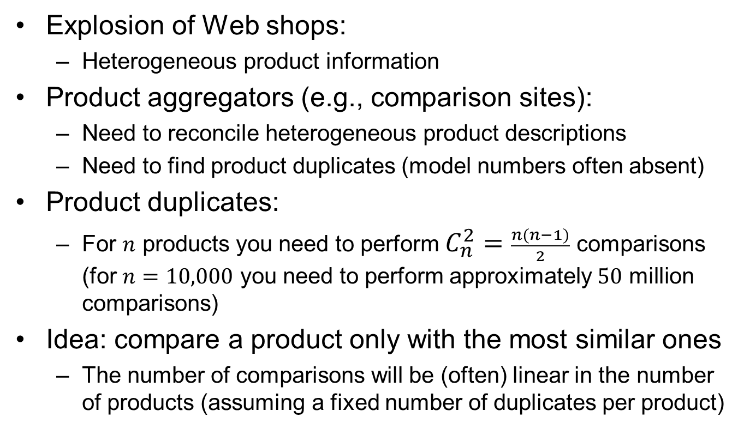
Motivation
Explosion of Web shops:
  Heterogeneous product information
Product aggregators (e.g., comparison sites):
  Need to reconcile heterogeneous product descriptions
  Need to find product duplicates (model numbers often absent)
Product duplicates:
  For $n$ products you need to perform $C_{n}^{2}=\frac{n(n−1)}{2}$ comparisons (for $n=10,000$ you need to perform approximately $50$ million comparisons)
Idea: compare a product only with the most similar ones
  The number of comparisons will be (often) linear in the number of products (assuming a fixed number of duplicates per product)

Slide 4
Motivation
Example (for one product):
  Header:
    ‘shop’: ‘newegg.com’
    ‘title’: ‘Sharp 70\" 1080p 120Hz LED-LCD HDTV - LC70LE650U’
    ‘modelID’: ‘LC70LE650U’ {available only for evaluation}
  Key-Value Pairs (KVP):
    ‘brand’: ‘Sharp’
    ‘maximum resolution’: ‘1920 x 1080’
    ‘refresh rate’: ‘120 Hz’
    ‘screen size’: ‘70’
    ‘aspect ratio’: ‘16:9’
    ‘USB’: ‘2’
    ‘energy star compliant’: ‘Yes’
    etc.

Slide 5
Related Work
Highly Heterogeneous Information Spaces (HHIS):
  Non-structured data
  High level of noise
  Large scale
Entity Resolution (ER):
  Dirty ER: single collection
  Clean-Clean ER: two clean (duplicate-free) collections [our focus]
Blocking = clustering of entities that need to be compared for duplicate detection (one block represents one cluster)
  Token (schema-agnostic): one block per token [our focus]
  Attribute Clustering (schema-aware): cluster attributes by value similarity (k clusters per token)
  Scheduling: rank blocks by utility (many duplicates, few comparisons blocks are first)
  {Reduce size of blocks}

Slide 6
Multi-component Similarity Method with Preselection+ Overview
Data Cleaning
Products
MSMP+
Cleaned Data
Extract Model Words from Titles and Key-Value Pairs
Extract Model Words from
Binary Product Vectors
Create Signature Matrix with Min-hashing
(MSMP+ computes more efficiently
the Signature Matrix)
MSMP
Signature Matrix
(SAC 2016)
Apply Locality-Sensitive Hashing to Signature Matrix
Nearest Neighbors
Apply Multi-component Similarity Method
Duplicate Products

Slide 7
Data Cleaning
All different representations of the units of measurement are transformed into one, e.g.,
All upper-case letters are replaced by lower-case letters
All spaces and non-alphanumeric tokens in front of the units are removed
E.g., “23 Inch” becomes “23inch”
Future work: convert between units of measurements
Original unit | Normalized unit
‘Inch’, ‘inches’, ‘"’, ‘-inch’, ‘ inch’, ‘inch’ | ‘inch’
‘Hertz’, ‘hertz’, ‘Hz’, ‘HZ’, ‘ hz’, ‘-hz’, ‘hz’ | ‘hz’

Slide 8
Model Words in MSMP
For every product extract the model words present in title (title contains descriptive and distinctive information)
A model word is a string that contains both integers as well as alphabetic or special characters
Model word regular expression:
  [a-zA-Z0-9]*(([0-9]+[^0-9, ]+) | ([^0-9, ]+[0-9]+))[a-zA-Z0-9]*
Examples of model words:
  32”, 720p, 60Hz

Slide 9
Model Words in MSMP+
Model Words from MSMP (look in title)
Two extensions:
  Look for model words from MSMP in values in key-values pairs
  Relax the definition of model words and look for these in key-value pairs
Relaxation of model words definition: model words start with a decimal number and have an optional alphabetic or special characters part:
\d+(\.\d+)?[a-zA-Z]+ | \d+(\.\d+)?
Examples of new model words:
  32”, 720, 60.1

Slide 10
Model Words in MSMP+
For normalization, the non-numeric part of model words in key-value pairs is deleted (values are less uniformly defined as titles), i.e., we have only numeric data
Every product is represented as a binary vector indicating the presence/absence of model words (we obtain the so-called characteristic matrix)

Slide 11
Min-hashing
n is the number of min-hashes (a permutation and a “hash” function)
P is the set of all product vectors
S is an empty signature matrix of size (n,|P|)
for all i = 1 to n do
for all v in P do
Determine for product v under permutation i the
number of the row containing the first 1 (x)
S(i,v) = x
end for
end for
Jaccard similarity between two products is the same as the probability that minhashes (one row in signature matrix) have the same value
Addresses the curse of dimensionality: smaller and denser vectors (n)!

Slide 12
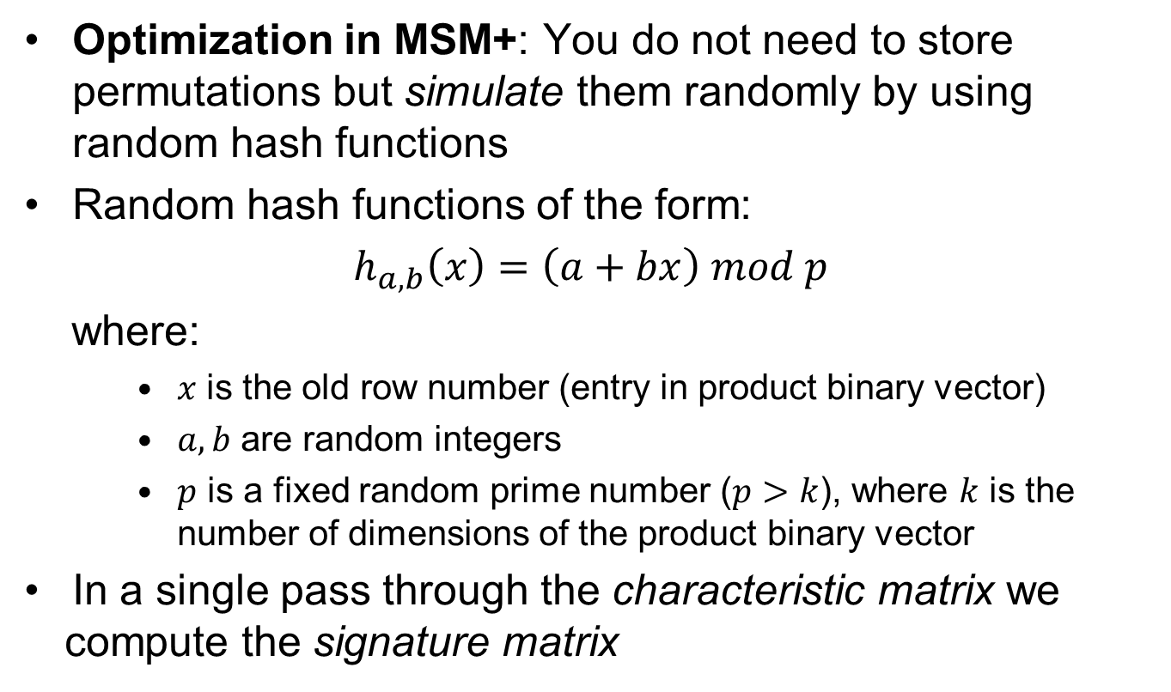
Min-hashing
Optimization in MSM+: You do not need to store permutations but simulate them randomly by using random hash functions
Random hash functions of the form:
$h_{a,b}\left(x\right)=\left(a+bx\right) mod p$
where:
    $x$ is the old row number (entry in product binary vector)
    $a,b$ are random integers
    $p$ is a fixed random prime number ($p>k$), where $k$ is the number of dimensions of the product binary vector
In a single pass through the characteristic matrix we compute the signature matrix

Slide 13
Locality-Sensitive Hashing
P is the set of all product vectors
Divide the signature matrix S into b bands, each containing r rows
for all b bands do
for all v in P do
Hash v to a bucket based on the value of the hash function
end for
end for
for all buckets do
Label all pairs of products in this bucket as candidate neighbors
end for
Consider as possible duplicates only products in the same bucket!
Note that a product can appear in multiple buckets
Pairs previously marked as candidate neighbors are not reconsidered

Slide 14
Locality-Sensitive Hashing
The number of bands and rows: allows us to control for the desired Jaccard similarity!
Set of hash functions (one per band): We use as hash function (same for all bands) the number obtained by concatenating the row values corresponding to a band
Example:
2
3
5
8
band 1
(4 rows)
2358
5
3
1
2
band 2
(4 rows)
5312

Slide 15
Locality-Sensitive Hashing
Two products are considered candidate neighbors if they are in the same bucket for at least one of the bands
Let t denote threshold above which the Jaccard similarity of two products determines them to be candidate neighbors
Pick number of bands b and number of rows per band r such that:
Tradeoff b and r is the tradeoff between false positives (FP) and false negatives (FN)
  b x r = n (1) [the size n of signature vectors is given]
  (1/b)^{(1/r)} = t (2) [ensure a small FP and FN for a given t]

Slide 16
Multi-component Similarity Method
Hybrid similarity function as weighted similarity of three components:
  Key-Value Pairs (KVP) component (for matching keys)
  Value component (for non-matching keys)
  Title similarity
Adapted single linkage hierarchical clustering
(one similarity stop condition parameter ε)
The adaptation comes from three heuristics:
  Products from the same Web shop have similarity 0
  Products from different brands have similarity 0
  Products not marked as candidate neighbors (LSH) have similarity 0
  and the similarity between two clusters with, respectively, two products of similarity 0, is 0

Slide 17
Example
5 products:
2 duplicates: (2,3) and (4,5)
Product ID | Title | Web shop
1 | SuperSonic 32" 720p LED HDTV SC-3211 | Newegg
2 | Samsung UN46ES6580 46-Inch 1080p 120Hz 3D HDTV | Amazon
3 | Samsung 46" 1080p 240Hz LED HDTV UN46ES6580 | Newegg
4 | Toshiba - 32" / LED / 720p / 60Hz / HDTV | Bestbuy
5 | Toshiba 32" 720p 60Hz LED-LCD HDTV 32SL410U | Newegg

Slide 18
Example
10 model words:
 |  |  | Product ID
Model word |  | 1 | 2 | 3 | 4 | 5
720p | 1 | 1 | 0 | 0 | 1 | 1
1080p | 2 | 0 | 1 | 1 | 0 | 0
60hz | 3 | 0 | 0 | 0 | 1 | 1
120hz | 4 | 0 | 1 | 0 | 0 | 0
240hz | 5 | 0 | 0 | 1 | 0 | 0
3d | 6 | 0 | 1 | 0 | 0 | 0
sc-3211 | 7 | 1 | 0 | 0 | 0 | 0
un46es6580 | 8 | 0 | 1 | 1 | 0 | 0
46-inch | 9 | 0 | 1 | 0 | 0 | 0
32l410u | 10 | 0 | 0 | 0 | 0 | 1

Slide 19
Example
n = 4, we need 4 permutations:
p1 | = | [1, 6, 2, 9, 3, 10, 8, 4, 5, 7]
p2 | = | [6, 1, 5, 9, 10, 3, 7, 2, 8, 4]
p3 | = | [5, 7, 8, 3, 6, 1, 2, 10, 4, 9]
p4 | = | [2, 7, 4, 3, 9, 8, 10, 5, 6, 1]
 |  | Product ID
Permutation | 1 | 2 | 3 | 4 | 5
p1 | 1 | 2 | 3 | 1 | 1
p2 | 2 | 1 | 3 | 2 | 2
p3 | 2 | 3 | 1 | 4 | 4
p4 | 2 | 1 | 1 | 4 | 4

Slide 20
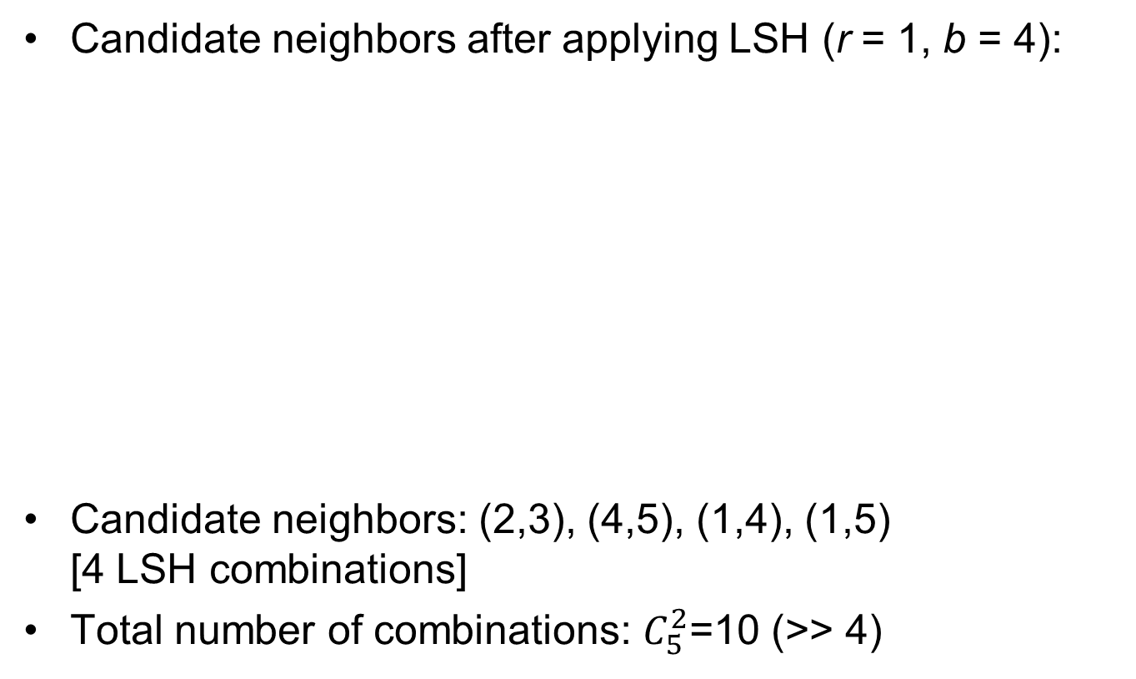
Example
Candidate neighbors after applying LSH (r = 1, b = 4):
Candidate neighbors: (2,3), (4,5), (1,4), (1,5)
[4 LSH combinations]
Total number of combinations: $C_{5}^{2}$=10 (>> 4)
 |  | Product ID
Product ID | 1 | 2 | 3 | 4 | 5
1 | 0 | 0 | 0 | 1 | 1
2 |  | 0 | 1 | 0 | 0
3 |  |  | 0 | 0 | 0
4 |  |  |  | 0 | 1
5 |  |  |  |  | 0

Slide 21
Evaluation
Data set with 1624 TVs obtained from 4 webshops:
  Amazon.com: 163 TVs
  Newegg.com: 668 TVs
  BestBuy.com: 773 TVs
  TheNerds.net: 20 TVs
Duplicate clusters (golden standard):
  Number of clusters of size 1: 933 (933 unique products)
  Number of clusters of size 2: 300
  Number of clusters of size 3: 25
  Number of clusters of size 4: 4
Data set contains model numbers to define golden standard
On average a product has 29 Key-Value pairs

Slide 22
Evaluation
n = 50% of product vector length
Two types of evaluation:
  Quality of the blocking procedure
  MSMP+ vs. MSMP vs. MSM
Evaluation procedure:
    Bootstraps:
      60-65% of the data
      Around 1000 products
      Parameters learned for one bootstrap and results reported for the remaining products
    100 bootstraps
    Performance: average among bootstraps

Slide 23
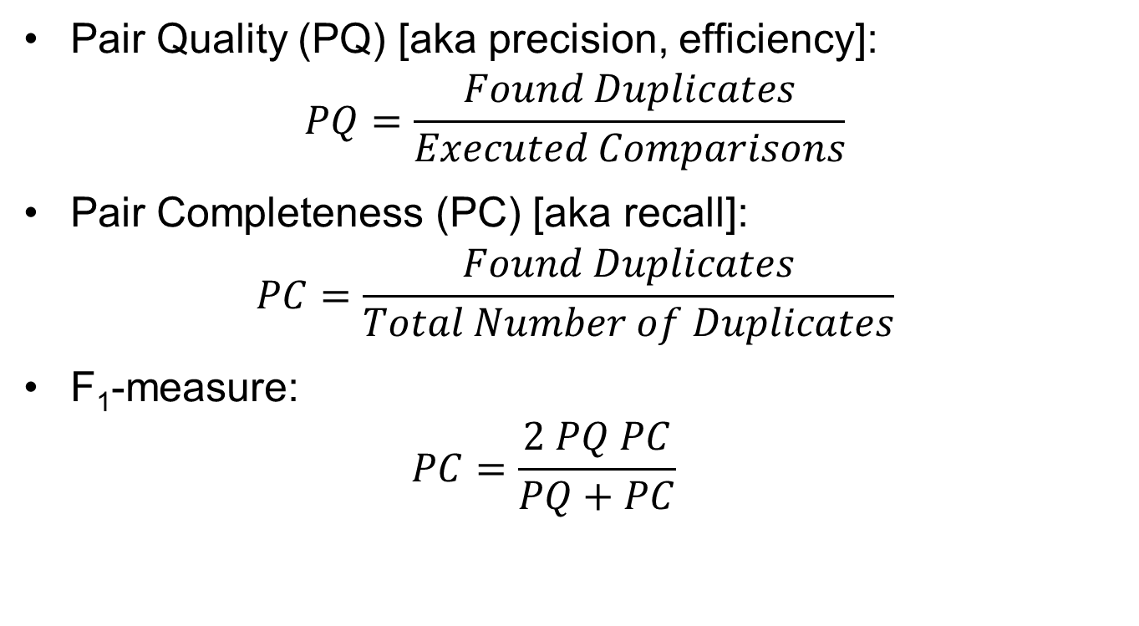
Blocking Quality
Pair Quality (PQ) [aka precision, efficiency]:
$$PQ=\frac{Found Duplicates}{Executed Comparisons}$$
Pair Completeness (PC) [aka recall]:
$$PC=\frac{Found Duplicates}{Total Number of Duplicates}$$
F₁-measure:
  $$PC=\frac{2 PQ PC}{PQ+PC}$$

Slide 24

Blocking Quality
Change threshold t from 0 to 1 with a step of 0.05:
  Changes the fraction of comparisons
Fraction of comparisons or computed pairs ratio (CPR):
$$CPR=\frac{Executed Comparisons}{Total Number of Comparisons}$$

Slide 25
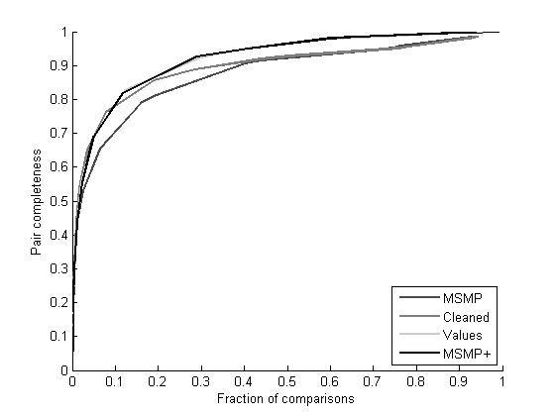
Pair Completeness vs. Fraction of Comparisons
MSMP = old preselection
Cleaned = + data cleaning
Values = + old model words in values
MSMP+= + new model words in values
By performing 10% of the pairwise comparisons MSMP+ achieves a PC of 80%, while MSMP has a PC of 70%
AUC of MSMP+ is 12.2% greater than the AUC of MSMP
High threshold t
Low threshold t

Slide 26
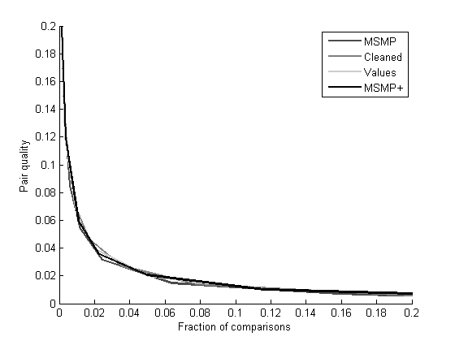
Pair Quality vs. Fraction of Comparisons
MSMP = old preselection
Cleaned = + data cleaning
Values = + old model words in values
MSMP+= + new model words in values
AUC of MSMP+ is 9.2% greater than the AUC of MSMP
High threshold t
Low threshold t

Slide 27
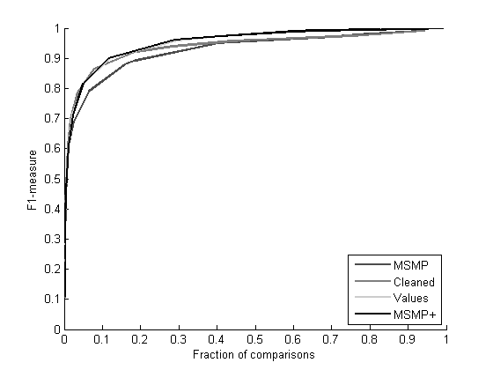
F₁ vs. Fraction of Comparisons
MSMP = old preselection
Cleaned = + data cleaning
Values = + old model words in values
MSMP+= + new model words in values
As in the PC figure, cleaning improves MSMP for lower threshold values and considering values improves MSMP for higher thresholds
AUC of MSMP+ is 9.3% greater than the AUC of MSMP
High threshold t
Low threshold t

Slide 28
MSMP+ vs. MSMP vs. MSM
5 MSM parameters:
  α,β [title similarity],
  γ [KVP similarity],
  μ [hybrid similarity],
  ε [hierarchical clustering]
  optimized using grid search using the Lisa computer
  cluster at SURFSara for each threshold t and each bootstrap
TP = pairs of items correctly found as duplicates
TN = pairs of items correctly found as non-duplicates
FP = pairs of items incorrectly found as duplicates
FN = pairs of items incorrectly found as non-duplicates

Slide 29
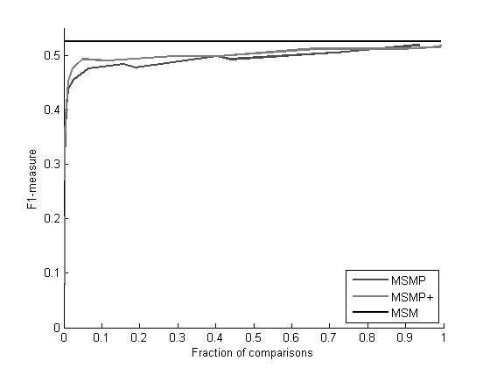
MSMP vs. MSM
The fraction of comparisons for MSM is always 1, as it performs all comparisons; MSM has an F₁ of 0.525
Performing 5% of the comparisons MSMP+ achieves an F₁ of 0.49, and MSMP gets an F₁ of 0.46
AUC of MSMP+ is 7.8% greater than the AUC of MSMP
High threshold t
Low threshold t

Slide 30
Conclusion
Applying LSH reduces the number of comparisons for duplicate detection by considering only candidate neighbors
Two main extensions:
  Data cleaning
  (Adapted) Model words extraction from titles and key-value pairs
AUC for MSMP+ is 12.2%, 9.2%, and 9.3% greater for PC, PQ, and F₁, respectively, than AUC for MSP
Performing 5% of the comparisons MSMP+ results only 6.7% decrease in F₁-measure compared to MSMP, and 12.4% decrease in F₁-measure compared to the state-of-the-art duplicate detection method MSM

Slide 31
Future Work
Data conversion for different units of measurement
Exploit additional token-based blocking schemes:
  words (from title and/or description values)
  q-grams (parts of tokens)
  n-tuples (groups of tokens)
  Combinations (AND and OR) of words, model words, n-tuples, and q-grams (the last two applied to both words and/or model words)
Exploit map-reduce during blocking
Infer property types and use these in the similarity computations

Slide 33
Multi-component Similarity Method
Key-Value Pairs (KVP) component (for matching keys):
sim = avgSim=0
m = 0 {number of matching keys} w = 0 {weight of matching keys}
nmk_{i} = KVP_{i} {non-matching keys of product p_{i}}
nmk_{j} = KVP_{j} {non-matching keys of product p_{j}}
for all KVP q in KVP_{i} do
for all KVP r in KVP_{j} do
keySim = q-gramSim(key(q),key(r)) {Jaccard similarity for q-grams; q = 3}
if keySim > γ then
valueSim = q-gramSim(value(q),value(r))
weight = keySim
sim = sim + weight * valueSim
m = m + 1
w = w + weight
nmk_{i} = nmk_{i} - q
nmk_{j} = nmk_{j} - r
end if
end for
end for
if w > 0 then avgSim = sim/w endif

Slide 34
Multi-component Similarity Method
Key-Value Pairs (KVP) component (for non-matching keys):
mwPerc = mw(exMW(nmk_{i}),exMW(nmk_{j})) {percent. of matching model words from values}
Title component:
titleSim = TMWMSim(p_{i},p_{j},α,β)
Hybrid (global) similarity:
if titleSim = 0 then {no similarity according to title}
θ₁ = m/minFeatures(p_{i},p_{j})
θ₂ = 1- θ₁
hsim = θ₁ * avgSim + θ₂ * mwPerc
else
θ₁ = (1 - μ) * m/minFeatures(p_{i},p_{j})
θ₂ = 1 - μ - θ₁
hsim = θ₁ * avgSim + θ₂ * mwPerc + μ * titleSim
end if

Slide 35
Multi-component Similarity Method
Title component (reused old parameters σ and δ):
nameCosineSim = calcCosineSim(title_{i},title_{j})
if nameCosineSim > α then titleSim = 1 {output1}
else
mwTitle_{i} = exMW(title_{i})
mwTitle_{j} = exMW(title_{j})
if found pair where non-numeric part is approx. the same AND the numeric part is
different(mwTitle_{i},mwTitle_{j}) then titleSim = 0 {output2} {approx. based on a threshold}
else
titleSim = σ * nameCosineSim + (1 - σ) * avgLvSim(title_{i},title_{j}) {output3}
if found pairs where non-numeric part is approx. the same AND the numeric part is
the same(mwTitle_{i},mwTitle_{j}) then
titleSim = δ * avgLvSimMW(mwTitle_{i},mwTitle_{j}) + (1 - δ) * titleSim {output4}
end if
if titleSim < β then titleSim = 0 {output5}
end if
end if
end if

